Slide 1
Techniques to maintain research quality studies:
Tara Edwards, MBA, RDCS, RCCS, RVS, FASE
Manager, Non-Invasive Cardiology
Gemma Morrow, RDCS
Cardiac Sonographer Supervisor

Slide 2
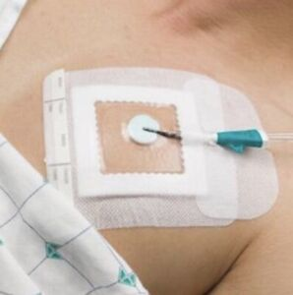

Obstacles for obtaining a quality exam
Patient discomfort
Port dressings/chest bandages
Patient age/communication
Poor acoustic windows

Slide 3
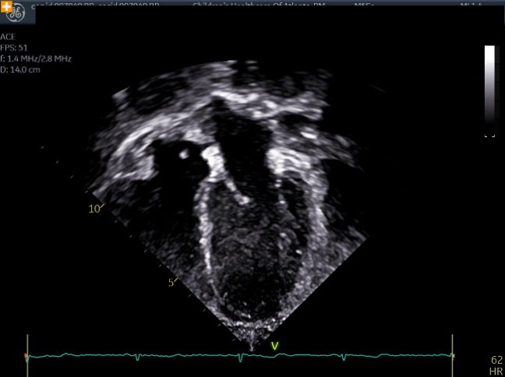
Appropriate imaging: Apicals

Slide 4
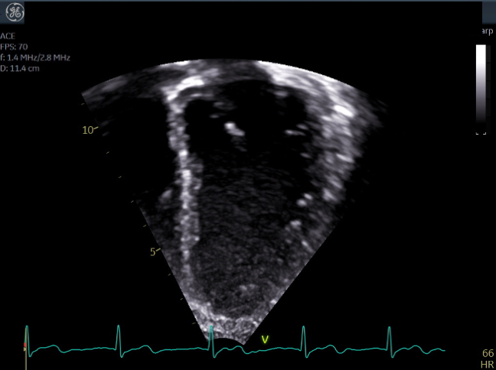
Appropriate imaging: Apicals

Slide 5
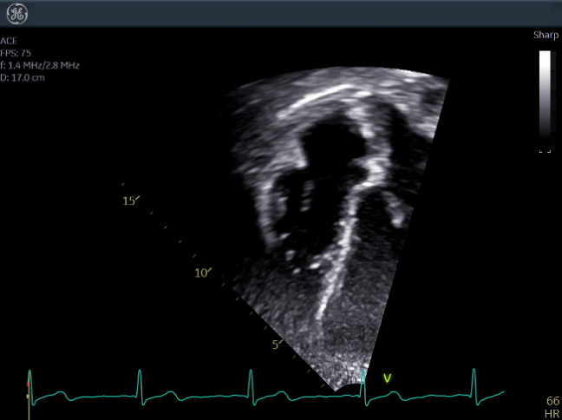
Appropriate imaging: Apicals

Slide 6
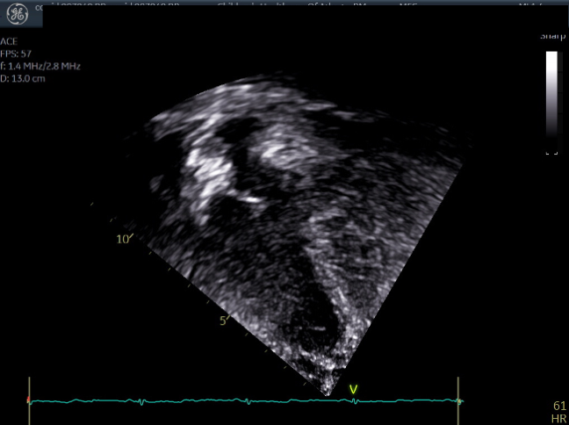
Optimizing difficult windows: Apicals

Slide 7
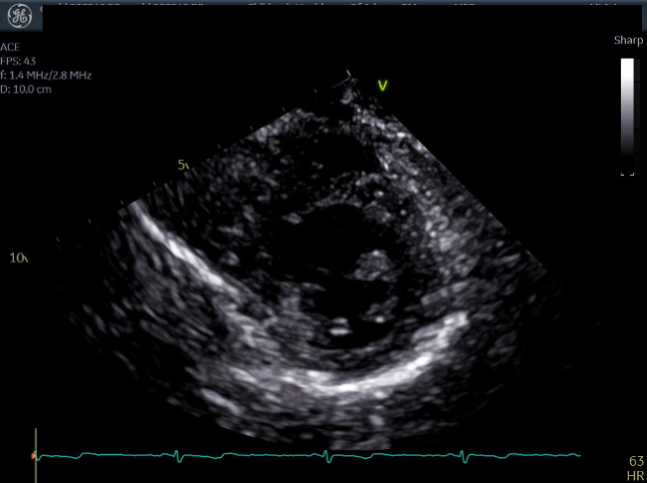
Optimizing difficult windows: Parasternals

Slide 8
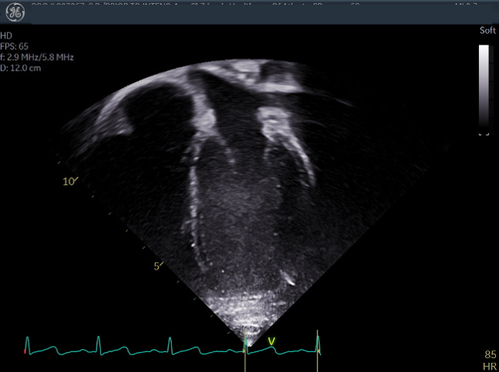
Optimizing difficult windows: APICALS

Slide 9
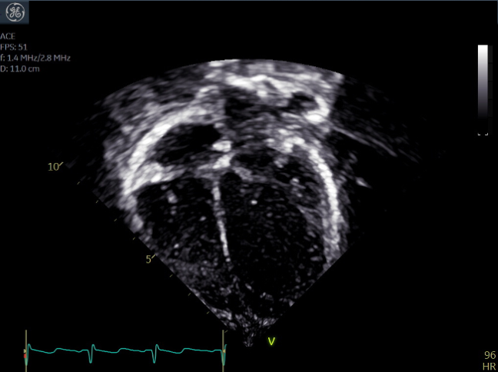
Try to avoid; foreshortening, lung interference, and drop out

Slide 10
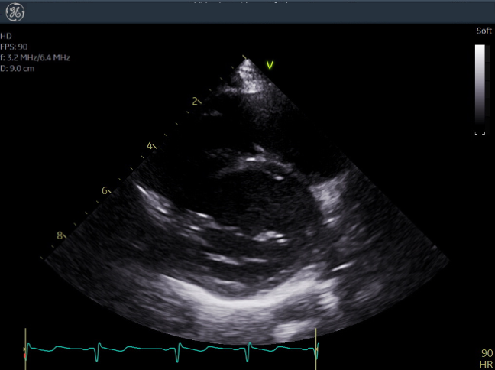
Try to avoid; moving between imaging planes and being dark in near field

Slide 11
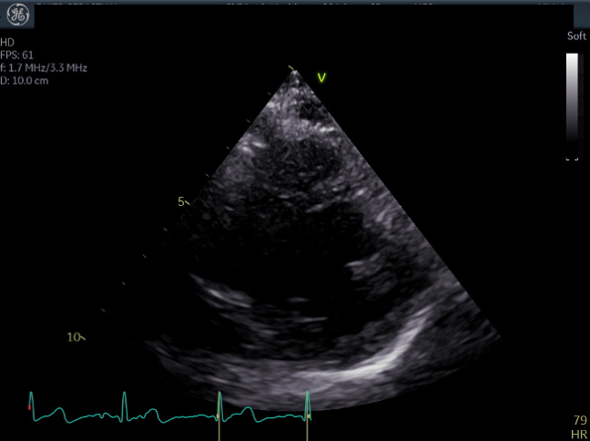
Try to avoid; under gaining of image

Slide 12
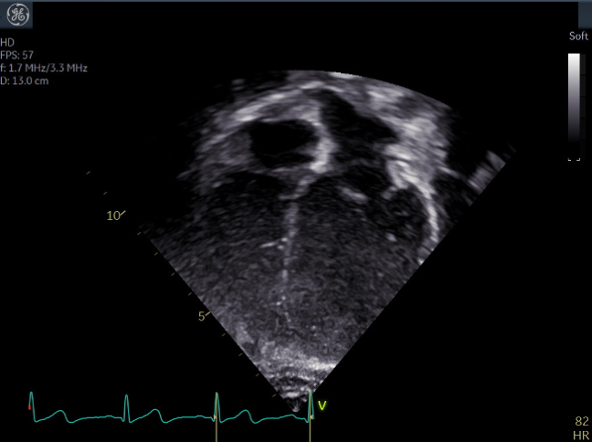
Try to avoid; apical cut off

Slide 13
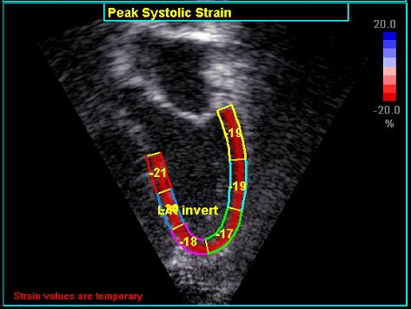
Segments for strain analysis

Slide 14
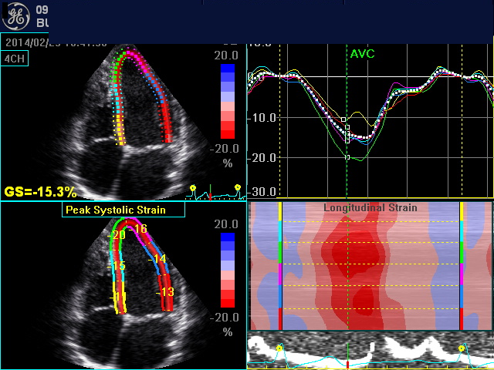
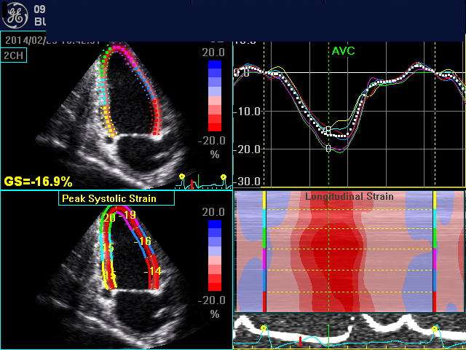
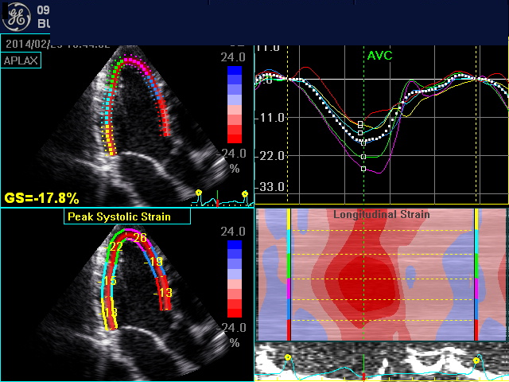
Segments for strain analysis

Slide 15
Take home points:
Have patient lay on left side if possible
Breath hold if patient is old enough
Use child life/parent/nurse to distract patient if they are young

