Slide 1

CHILDREN’S ONCOLOGY GROUP
AAML1831 Cardiac Studies
A PHASE 3 RANDOMIZED TRIAL FOR PATIENTS WITH DE NOVO AML COMPARING STANDARD THERAPY INCLUDING GEMTUZUMAB OXOGAMICIN (GO) TO CPX-351 WITH GO, AND THE ADDITION OF THE FLT3 INHIBITOR GILTERITINIB FOR PATIENTS WITH FLT3 MUTATIONS
Echocardiogram Acquisition Training
June 14, 2020

Slide 2
AAML1831 Cardiac Studies
AAML1831 Cardiac Studies
PI: Kasey Leger, MD, MSC
Seattle Children’s Hospital
206-987-2106
CRA: Sabrina Skiba, CCRC
Seattle Children’s Hospital
206-884-1058
AAML Pediatric Cardiology Leads
William Border, MD
Ritu Sachdeva, MD
David Cox (Sonographer)
Echocardiography Core Lab
Center for Quantitative Echocardiography
Hospital of the University of Pennsylvania
Rhoades Building, Ground Floor
3400 Spruce Street
Philadelphia, PA 19104
PI: Bonnie Ky, MD, MSCE
Lead Sonographer: Jade Chung, RDCS
Project Manager: Laney Smith, MA
AAML1831cardiacstudies@seattlechildrens.org

Slide 3
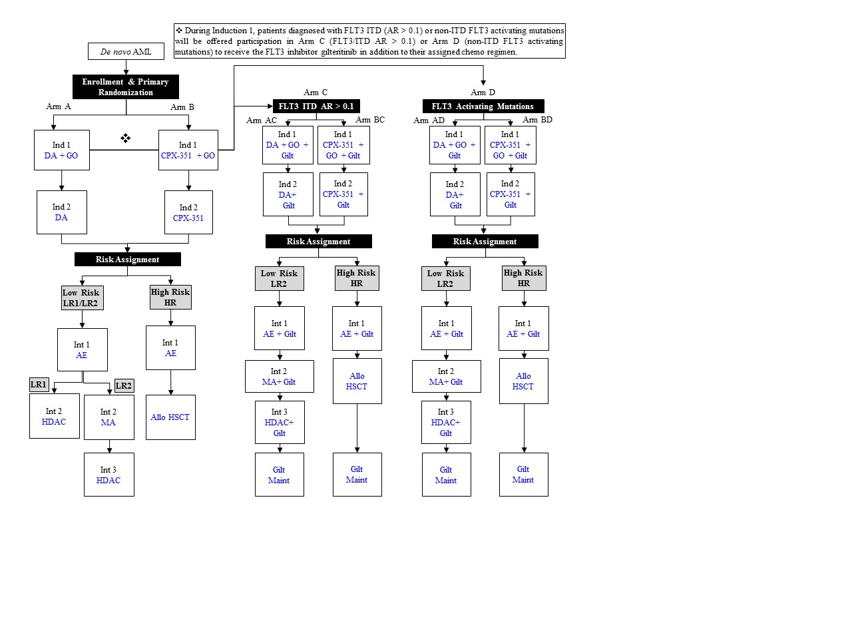
AAML1831 Study Overview
Study Description: Randomized Phase III study of CPX-351 in children with newly diagnosed AML (N = 1,330)
  5 year enrollment period; total trial duration 10 years
Study Schematic:
Legend: AE= cytarabine/etoposide, Allo= allogeneic, AR= allelic ratio, DA= daunorubicin/ cytarabine, DL= dose level, Gilt= gilteritinib, GO= gemtuzumab ozogamicin, HDAC= high dose cytarabine/ asparaginase (Capizzi II), HSCT= hematopoietic stem cell transplant, Ind= induction, Int= intensification, ITD= internal tandem duplication, MA= mitoxantrone/cytarabine, Maint=maintenance

Slide 4
AAML1831 Study Background
Cardiac Correlative Study Objectives:
  Arms: Daunorubicin + Dexrazoxane (A) and CPX-351 (B)
  To determine the incidence of cardiac dysfunction across study arms
  To determine the changes in cardiac function and remodeling across treatment arms
  To determine the utility of sensitive measures of cardiac function in predicting cardiotoxicity
Echo Core Lab Objectives:
  To work collaboratively with the study teams to ensure robust, precise and accurate cardiac phenotyping
  High quality image acquisition
  Blinded, reproducible quantitation of cardiac structure and function

Slide 5
Visit Schedule
Submission of echocardiogram images is required for all patients on AAML1831. Echocardiograms will be performed as standard of care at the following time points according to risk assignment:
Low Risk (all arms)
Baseline
Pre-Induction 2
Pre-Intensification 1
Pre-Intensification 2
Pre-Intensification 3
End of therapy*
High Risk (all arms)
Baseline
Pre-Induction 2
Pre-Intensification 1
Pre- HSCT
End of therapy*
Note: Patients receiving TKI inhibitors (Arm C/D) will also have the following time points:
  Pre-Maintenance
  Week 26 of Maintenance
*After completion of therapy all patients across all arms/risk assignments will submit follow up
echos at Year 1, Year 3, Year 5, Year 7, and Year 9 post therapy.

Slide 6
General Echo Acquisition Guidelines
Record generously. Record multiple loops of all required views with a minimum 3 beats/clip. If tachycardia is present, record an additional 5 beats/clip of 2D images in apical (4C, 2C, 3C), short axis (base, mid, apical), and parasternal long axis views.
Extra 2-D gain is indicated for quantitative analysis of 2D images. It is preferable to overgain rather than to undergain.
Maintain a frame rate of 50-70 frames per second throughout the entire echo exam, by continuously optimizing imaging depth and sector width.
Do not narrow the sector angle excessively for 2D imaging. Please include both the epicardium and endocardium in all images, throughout systole and diastole (this aspect is critical).
Avoid foreshortening of the cavities, especially the left ventricle. In apical imaging planes, the maximum cavity lengths must be displayed and should be the same in all apical images.

Slide 7
General Echo Acquisition Guidelines
Recommended color Doppler Nyquist limit > 50-70 cm/sec; sample window is large enough to encompass structure of interest, but not excessively large.
A high quality electrocardiographic (ECG) signal should be obtained and recorded with all images.
Please send images free of markings/measurements. No measurements should be recorded on the images acquired at the site. If measurements need to be recorded, please also take a “clean” capture without measurements.
All echos should be anonymized and patient identifiers should be removed from echo images if possible and images labeled with Subject ID, Subject Initials, Visit Type, and Date of Echo. The DVD should be labeled with AAML1831, Subject ID, Subject Initials, Visit Type, Date of Echo.
Measure and Record Blood Pressure prior to echo initiation as per standard clinical practice. Please ensure proper cuff size and that patient has rested for 5 minutes prior to assessment. Two BP measurements should be taken and each should be recorded.

Slide 8
General Image Acquisition Guidelines
All 2D images used for strain analyses and quantitation of chamber size, geometry, and function.
  Images at specific frame rates (50-70 frames/sec) are necessary for posthoc analyses.
Maximize the size of the pulsed and continuous Doppler spectral velocity tracings by adjusting scale and using baseline shift function
  Optimize the reject and gain to provide thin and clearly defined spectral envelopes
  Minimal gain should be employed
  Use of excessive wall filtering should be avoided
Continuous wave signal of tricuspid regurgitation should be sought from parasternal, apical, and subcostal imaging windows.
For apical views, apex-down views are acceptable.

Slide 9
Image Acquisition - Parasternal Views
Parasternal Long Axis View
2D images are recorded
Color Doppler interrogation of the left atrium for mitral regurgitation and left ventricular outflow tract for aortic regurgitation is performed
In the ideal echocardiographic window for the parasternal long axis:
  The LV endocardium at the septum and the posterior wall are well delineated
  The proximal interventricular septum is horizontal and continuous with the aortic root
  The anterior and the posterior mitral valve leaflets, and the right and noncoronary aortic valve leaflets are visible
  The left ventricular apex is not visualized

Slide 10
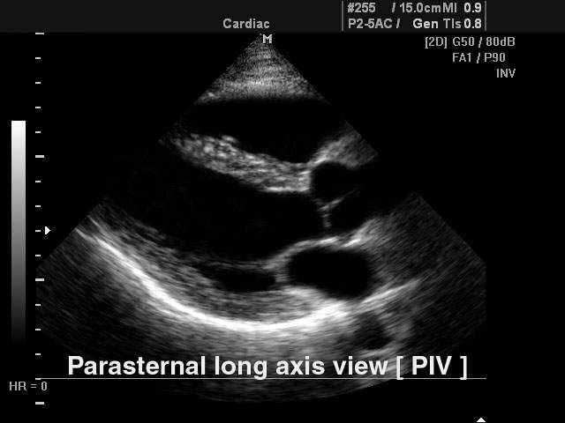
Image Acquisition - Parasternal Views
Parasternal Long Axis View
PLAX View – 2D Imaging
Parasternal Long Axis View

Slide 11
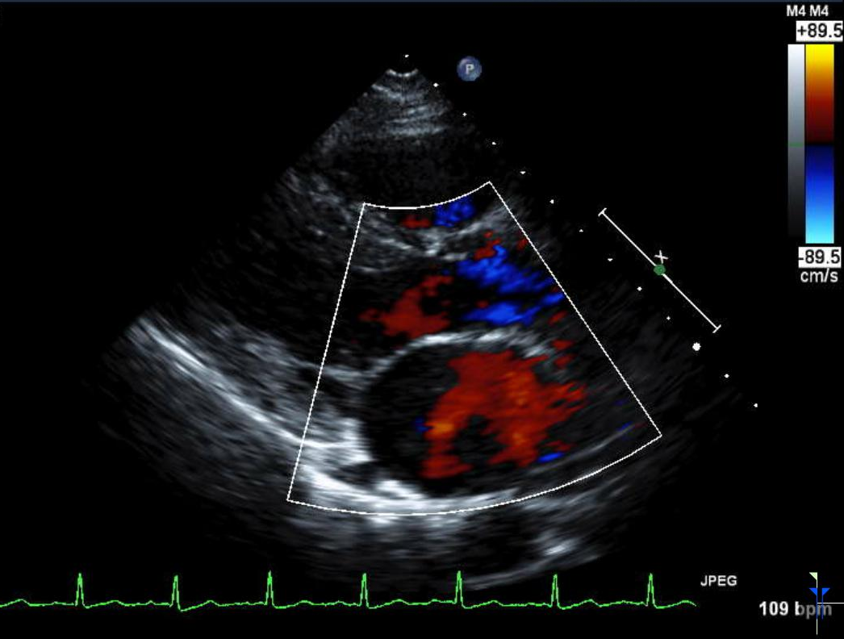
Image Acquisition - Parasternal Views
Parasternal Long Axis View
PLAX View – Color Doppler of AV and MV

Slide 12
Image Acquisition - Parasternal Views
Parasternal Long Axis View
M-mode
A standard M-mode of the aorta, left atrium, and left ventricle are obtained from the parasternal long axis view:
  M-mode of the aorta and left atrium should be obtained from the PLAX view at the level of the aortic root and aortic valve leaflets
    Ideally, the cursor should be placed through widest part of the aortic root and should be perpendicular to the long axis of the Ao root and LA
  M-mode of the left ventricle at the level of the chordae tendinae should be obtained from either the PLAX view or the PSAX view (at the papillary muscle level)
    Ideally, the cursor should be placed through widest part of the LV just distal from the mitral valve leaflet tips and perpendicular to the long axis of the LV

Slide 13
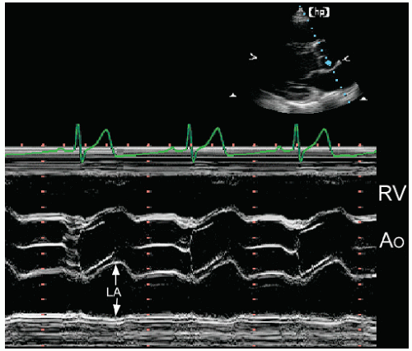
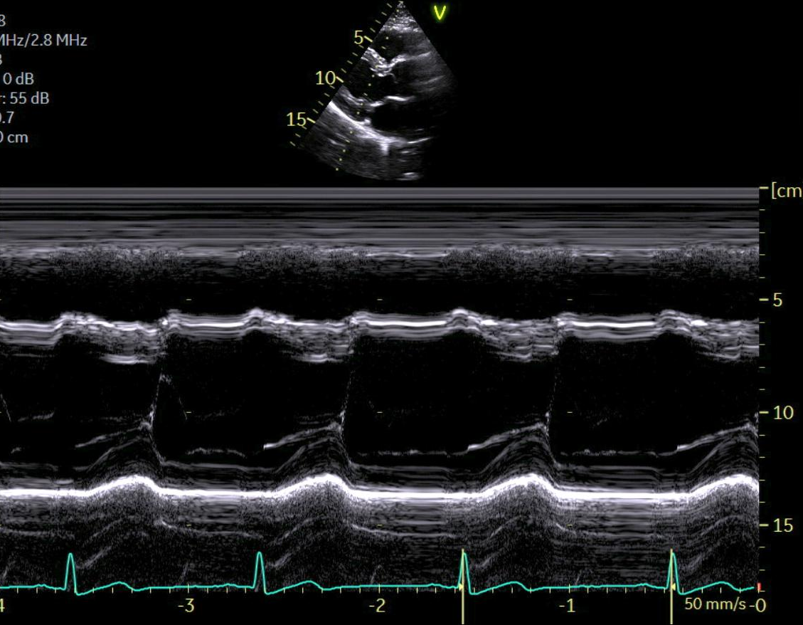
Image Acquisition - Parasternal Views
Parasternal Long Axis View
M-mode
PLAX view M-mode of the aorta and left atrium
at the level of the aortic root
PLAX view M-mode of the left ventricle
at the level of the chordae tendineae

Slide 14
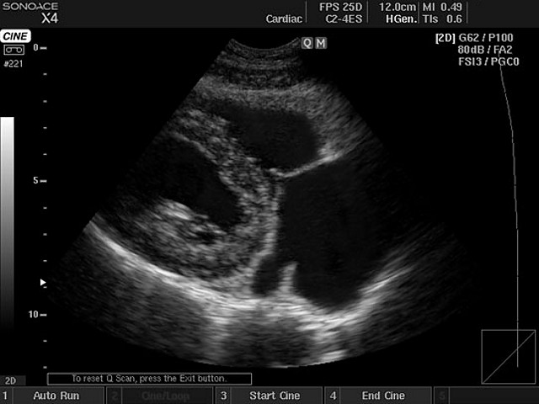
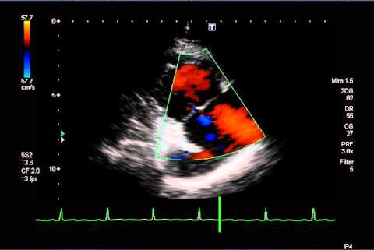
Image Acquisition - Parasternal Views
Right Ventricular Inflow Tract
2D images of right ventricular inflow tract will be obtained in PLAX
Color Doppler assessment of tricuspid regurgitation (TR) will be performed with color box covering the RVIT and the entire RA
If color signal of TR is identified, continuous wave Doppler through tricuspid valve is recorded
Pulsed wave Doppler is performed with sample volume positioned in the RVIT at TV leaflet tips

Slide 15
Image Acquisition - Parasternal Views
Parasternal Short Axis View
Parasternal short axis view will be obtained at four levels:
  At the aortic valve level with the RVOT and pulmonic valve visible
  At the mitral valve level (base) when both anterior and posterior mitral valve leaflets are visualized
  At the MID-papillary muscle level with the papillary muscles visible
  At the left ventricular apex

Slide 16
Image Acquisition - Parasternal Views
Parasternal Short Axis View
Aortic Valve Level
Record images of aortic valve, in 2D and color Doppler to evaluate for regurgitation.
In the ideal echocardiographic window for the parasternal short axis at the aortic valve level:
  All 3 cusps of the aortic valve are visible, with a clear upside down triangle pattern during systole
  The tricuspid valve and interatrial septum are visible
PSAX View AORTIC LEVEL – 2D Imaging

Slide 17
Image Acquisition - Parasternal Views
Parasternal Short Axis View
Aortic Valve Level
PSAX View AORTIC LEVEL – Color Doppler of AV

Slide 18
Image Acquisition - Parasternal Views
Parasternal Short Axis View
Aortic Valve Level – Right Ventricular Outflow Tract
2D images of proximal pulmonary artery will be obtained
Color Doppler interrogation of RVOT for presence of pulmonic insufficiency
Spectral Doppler signals will be obtained with pulsed and continuous wave, with PW sample volume placed in the RVOT just proximal to the pulmonic valve
  The peak velocity, flow velocity integral, and flow duration of PW Doppler signal will be measured

Slide 19
Image Acquisition - Parasternal Views
Parasternal Short Axis View
Aortic Valve Level – Right Ventricular Outflow Tract
From PSAX view at AV level, the following images of the right ventricular outflow tract, pulmonic valve, and pulmonary artery will be obtained:
PSAX view AORTIC LEVEL 2D imaging
focused on the RVOT and PV
PSAX view AORTIC LEVEL color Doppler
focused on the RVOT, PV, and PA

Slide 20
Image Acquisition - Parasternal Views
Parasternal Short Axis View
Aortic Valve Level – Right Ventricular Outflow Tract
Pulsed-wave Doppler of the right-ventricular outflow tract and continuous-wave Doppler of trans-pulmonic flow will be obtained:
PW Doppler w/ the sample volume positioned in the RVOT approx. 0.5 cm proximal to the pulmonic valve leaflets
CW Doppler through the pulmonic valve
and main pulmonary artery

Slide 21
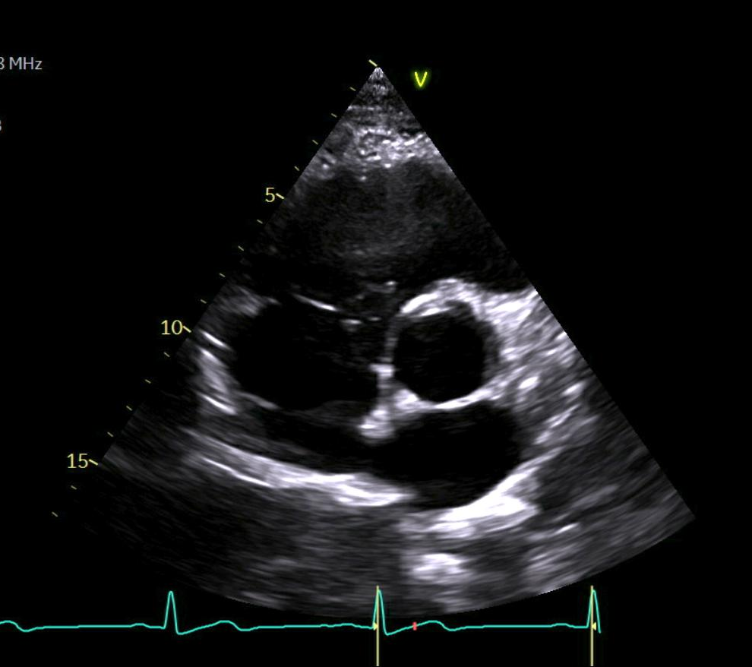
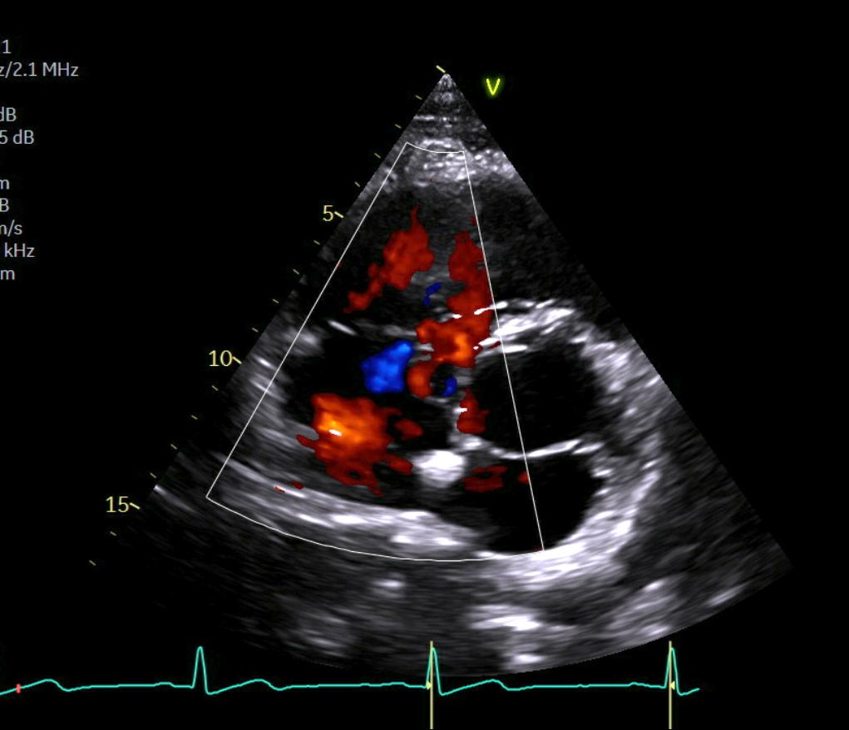
Image Acquisition - Parasternal Views
Parasternal Short Axis View
Aortic Valve Level – Right Ventricular Inflow Tract
From the PSAX view at AV level, the following images of RVIT, tricuspid valve, and right atrium will be obtained:
PSAX view AORTIC LEVEL 2D imaging
focused on the RVIT, TV, and RA
PSAX view AORTIC LEVEL color Doppler
focused on the RVIT, TV, and RA

Slide 22
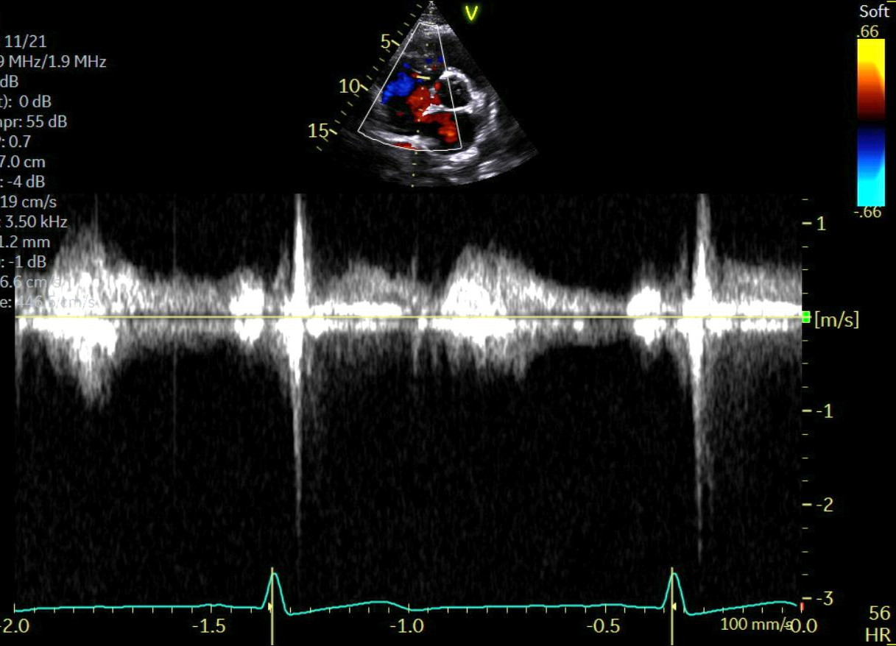
Image Acquisition - Parasternal Views
Parasternal Short Axis View
Aortic Valve Level – Right Ventricular Outflow Tract
Continuous wave Doppler for presence of any tricuspid regurgitation will also be obtained:
CW Doppler through the tricuspid valve and right atrium

Slide 23
Image Acquisition - Parasternal Views
Parasternal Short Axis View
mitral Valve, mid-papiLlary & apical Levels
In the ideal echocardiographic window for parasternal short axis LV Levels:
    Left ventricle should have a circular shape in short axis views; an elliptical shape suggests off-axis/tangential cut through the ventricle.
    Use internal LV landmarks to ensure imaging at consistent planes in the short axis: visualization of anterior and posterior mitral leaflets for mitral valve view; visualization of both papillary muscles for mid-papillary level view
    For all short axis images, adjust sector width and imaging depth to ensure acquisition frame rate of 50-70 frames per second

Slide 24
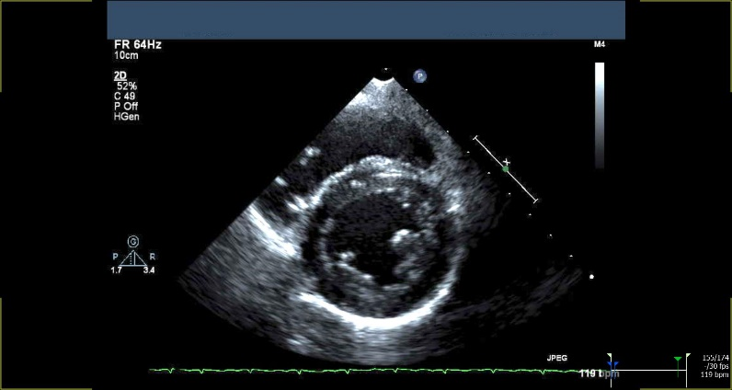
Image Acquisition - Parasternal Views
Parasternal Short Axis View
mitral Valve, mid-papiLlary & apical Levels
2D images of left ventricle short axis should be recorded (base, mid, and apex):
    Gain controls are adjusted to minimize/eliminate drop out from myocardial or endocardial echoes when image is frozen; as images are analyzed in stop-frame, extra gain is required.
    Do not excessively narrow sector angle for these images
mitral Valve Level
mid-papillary Level
Apical Level

Slide 25
Image Acquisition: Apical Views
Following apical views will be obtained:
  Standard apical-4-chamber focused on LV and LA
  RV focused apical-4-chamber dedicated to optimal imaging of RV
  Apical 5 chamber view
  Apical 2 chamber view
  Apical 3 chamber view
  Left ventricular and atrial areas and volumes will be measured from these views (using Simpson’s Biplane method) by core lab. In all apical views, special attention should be paid to properly align the image and capture the left ventricle and atrium in full. Avoid either foreshortening of the chambers by transducer’s angulation and position.

Slide 26
Image Acquisition: Apical Views
General Image Acquisition Guidelines
In apical imaging planes, maximum cavity lengths must be displayed and should be same in all apical images
  It is very important to avoid foreshortening of the cavities, especially the left ventricle
For apical images, acquisitions focusing on left ventricle (LV) should not include the left atrium (LA):
  Depth should be adjusted accordingly
  Left atrium will be acquired separately in a dedicated acquisition
  This will allow maximization of spatial resolution and frame rates for offline analyses focused on LV and LA, respectively
For 2D apical acquisitions, do not narrow sector angle excessively for two-dimensional imaging because this crops LV apical segments

Slide 27
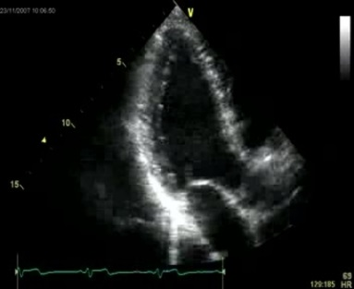
Image Acquisition: Apical Views
General Image Acquisition Guidelines
Figures below show examples of mild cropping, severe cropping and adequately acquired 2D images for LV assessment from apical views.
  Again, please include both the epicardium as well as endocardium.
Adequate image of the 3-chamber w/o cropping

Slide 28
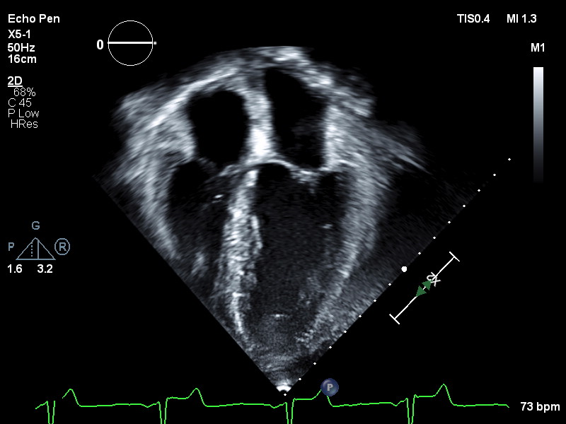
Image Acquisition: Apical Views
Apical 4-Chamber View
In ideal echocardiographic window for the Apical 4-Chamber View:
  Maximize LV length and be careful not truncate true long axis or length of ventricles
  Entire LV endocardium must be within imaging sector in both end-diastole and end-systole
  Pay special attention to apex and LV lateral wall, often most difficult areas to visualize
  Adjust sector width and imaging depth to ensure acquisition frame rate of 50-70 frames per second
2D imaging of standard A4C view
A4C focused/zoomed on the LV

Slide 29
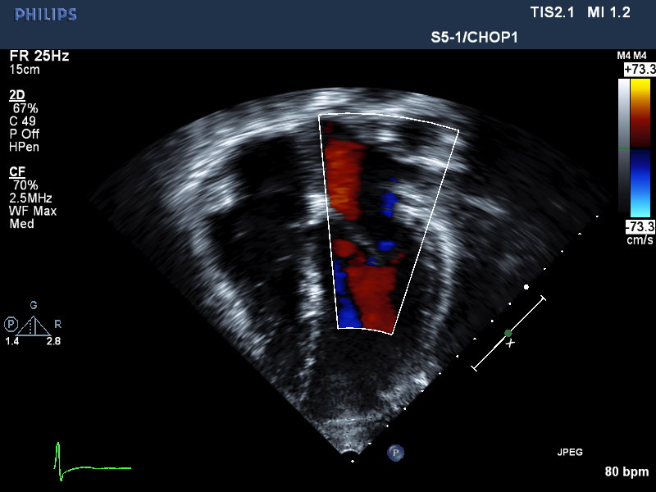
Image Acquisition: Apical Views
Apical 4-Chamber View
LEFT ATRIUM – Zoom & Color Doppler
A4C color Doppler of mitral valve and LA
to interrogate for mitral regurgitation (MR)
A4C focused/zoomed on LA

Slide 30
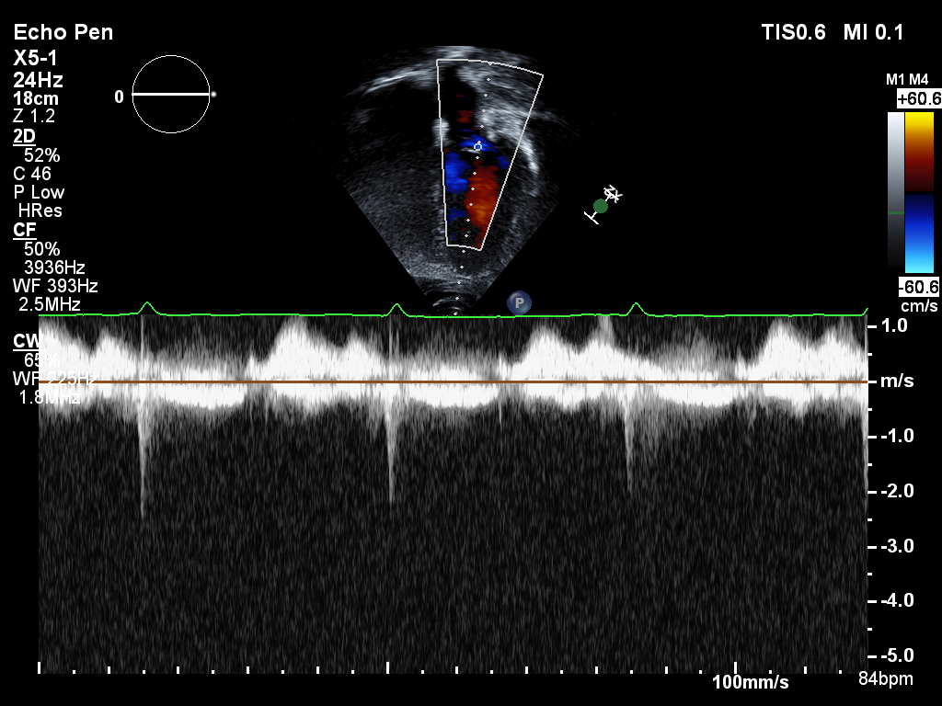
Image Acquisition: Apical Views
Apical 4-Chamber View
Mitral Valve Continuous-Wave Doppler
A4C trans-mitral valve CW spectral Doppler of mitral regurgitation (MR)

Slide 31
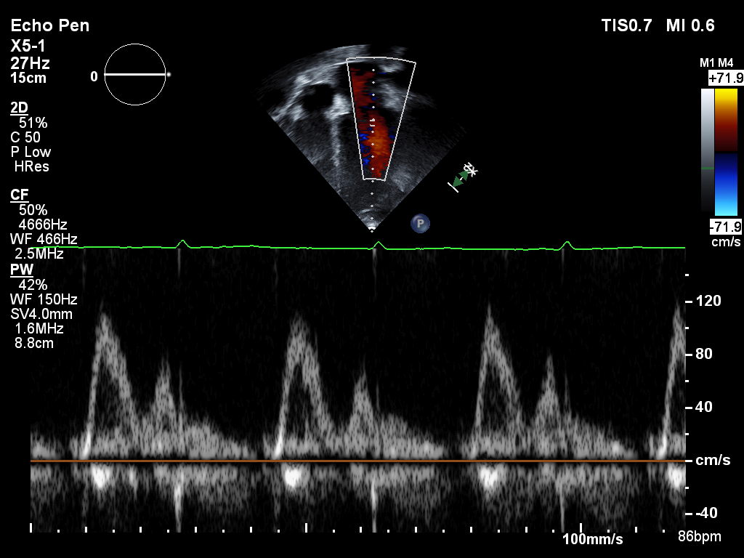
Image Acquisition: Apical Views
Apical 4-Chamber View
Mitral Inflow Pulsed-Wave Doppler
From apical 4CH view, record mitral inflow velocity profile with pulsed-wave Doppler sample volume positioned at tips of mitral leaflets during quiet respiration
  Adjust baseline and Doppler scale to visualize peak E and A wave velocities
  Record a minimum of 3 full cardiac cycles at a sweep speed of 100 mm/sec

Slide 32
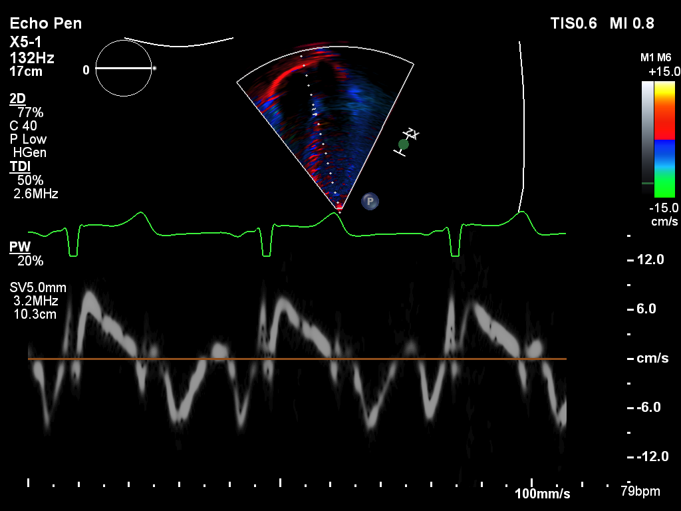
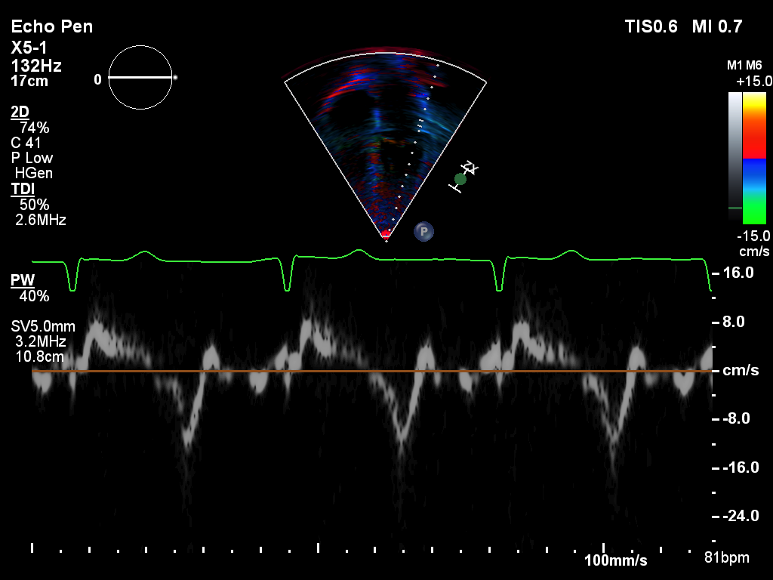
Image Acquisition: Apical Views
Apical 4-Chamber View
Tissue Doppler
TDI at the septal mitral annulus
TDI at the lateral mitral annulus

Slide 33
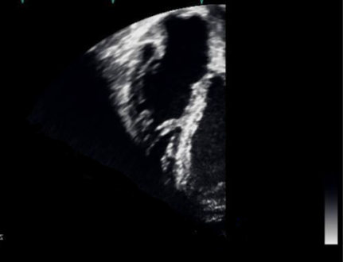
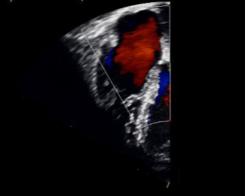
Image Acquisition: Apical Views
Apical 4-Chamber View
RIGHT VENTRICLE – Focused Views
In ideal echocardiographic “window” for the Apical 4-Chamber View focused on right ventricle:
Right ventricular length is maximized and right ventricular apex is clearly visualized
Entire RV endocardium must be within the sector scan in both end diastole and end systole.
Color Doppler of tricuspid inflow/RA in RV focused view
to interrogate for tricuspid regurgitation (TR)
2D imaging of the RV focused view

Slide 34
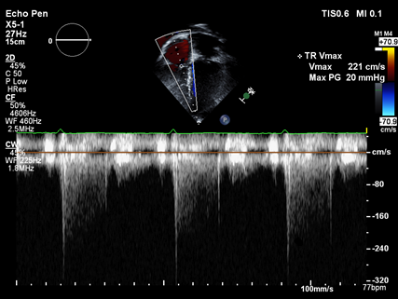
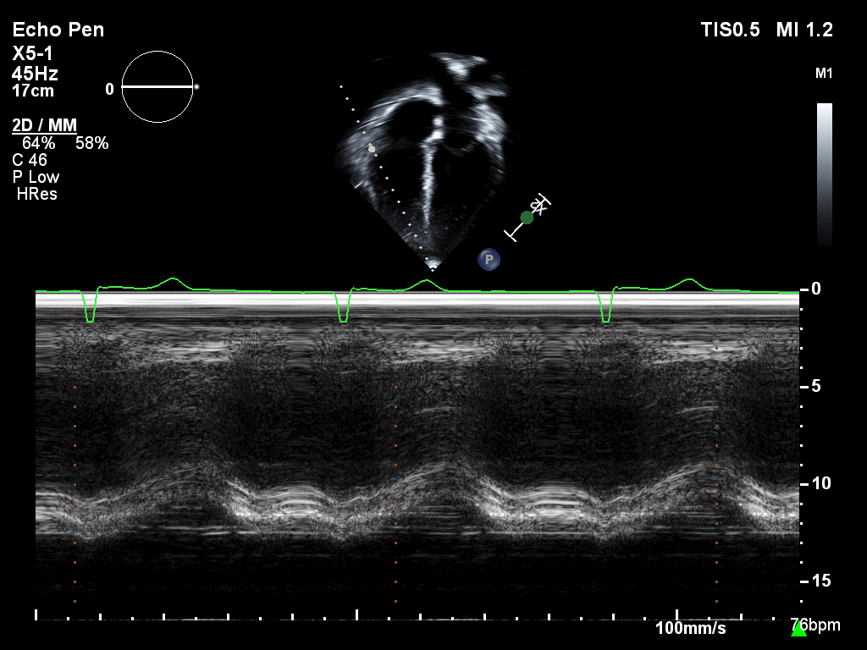
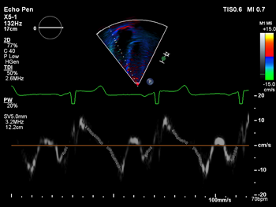
Image Acquisition: Apical Views
Apical 4-Chamber View
RV Focused Views
CW Doppler of tricuspid regurgitation
M-mode of the lateral tricuspid annulus (TAPSE)
TDI at the lateral tricuspid annulus

Slide 35
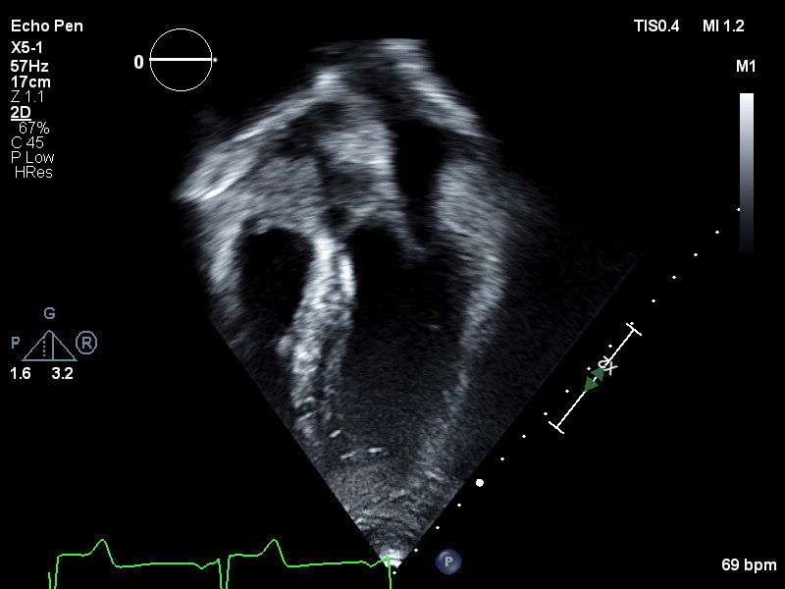
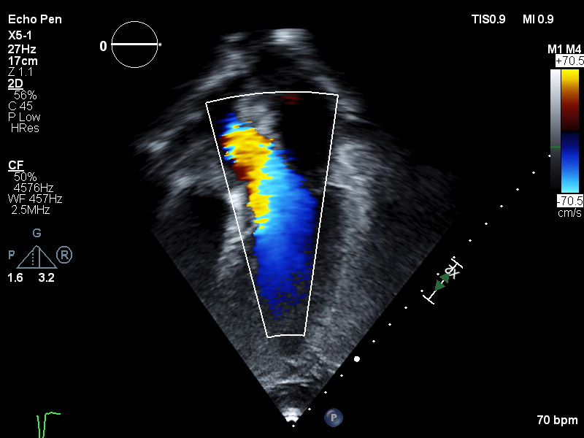
Image Acquisition: Apical Views
Apical 5-Chamber View
In the ideal echocardiographic window for the Apical 5-Chamber View:
Maximize LV length, making sure not to truncate the true long axis
2D imaging of A5C view
A5C color Doppler of the LVOT to interrogate for AI

Slide 36
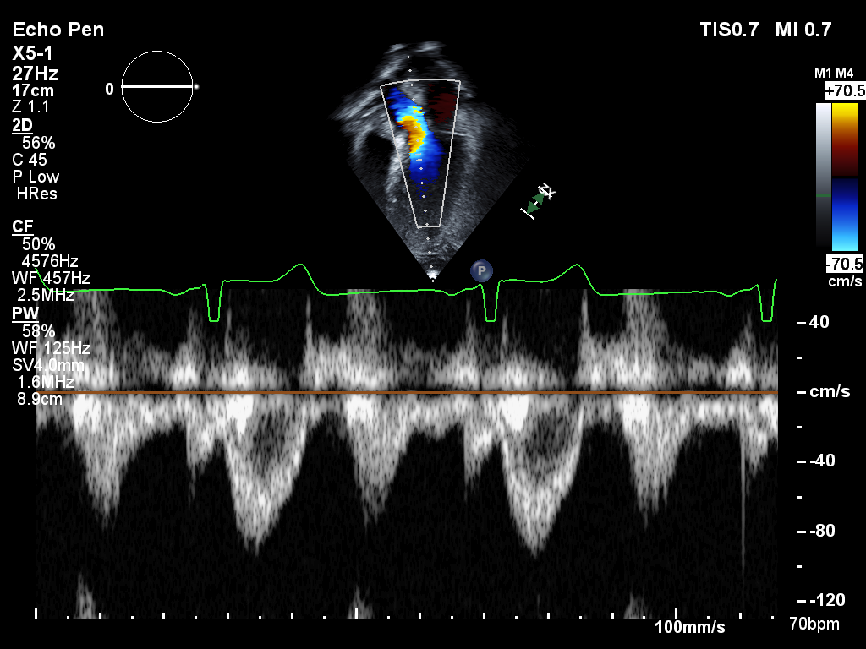
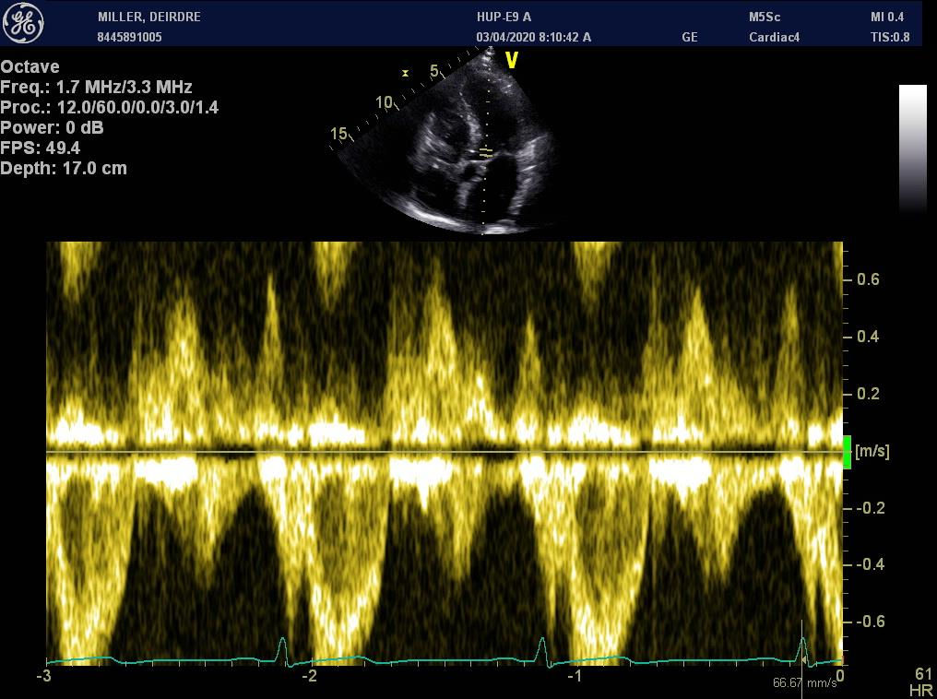
Image Acquisition: Apical Views
Apical 5-Chamber View
Pulsed-Wave Doppler of Simultaneous Mitral Inflow
and LVOT Flow for IVRT/IVCT

Slide 37
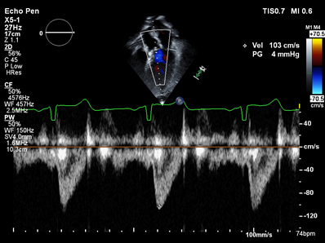
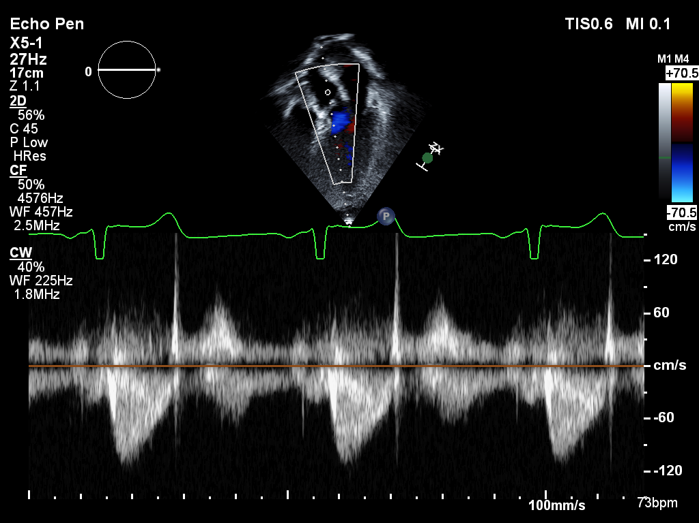
Image Acquisition: Apical Views
Apical 5-Chamber View
Left-Ventricular Outflow Tract (LVOT)
Pulsed-Wave Doppler
PW sample volume is positioned in LVOT approximately 0.5 cm proximal to the aortic valve leaflets and spectral Doppler signal is recorded.
A5C view PW Doppler of the LVOT proximal to the AV
A5C view CW Doppler across the AV

Slide 38
Image Acquisition: Apical Views
Apical 2-Chamber View
In the ideal echocardiographic window for the Apical 2-Chamber View:
  Obtain a clip optimizing visualization of left ventricle during systole and diastole
  Maximize LV length and be careful not to truncate true long axis
  Scan plane transects anterior and inferior LV walls, with neither RV nor LV outflow tract visualized
  Pay particular attention anterior LV wall and apex, usually the most difficult areas in which to visualize the endocardium
  Adjust sector width and imaging depth to ensure acquisition frame rate of 50-70 frames per second
  Visualization of both anterior and inferior wall endocardium will be essential to accurately calculate left ventricular volume by Simpson’s method at core lab

Slide 39
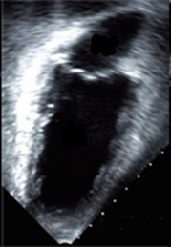
Image Acquisition: Apical Views
Apical 2-Chamber View

Slide 40
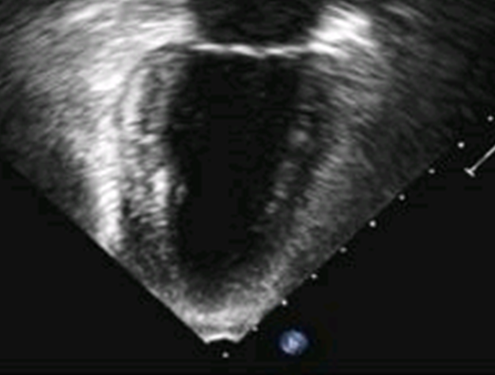

Image Acquisition: Apical Views
Apical 2-Chamber View
A2C view focused/zoomed on LV
A2C view focused/zoomed on LA

Slide 41
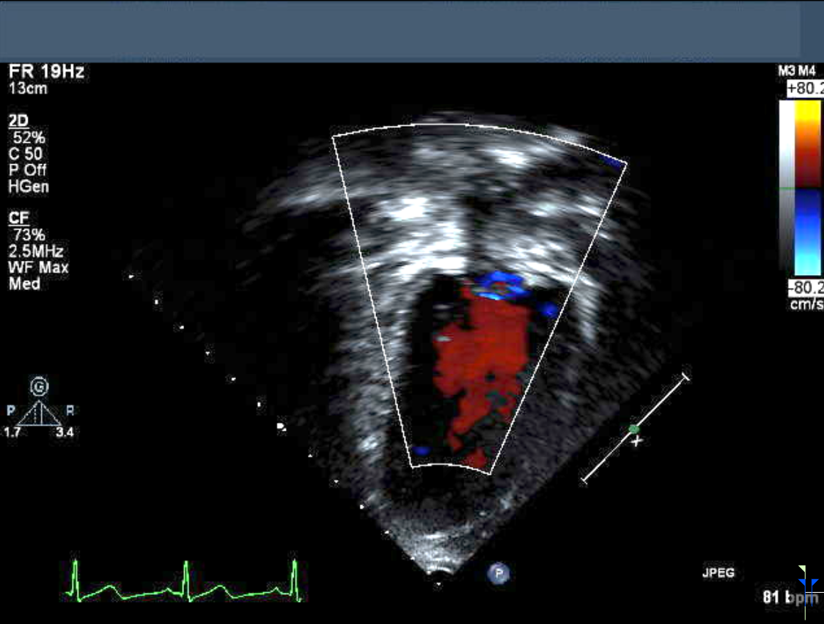
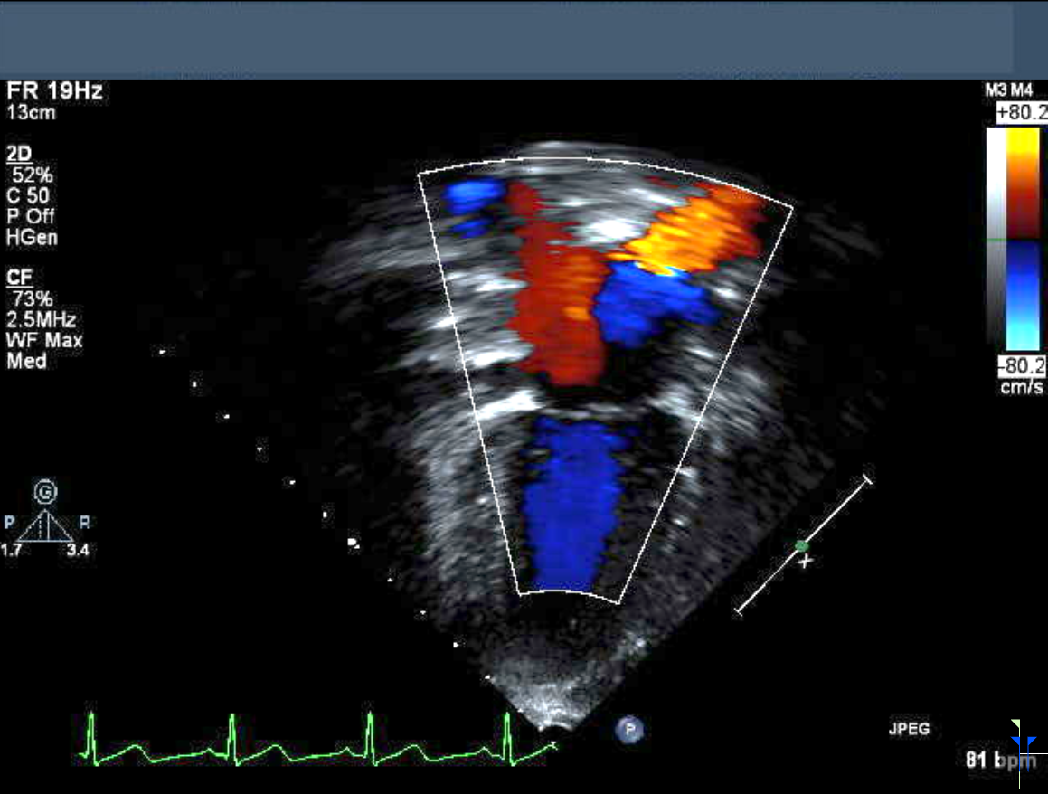
Image Acquisition: Apical Views
Apical 2-Chamber View
Mitral Valve Inflow Color Doppler
A2C view color Doppler of MV and LA to interrogate for mitral regurgitation (MR)

Slide 42
Image Acquisition: Apical Views
Apical 3-Chamber View
Obtain a 2D image, including entire LA and LV and mitral valve.

Slide 43
Image Acquisition: Apical Views
Apical 3-Chamber View
Left-Ventricular Outflow Tract (LVOT)
Pulsed-Wave Doppler
PW sample volume is positioned in LVOT approximately 0.5 cm proximal to aortic valve leaflets and spectral Doppler signal is recorded.
  LVOT flow velocity integral will be measured.
A3C view PW Doppler of the LVOT proximal to the AV
A3C view CW Doppler across the AV

Slide 44
Image Acquisition: Subcostal View
In the ideal echocardiographic window for the Subcostal View:
View is obtained from sub-xiphoid position with transducer manipulated to visualize proximal inferior vena cava where it meets the right atrium
From a subcostal 4-chamber view, scan plane is angled to patient's right to image the inferior vena cava, and this is recorded through several respiratory cycles
In long-axis plane of abdomen
Approximately 5 second acquisition should be acquired in this view to allow for assessment of both IVC size and compressibility with respiration (capture 5 secs in this view of IVC w/ sniffing)
CW Doppler of maximum TR velocity may also obtained from this view
  Inferior vena cava is imaged through multiple respiratory cycles and RAP estimated from visual assessment of the inferior vena cava.

Slide 45
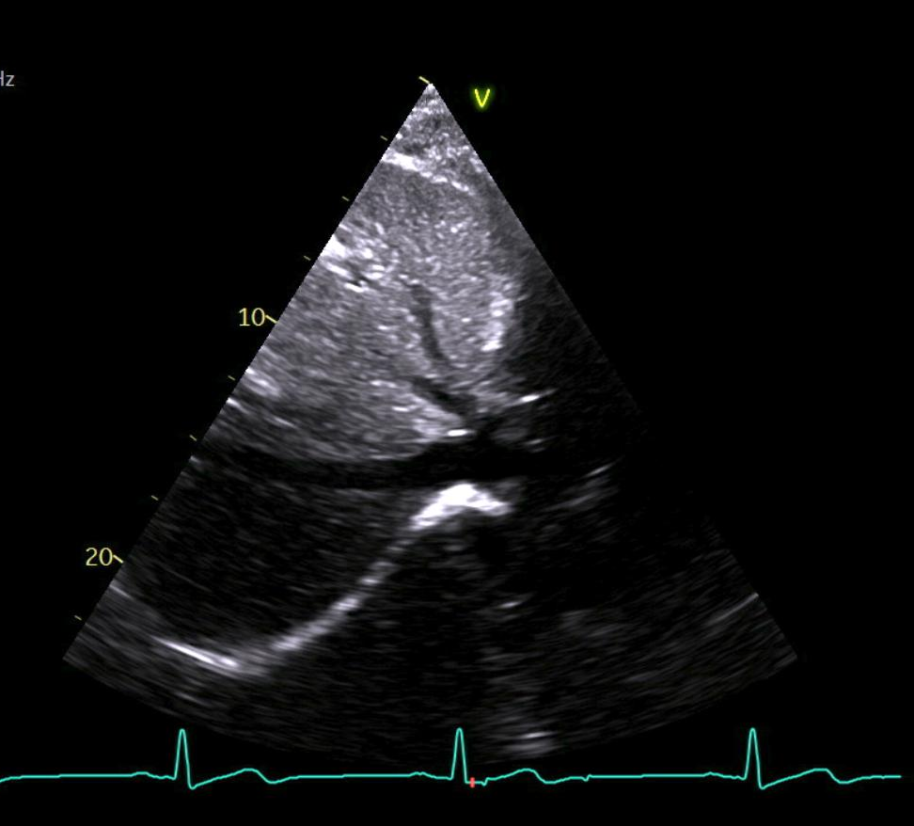
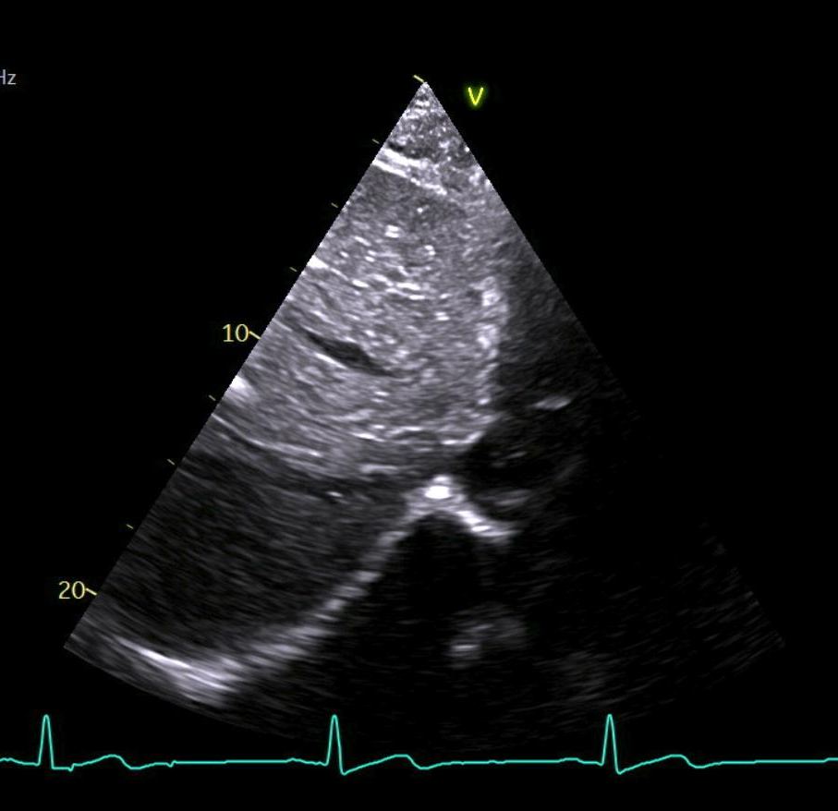
Image Acquisition: Subcostal View
Inferior Vena Cava
Inferior vena cava 2D imaging (5-second acquisition)

Slide 46
Image Acquisition: Optional 3D
3D Acquisition of LV (Optional):
  Sites that are performing 3D imaging as part of routine echocardiograms have an option of recording 3D images for AAML1831
  Images must be at least 25 frames per second:
    Image of LV only
    Image of LV and LA
    Image of RV only
    Image of RV and RA

Slide 47
Sonographer Certification
To meet study objectives of attaining high quality image acquisition, site sonographers will need to be certified prior to or at time of initial echo.
It is strongly encouraged that sites utilize dedicated sonographer(s) for echo acquisition for all echocardiograms obtained on AAML1831.
Certification Process:
  Review echo acquisition webinar
  Review AAML1831 Cardiac Studies Manual
  All studies acquired by a sonographer prior to certification must be submitted in real time, within 5 days of being performed
  Core Lab will provide feedback to site CRA and sonographer regarding image quality within 10 days of receipt
Until certified, sites are required to send echo DICOM images within 5 days of acquisition.
Echocardiograms acquired by certified sonographers may be submitted at end of reporting period.

Slide 48
Echo Submission
Measurements will be made by core lab; do not submit images with measurements.
Studies will be routinely monitored for quality; feedback will be provided by email regarding any deficiencies.
Research coordinator will provide an “Echo Acquisition CRF” (in MOP) prior to each planned echo for patients on study. Please review and complete the sonographer checklist.
Burn echo to DVD in standard DICOM format, copied directly from echo machine
  Ensure export contains acquisition data
  If 3D acquired, also need an Archive or Raw Data copy
Label DVDs with AAML1831, subject ID, subject initials, visit type and echo date (same as study images).
Provide DVD and the Echo Acquisition CRF to the research coordinator to submit to Core Lab.

Slide 49
THANK YOU! and Questions?
AAML1831CardiacStudies@seattlechildrens.org
AAML1831 Echo Acquisition Training Attestation – Please click this link to complete training attestation

