Slide 1
Penn Center for Quantitative Echocardiography AAML 1831 Sonographer Office Hours January 24, 2023

Slide 2
Welcome!
We have received over 1,000 echoes for this study to date. Quantitation is ongoing, with 750 echoes analyzed so far.
Thank you for your commitment and dedication to the clinical care of your patients and the advancement of cardio-oncology science!

Slide 3
Objectives
To understand the importance of obtaining high quality echo images.
To discuss the differences in 2D and strain measurement techniques.
To improve proficiency in strain imaging acquisition.

Slide 4
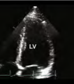
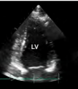
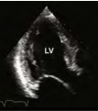
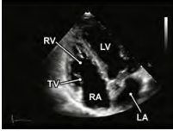
What views do we need? 2D and Strain
Apical 4-chamber
Apical 2-chamber
Apical 3-chamber (long axis)
RV focused

Slide 5
Why do we need these views?- 2D
We are using the Simpson biplane method to measure LV volumes and calculate ejection fraction.
Please acquire high quality apical 4-chamber and apical 2-chamber views for this calculation.
(J Am Soc Echocardiogr 2010;23:465-95.)

Slide 6
What is strain?
Strain measures LV deformation in longitudinal, radial, and circumferential directions.
Strain represents the percent change in LV fiber length from relaxed to contractile state.
https://doi.org/10.1016/j.jaccao.2020.10.011

Slide 7
Why is strain important to us?
LVEF lacks sensitivity to detect subclinical changes in cardiac function caused my myocyte damage due to cardiotoxic treatment.
Global longitudinal strain (GLS) is a more sensitive and reproducible measure of LV systolic function, is an early marker of cardiotoxicity, and is the optimal deformation parameter for the detection of subclinical LV dysfunction.

Slide 8
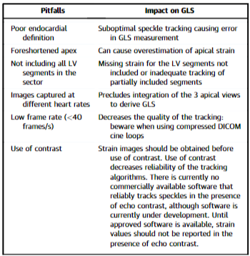
Common pitfalls in image acquisition
Liu J, Barac A, Thavendiranathan P, et al. Strain Imaging in Cardio-Oncology. J Am Coll Cardiol CardioOnc. 2020 Dec, 2 (5) 677–689.https://doi.org/10.1016/j.jaccao.2020.10.011

Slide 9
Avoiding pitfalls in image acquisition
It is critical to include both the epicardium and endocardium throughout systole and diastole for strain analysis.
Please acquire high quality apical 4-chamber, 2-chamber, 3-chamber, and right ventricular views.

Slide 10
Apical 4-chamber view
Please optimize your image to include a full view of all 4 chambers, including full visualization of the atria.
Then, adjust sector size and depth to include only the ventricles (please acquire images of the LV and RV separately).
The myocardium should be visible uniformly from the apex to the AV valves.

Slide 11
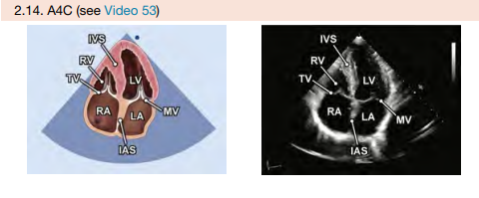
Apical 4-chamber view

Slide 12
Apical 2-chamber view
From the 4-chamber view, rotate the transducer approximately 60 degrees counterclockwise.
The left atrium, mitral valve, and left ventricle should be shown.
Adjust the sector size and depth to only show the left ventricle.

Slide 13
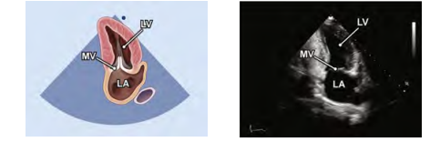
Apical 2-chamber view

Slide 14
Apical 3-chamber view
Also known as the apical long-axis view.
From the apical 2-chamber view, continue rotating the transducer approximately 60 degrees counterclockwise.
The left atrium, mitral valve, left ventricle, aortic valve, and aorta should be shown.
Adjust sector size and depth to only show the left ventricle.

Slide 15
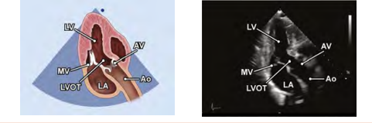
Apical 3-chamber view

Slide 16
RV focused view
Starting in an apical 4-chamber view, rotate the transducer slightly counterclockwise.
Maximize the visualized area of the RV, avoiding tilting anteriorly into a 5-chamber view.
Tilting the transducer or sliding medial/lateral or into a different rib space may be necessary in some patients.

Slide 17
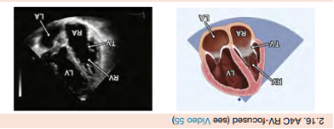
RV focused view

Slide 18
Example
Right Ventricle
At first glance, this image may look acceptable given that all segments are shown within the sector.
Sometimes, we are able to provide 2D measurements even when image quality is suboptimal for strain.

Slide 19
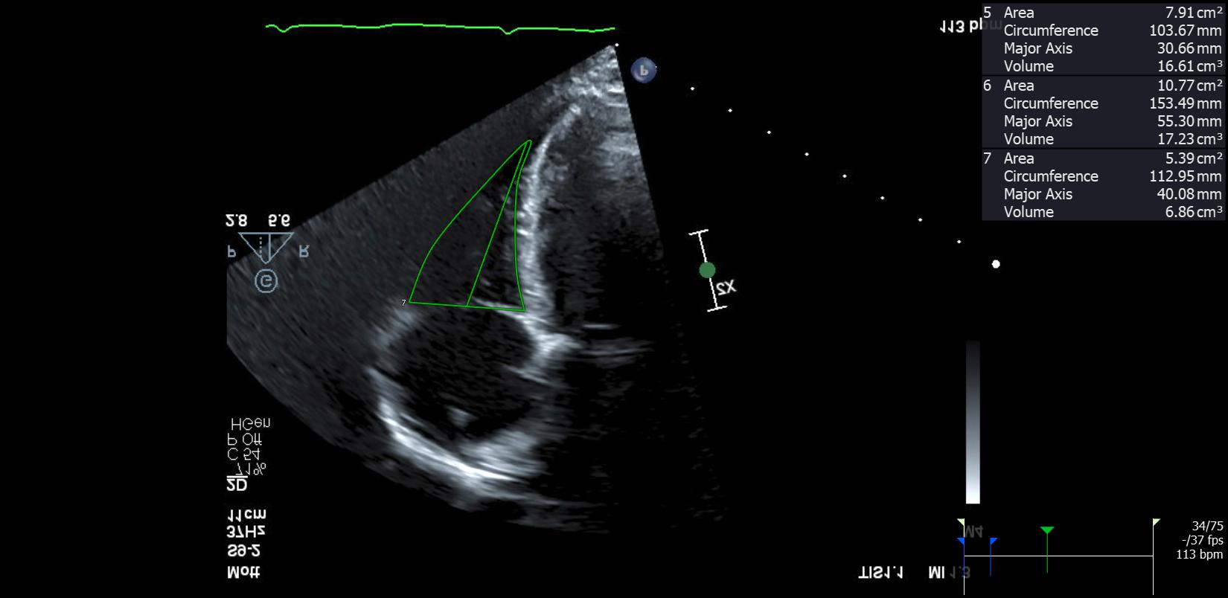
Example: Right Ventricle- 2D

Slide 20
Example: Right Ventricle- Strain
Although RV area was measured, the strain is not tracking
The RV free wall is too dark and the speckles are not being recognized
This strain will be reported as “not analyzable”

Slide 21
Example: Right Ventricle
RV focused view showing all segments within the sector
Frozen end diastole
Frozen end systole
Endocardial borders are not well defined and RV area may be deemed “not analyzable.”

Slide 22
Example: Apical 4-chamber
Endocardial borders are seen well enough to measure LV volume. Epicardial borders are not seen within the sector and stain may be reported as “not analyzable.”

Slide 23
Example: Apical 2-chamber
Endocardial borders may be seen well enough to measure LV volume. Epicardial borders are not seen within the sector and stain may be reported as “not analyzable.”

Slide 24
Analyzability Factors
Challenging patient population.
Strain is dependent on image quality.
Protocol- use your sonographer checklist.
Lack of ECG tracing.

Slide 25
Image Optimization
Please optimize each image as best you can.
You may want to use tools such as:
Harmonic Imaging- maximize signal-to-noise ratio
Dynamic Range/Compression- appearance of shades of gray
Sector Size and Depth- increasing frame rate
Focus- improve resolution
Overall Gain and TGC - equalize the appearance of structures across the entire sector

Slide 26
Image Optimization
Maintain a high quality ECG throughout the study. Strain will always be marked as “not analyzable” without an ECG tracing.
Record at least 3 beats per clip. If the heart rate is ≥ 100bpm, then at least 5 beats per clip.
Utilize proper patient positioning and breathing maneuvers.
2D gain: It is preferable to overgain than undergain.
Record images at 50-70 frames per second.

Slide 27
Image Optimization
Ensure that sector angle is not excessively narrow -narrowing results in cropping of LV apical segments and limits quantitation. Consider widening image sector width in order to include all wall anatomy.
Ensure endocardium and epicardium are visualized throughout entire cardiac cycle.
Avoid foreshortening: maximize cavity lengths in apical imaging planes.

Slide 28
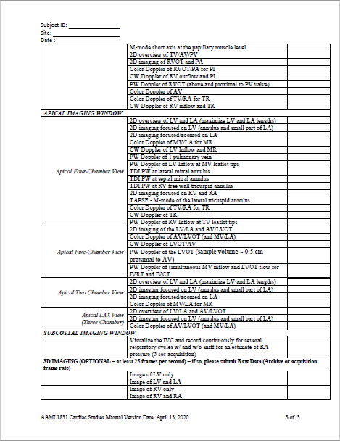
Please Use Your Sonographer Checklist!
Although this training was focused on 2D imaging, it is important to follow the protocol and acquire all required Doppler images as well.

Slide 29
Feedback form
We have updated our feedback form to include space for comments.
We are providing more specific comments in the hopes of helping our sonographer community.
We always appreciate any feedback you have, and are always willing to help in any way we can.

Slide 30
Thank you
Contact: aaml1831cardiacstudies@seattlechildrens.org

