Slide 1

CHILDREN’S ONCOLOGY GROUP
A PHASE 3 RANDOMIZED TRIAL FOR PATIENTS WITH
DE NOVO AML COMPARING STANDARD THERAPY INCLUDING GEMTUZUMAB OXOGAMICIN (GO) TO CPX-351 WITH GO, AND THE ADDITION OF THE FLT3 INHIBITOR GILTERITINIB FOR PATIENTS WITH FLT3 MUTATIONS
AAML1831 Cardiac Studies
Echocardiography Review Session
Penn Echo Core Lab & AAML1831 Study Team
January 12 and 22, 2021

Slide 2
THANK YOU!
Thank you for your dedication, commitment, and great efforts to ensure the feasibility of this cardiac substudy
Objectives of today’s session:
  Study overview
  Collective review of QC results to date
  General acquisition principles
  Example Studies
  Listen to feedback from sites (we know these are challenging patients!)
    Experiences with echo acquisition to date
  Discussion and opportunities for creative solutions/problem solving

Slide 3
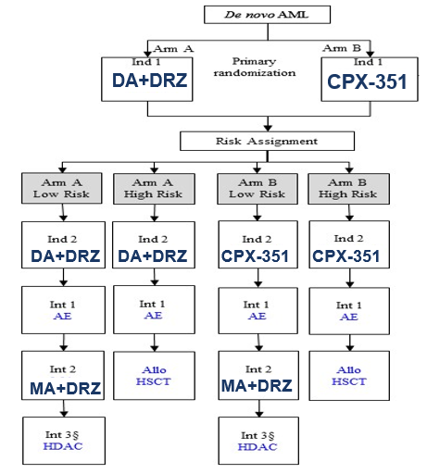
AAML1831 Study Overview & Status
Randomized study of CPX-351 (liposomal anthracycline formulation) vs. standard therapy with Dexrazoxane (DRZ) cardioprotection
Primary Endpoint: Event free survival
Key Secondary Endpoint: Cardiac outcomes
Cardiac Objectives:
  To determine the incidence of cardiac dysfunction
  To determine the changes in cardiac function and remodeling
  To determine the utility of global longitudinal strain in predicting systolic dysfunction
Study Status & Timeline - Activated: 7/20/20
Anticipated Accrual: n= 1,400 through 2025
50 patients enrolled and 65 DICOM echo images collected to date
CPX-351: Liposomal Cytarabine + Daunorubicin
DA + DRZ: Daunorubicin, Cytarabine, Dexrazoxane (DRZ)
MA + DRZ: Mitoxantrone, Cytarabine, Dexrazoxane (DRZ)

Slide 4
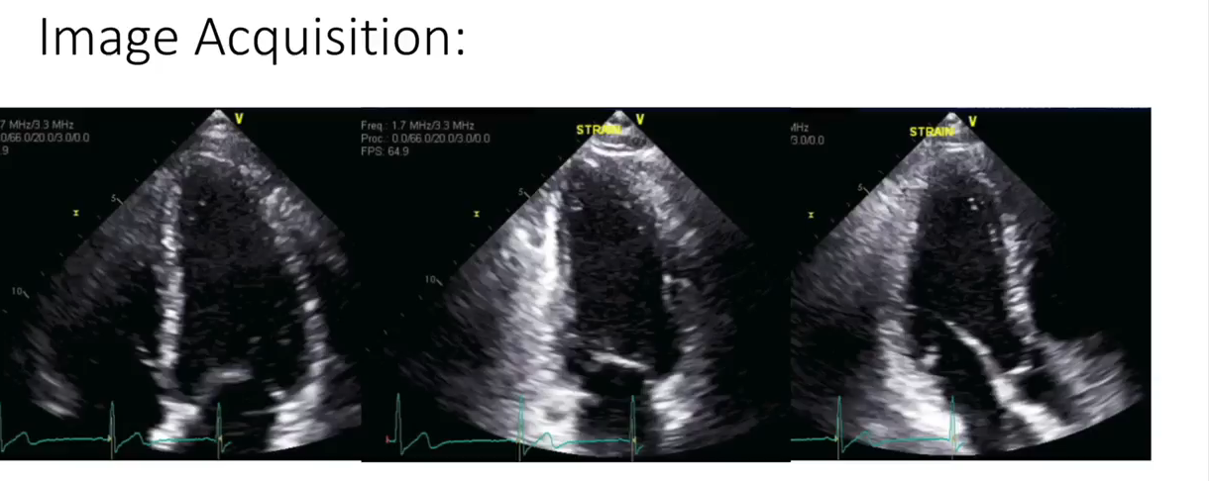
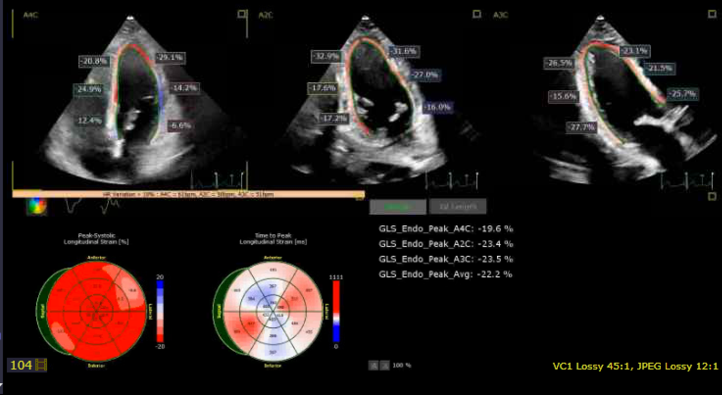
Strain Analyses
JACC: CardioOncology. December 2020.
https://www.jacc.org/doi/10.1016/j.jaccao.2020.10.011

Slide 5
Echo Certification and Quality Review
Status
  64 sonographers certified from 38 sites
  5 sonographers from 5 sites did not certify (2 have since certified)
Commonly identified issues of greatest importance:
  LV apical segments cropped (~30%)
  High quality ECG tracing not recorded on some/all images (~15%)
At least 1 missing or not analyzable image noted in the majority of studies
    4C and 2C: 2D LV focused (~50%) or LA (~40%)
    3C: 2D LV and LA (~40%) and 2D LV focused (~65%)
    2D RV and RA (~35%)

Slide 6
General Image Acquisition Guidelines
Record generously. Record multiple loops of all required views with a minimum 3 beats/clip. If tachycardia is present, record an additional 5 beats/clip of 2D images in apical (4C, 2C, 3C), short axis (base, mid, apical), and parasternal long axis views.
Extra 2-D gain is indicated for quantitative analysis of 2D images. It is preferable to overgain rather than to undergain. Optimize endocardial definition.
Maintain a frame rate of 50-70 frames per second throughout the entire echo exam.
Do not narrow the sector angle excessively for 2D imaging. Please include both the epicardium and endocardium in all images, throughout systole and diastole.
Avoid foreshortening of the cavities, especially the LV. In apical imaging planes, the maximum cavity lengths must be displayed.
A high quality electrocardiographic (ECG) signal is necessary and should be recorded with all images.
Follow checklist (End of AAML1831 Cardiac Manual)

Slide 7
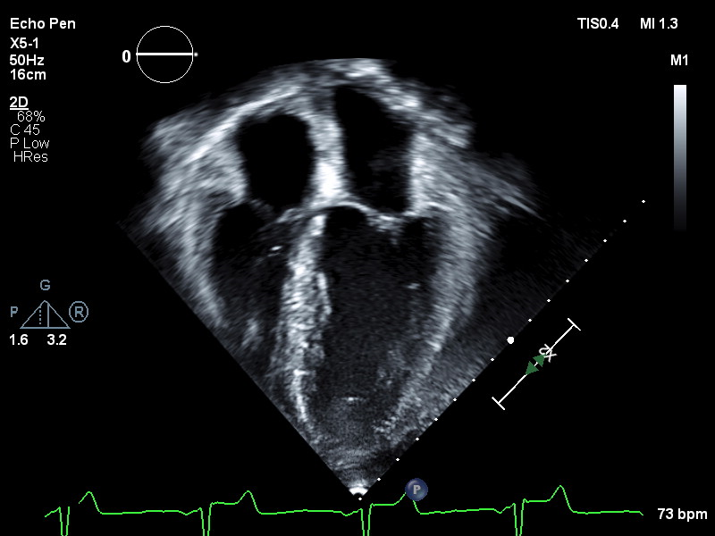
Optimal Apical 4-Chamber View
  Maximize LV length; be careful not truncate true long axis of LV
  Entire LV endocardium must be within imaging sector (both end-diastole and end-systole)
  Pay careful attention to apex and LV lateral wall, often most difficult areas to visualize
  Adjust sector width and imaging depth to ensure acquisition frame rate of 50-70 frames per second
2D imaging of standard A4C view
A4C focused/zoomed on the LV

Slide 8
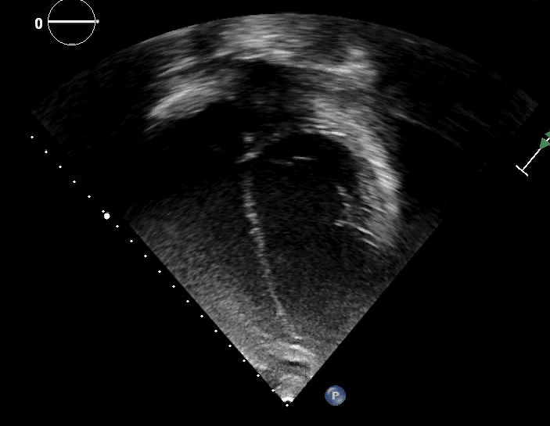
Suboptimal Apical 4-Chamber View
Concerns:
No ECG
Apex incompletely visualized
Endocardium incompletely visualized
Off-axis
Potential Suggestions:
Increase gain (TGC)
Alter focal zone
Position probe laterally (into axilla)
Alter sector width/tilt to acquire lateral apical segment

Slide 9
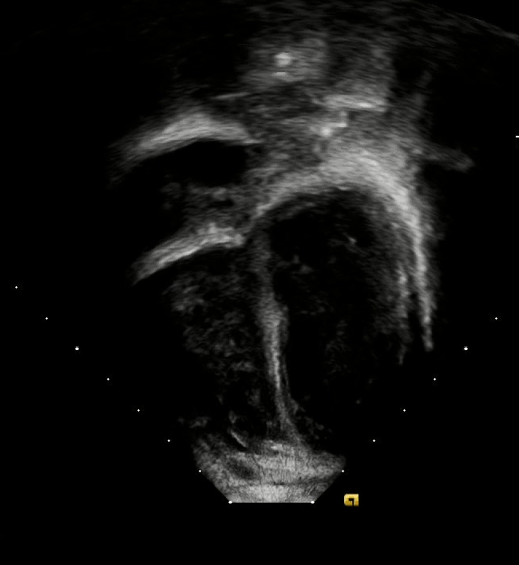
Suboptimal Apical 4-Chamber View
Concerns:
Apex incompletely seen
Mildly foreshortened
Tachycardia adds complexity (≥5 beats)
No ECG
Potential Suggestions:
Position transducer laterally to see apex (into axilla)
Breath hold (depending upon age)

Slide 10
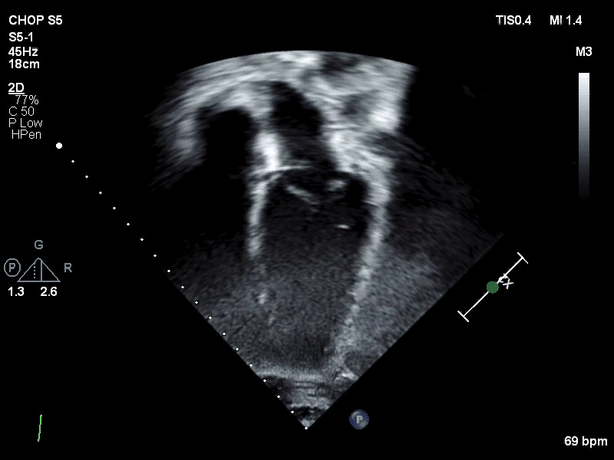
Suboptimal Apical 4-Chamber View
Concerns
Endocardium incompletely visualized for strain analysis
Potential Suggestions
Decrease depth and acquire focused LV view
Increase gain (apex)
Consider altering focal zone

Slide 11
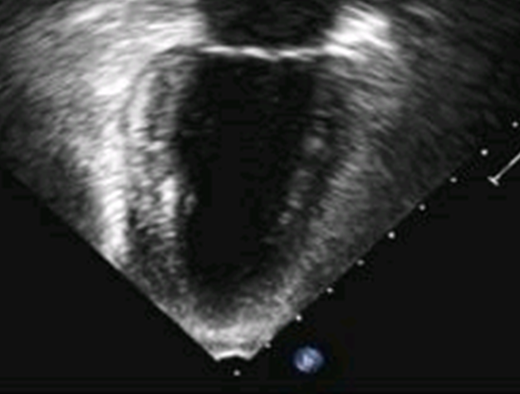
Optimal Apical 2-Chamber View
  Visualization of left ventricle during systole and diastole
  Maximize LV length and be careful not to truncate true long axis
  Scan plane transects anterior and inferior LV walls, with neither RV nor LV outflow tract visualized
  Pay particular attention anterior LV wall and apex, usually the most difficult areas in which to visualize the endocardium
  Adjust sector width and imaging depth to ensure acquisition frame rate of 50-70 frames per second
A2C view focused/zoomed on LV

Slide 12
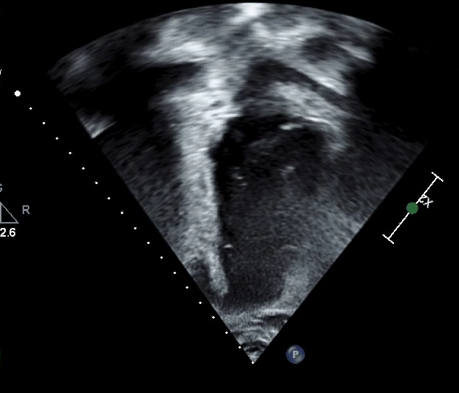
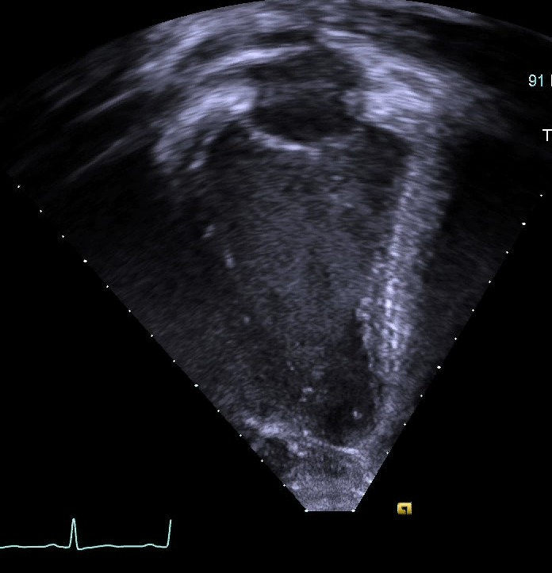
Suboptimal Apical 2-Chamber View
Concerns
Poor visualization of anterior wall
Foreshortening
Possible Solutions:
Breath hold (if patient able to tolerate)
Concerns
Slightly limited visualization of inferior wall at end diastole
Foreshortening
Possible Solutions:
Breath hold (if patient able to tolerate)

Slide 13
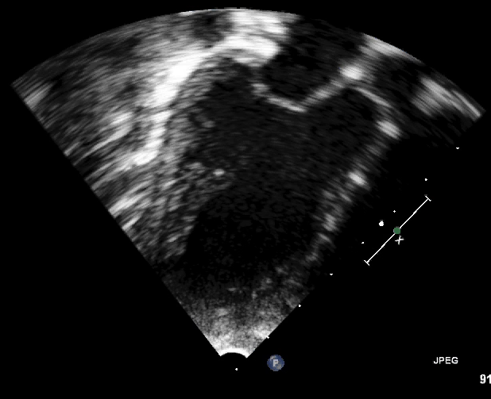
Optimal Apical 3-Chamber View
Obtain a 2D image, including entire LA and LV and mitral valve.

Slide 14
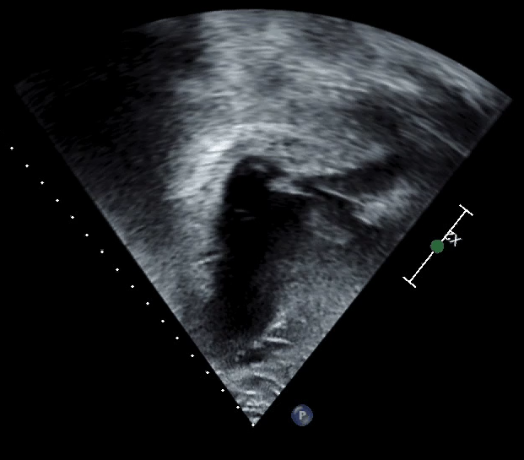
Suboptimal Apical 3-Chamber View
Concerns
Poor visualization of anteroseptum and apex
Possible Solutions:
Increase gain
Decrease depth
Transducer position

Slide 15
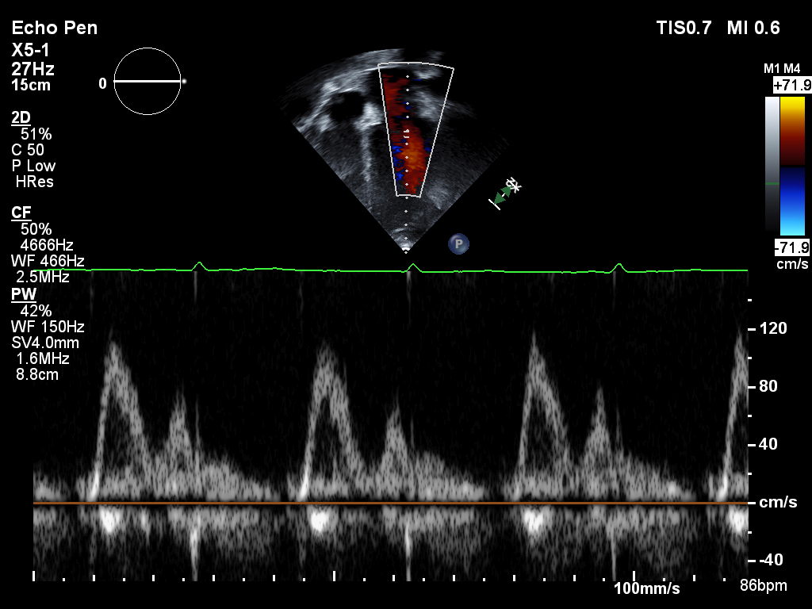
Optimal Apical 4-Chamber: Pulsed-Waved Doppler Mitral Inflow
From apical 4CH view, record mitral inflow velocity profile with pulsed-wave Doppler sample volume positioned at tips of mitral leaflets during quiet respiration
  Adjust baseline and Doppler scale to visualize peak E and A wave velocities
  Record a minimum of 3 full cardiac cycles at a sweep speed of 100 mm/sec
  Alignment of Doppler with inflow

Slide 16
THANK YOU!!!
AAML1831 Cardiac Studies
PI: Kasey Leger, MD, MSC
Seattle Children’s Hospital
206-987-2106
CRA: Laura Hill
Seattle Children’s Hospital
206-884-1058
AAML Pediatric Cardiology Leads
William Border, MD
Ritu Sachdeva, MD
David Cox (Sonographer)
Echocardiography Core Lab
Center for Quantitative Echocardiography
Hospital of the University of Pennsylvania
Rhoads Building, Ground Floor
3400 Spruce Street
Philadelphia, PA 19104
PI: Bonnie Ky, MD, MSCE
Lead Sonographer: Jade Chung, RDCS
Project Manager: Laney Smith, MA
Co-I: Bénédicte Lefebvre, MD
AAML1831cardiacstudies@seattlechildrens.org

