Slide 1
PBT-22FHTC
Patient
Age: 5 yrs
Gender: nd
Location: pons
Diagnosis: DIPG/DMG H3.3 K27M
Pre-treatment: no prior treatment
Source: biopsy
Stage: WHO grade IV
Genetic mutations:
H3F3A (p.K28M)
TP53 (p.R306*)

Slide 2
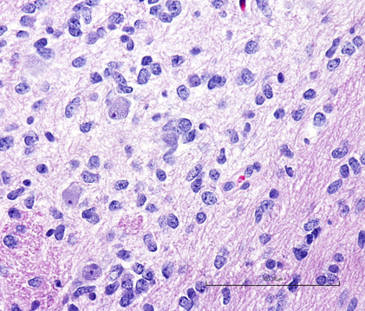
PBT-22FH
H&E staining
Primary Tumor

Slide 3
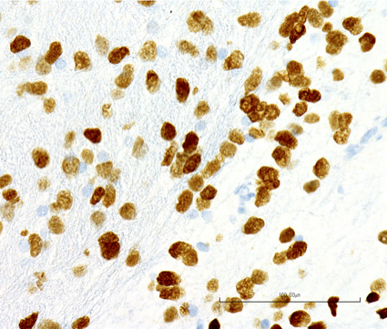
PBT-22FH
H3 K27M Stain
Primary Tumor

Slide 4
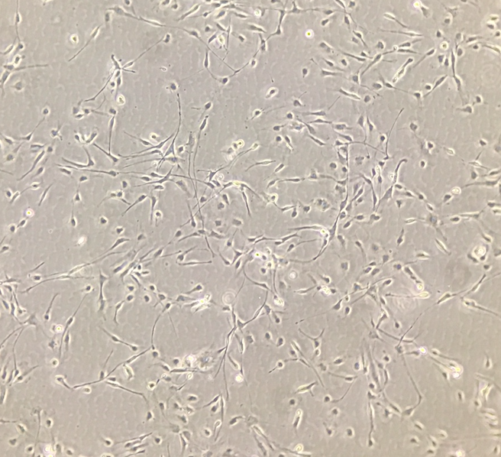
PBT-22FHTC
Tissue Culture
Laminin coated plastic

