Slide 1
FAST-Parenting Teens
Skills Group

Slide 2
Week 1
Family Cycles

Slide 3

Welcome to group!
Please log into Zoom early, we will start right on time
Label yourself on Zoom:
  Your name (child’s name – age)
  Example: Tim & Ellen (Lina- 14)

Slide 4
TeleGroup guidelines
Please do:
  Turn on your video!
  Mute when not talking
  Prop up device
  Use the chat, hand raising, and “reaction” emojis anytime
  Use big nonverbal communication to support each other
  Try to remain in one place

Slide 5
TeleGroup guidelines
During group, please avoid:
  Driving
  Calling from a public place
  Cooking meals
  Walking around
Privacy: Please keep other families’ information private

Slide 6
What is this group?
Evidence-based treatment for:
  ADHD
  Disruptive or oppositional behaviors
  Teen/parent relational and adjustment problems
Goals:
  Improve connection and communication with teen
  Teen independence with daily tasks
  Respond to difficult behaviors
  Reduce family stress
Notes:
Note, the program will not change your child’s temperament altogether, or get rid of ADHD. We are focused on helping your teen be successful, and improving communication and boundaries in your relationship with them.
1. Evidence-based skills
“The skills we will practice are part of “well-established” treatments for teens with challenging behavior.
b. This type of treatment is called Parent Behavior Management Training
2. What to expect
a. Skills focus: “Each time we meet, I will introduce something new to try out with your child at
home, and we will troubleshoot how it went the next time we meet. This program will only work
if you try out the things we talk about. Each skill builds on the previous one, so they work best
together as a package. The more you put into working on these things outside of our meetings
here, the more change you will see in managing your child at home.”
b. “You may have already tried similar things and found they haven’t worked. However, for an
especially challenging child, the usual strategies need to be tweaked, and that’s something we
will do together. This program will give you the structure and support to practice using and
fine-tuning these strategies successfully.”
c. “Finally, I will warn you that some kids may resist new changes at home, so there will be ups and downs. Things may get worse before they start to get better. We’ll be here to talk about it every step of the way.

Slide 7
Introductions
Leaders
You/your teen
  Teen’s name and age
  Something you love about your teenager
  Something you hope to learn from group
Notes:
10 min - break into halves if more than 8 families
Ask families to keep their intro to about 1 min

Slide 8

Why is parenting teens SO HARD??
The “To Do List” of adolescence:
  Branch out from your parents/family
  Handle daily tasks independently
  Communicate clearly, get needs met
  Understand and manage feelings
  Find identity and belonging
Factor in:
  Social world is more and complex
  Hormones
  Your teen’s temperament and mental health
Notes:
Invite families to type into chat as you mention each column – what goes in that column for you?
If there are parent or environmental factors that you think contribute to the behavior patterns, are they changeable? May wish to brainstorm possible ways to address.
Learned behavior patterns: Automatic ways of responding to each other. Kids learn when to push limits, parents learn to use harsher or ineffective strategies or give up when the child gets angry. Then the child learns that this “not ok” behaviors can get them what they want, or get them out of things they dislike.
What arguments do you find yourself having over and over with your child?
Detailed examples:
A. Rationale: “We want to begin with better understanding WHY your child is acting up, because this will help
us figure out how to help change behavior.”
B. Introduce Handout 1: Causes of Child Problem Behaviors and encourage parent to fill in the blanks.
1. Characteristics of the Child
a. “[Child] is having some challenging behaviors. Some of this stems from aspects of your
child’s temperament and personality as well as their development of different skills (social,
emotional, self-care, learning).”
b. Brainstorm in the bubble child-based difficulties or characteristics that may contribute to the
behavior.
c. Examples: ADHD, learning problems, low frustration tolerance, high intelligence, lacking
social skills, need for instant gratification, focus on certain interests such as electronics,
emotionally sensitive, anxious, developmental delays.
2. Characteristics of the parent
a. “As child behaviors escalate and we try to deal with them as best we can, we can get sucked into
negative interactions that may be personally triggering for us. What are some qualities that you
have that can make it a challenge to parent [Child]?”
b. “Any qualities in [Child] that you see in yourself?”
c. Examples: Parent attention problems, lack of consistency, busy work schedule, medical problems,
parent mental health, parent’s own experiences as a child and with caregivers, quick to anger,
feeling alone or unsupported, stressed by other children.
3. Family/environmental stressors
a. “The environment can add stress and affects both children’s and parents’ behavior. What are
things going on in your home or lives that affect you both?”
b. Examples: Housing problems, poor fit with teacher/school, lack of school resources, marital
conflict, other family members’ difficulties, financial problems, unsafe neighborhood, lack of
activities for child, stressful family schedule, loss/separation/divorce.
4. Interaction patterns
a. Refers to learned patterns of behavior over time, leads parents and children to develop
“automatic” ways of responding to each other.
b. “Do you notice any patterns that happen between you and your child where you react in the same
negative way to each other so often that it gets to be automatic? “
1) Example: “If your child loves videogames, and you have to ask them 10 times to turn it off
before they do it, what are they learning?” (answer: If they ignore you, they get to play
for longer)
2) Example: “If your child throws a tantrum when you say “no” to something, what do many
parents learn to do to make the tantrum go away?” (give in). “And if parents give in, what do
children learn about the usefulness of throwing a tantrum?” (it gets them what they want).
“What do parents learn about the benefits, at least in the short term, of giving in to a
tantrum?” (Parents also learn that the tantrum will stop if they give in).
c. Brainstorm types of interaction patterns between parent/child that affect behavior. Examples:
getting annoyed right away by a child behavior; expecting the worst; child escalates until parent
loses patience; parent backs down to keep the peace; child is escaping demands by being noncompliant;
parent is inconsistent with limits; child refuses before even hearing the instruction.
5. Potential pitfall: The family may have a different explanation for child’s behavior (e.g., child is lazy,
manipulative; child hates the parent, it’s all due to a past stressor)
a. Reframe parent’s explanation in as neutral of language as possible.
b. Find a place to put it on the worksheet as one possible contributor, and encourage focus on
other contributors.

Slide 9
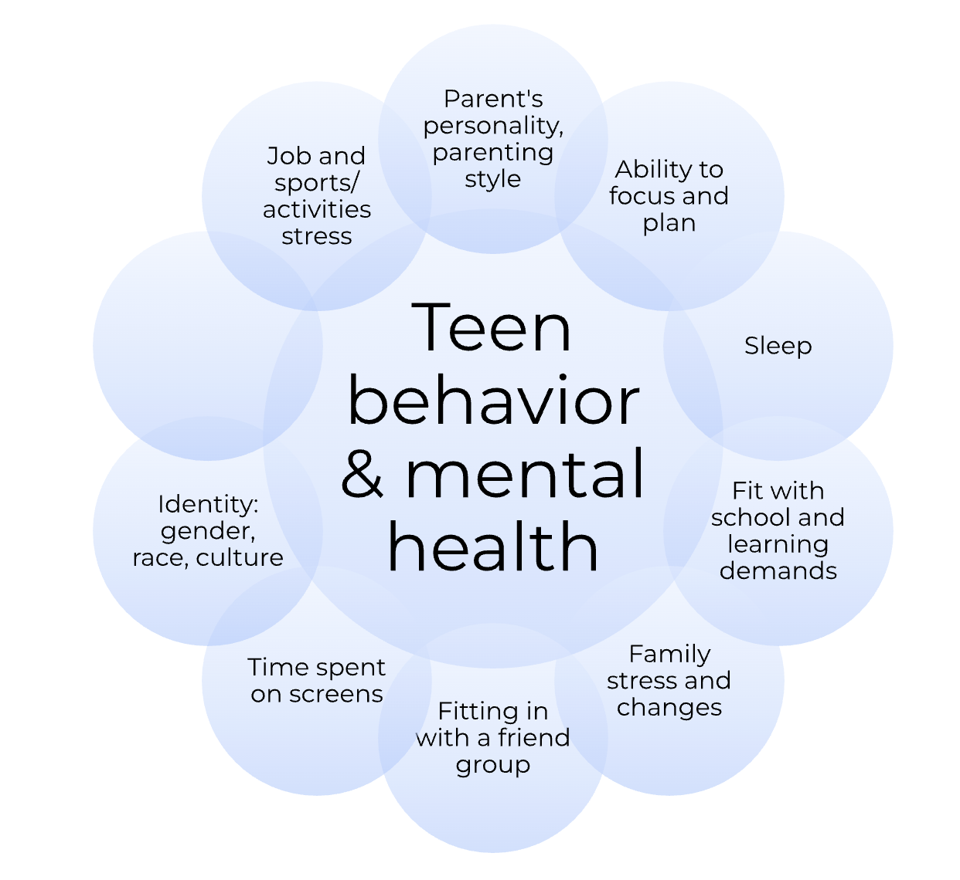
What’s going on for my teen?
Notes:
Star the bubbles that seem especially relevant in contributing to your teens’ struggles.
Add some notes about what their experience is with that topic.
Are there any that you may be able to support them with?

Slide 10
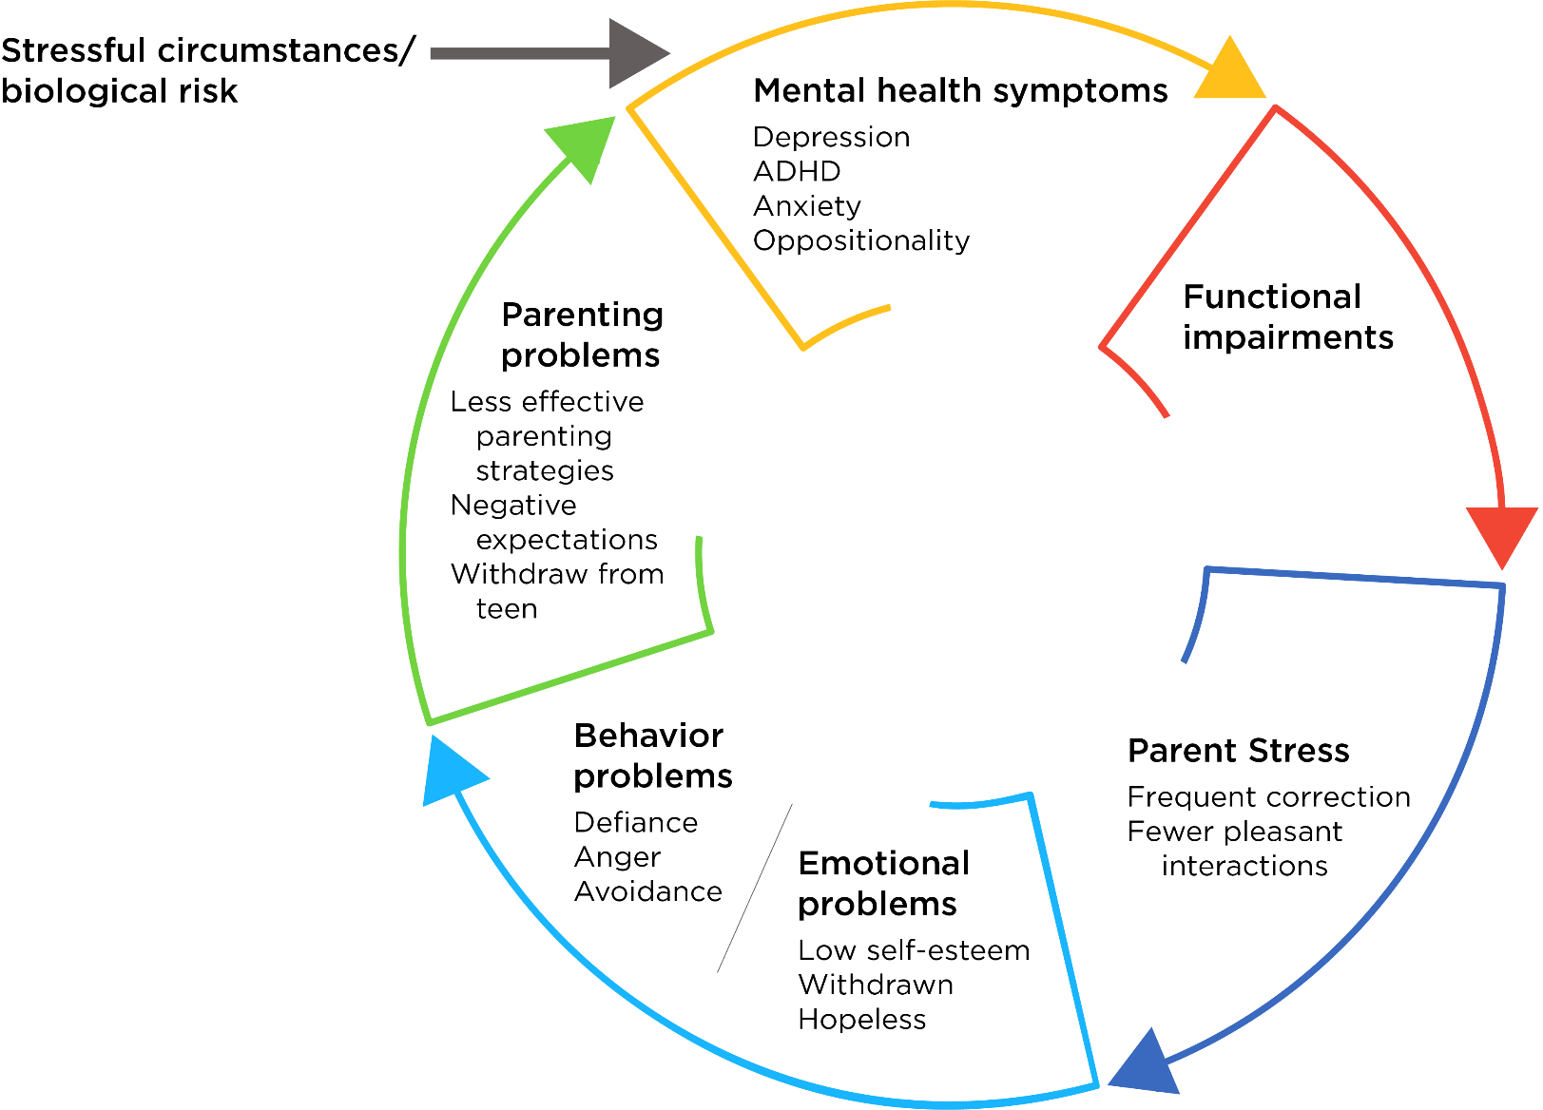
Family Cycle
Notes:
When teens struggle, the entire family gets pulled into the cycle. Do any parts of this cycle show up in your home?
If your child has challenging behavior, they are likely to be getting a lot of negative attention and correction – maybe from teachers, coaches, and other kids. And you may be doing a lot more correcting than other parents are having to do. Teen behavior often gets worse in response to feeling “over-parented,” and in turn, parenting becomes less effective.
This program starts with helping your teen learn how to communicate about and meet expectations. And help you and your teen connect and enjoy each other more.

Slide 11

Breaking the Cycle
Notes:
How do we break the cycle?
Start at the dark blue part. We can’t directly control our teen, but we can control our own behavior. If we can approach them differently, we can start to create positive moments that engage them better.

Slide 12

Where should we start?
One on One Time
Schedule 15 minutes, 3-4 times a week
Let teen choose (as long as it involves interacting)
Give your full attention – put away phones
Make positive or neutral comments about:
  What they are doing: “You’re getting really good at free throws. That was a great shot.”
  Positive qualities: “I love how creative you’ve gotten with your videos. You crack me up!”
Ignore annoying or button-pushing behavior
Calmly end the activity if your teenager becomes disrespectful or breaks house rules.
Notes:
E. How to do Special Time. Refer to Handout 3: Special Time and review guidelines with parent
1. Schedule 10-15 min per day (set a timer) of “Special Time” to play with your child.
2. Child picks the activity (can set ground rules: no electronics, must be free, avoid competitive games
with a winner and loser).
3. Parent will use attending skills during Special Time.
a. Describe child’s activity like a sports commentator: i.e., “You are…putting the red block on the blue
one. It looks like you are ______ [searching for a matching piece]”
b. Be positive and enthusiastic. No conversations about past or future or controversial topics e.g.
how he got in trouble at school yesterday, how he needs to clean his room . . . No criticism or
punishment.
c. Do Special Time, even if the child has had negative behaviors that day. In fact, those are the days
when Special Time is needed even more.
d. If negative behavior occurs, coach parents to ignore until it stops (parents can focus on playing
with the toys by themselves). If a major misbehavior happens, handle as usual and redirect to play
appropriately. If major misbehavior continues, say, “Ok, we have to end Special Time for today.
We’ll try it again tomorrow.”
e. Kids older than 9 need less intensive commenting and may use cooperative interactive games
(puzzles, drawing, sports activity or have a conversation about something the child is interested
in). Even teens will benefit from Special Time.
f. Choosing activity: Ask, “Will it be hard for your child to find appropriate ideas to do during Special
Time?” Direct to Handout on 1:1 Time Activities, for ideas.
4. Ask parents: “Do you foresee any barriers to doing 1:1 Time?”

Slide 13

One-on-one time ideas
What might your teen choose?
Practice a sport
Help cook/bake something for their friends
Arts or crafts (drawing, making cards, knitting/sewing)
Let them share their favorite music with you
Take or edit pictures
Masks or beauty/spa activities
Let them show you a favorite online fandom
Have tea or hot chocolate
Go for a walk, play with pet
Hear them play an instrument
Notes:
Brainstorm aloud or in chat – what are some activities your teen might choose (or be willing to try with you) for 1:1 time?
If they are resistant, you might have to make it something extra special the first few times. E.g. trip to Starbucks or running an errand together they wanted to do

Slide 14
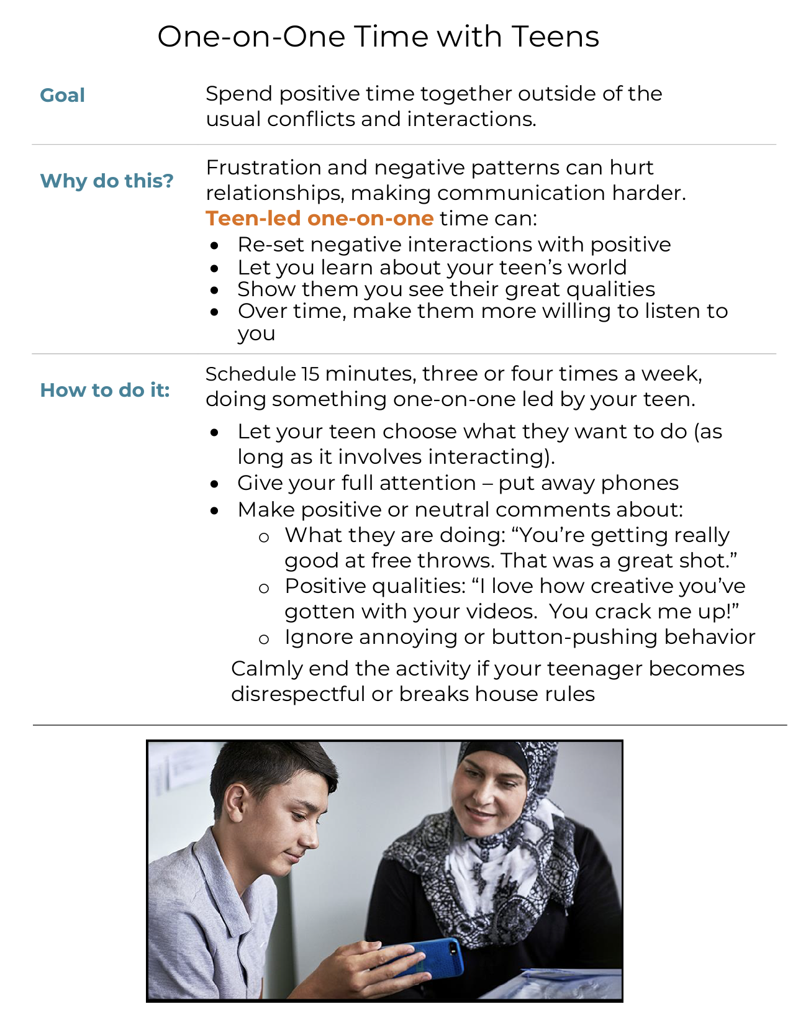
Ways to practice
Schedule 10 to 15 minutes one-on-one time, 5 times per week
How will you explain it to your teen?
What boundaries will help it be successful?
When is a good regular time to do it?
Notes:
Assign HW and refer to handouts in Workbook

Slide 15
Week 2
Flowers and Weeds

Slide 16
Home Practice Review
What did you observe about patterns that happen between you and your teen?
How did one-on-one time go for:
  Your teen?
  For you?
How will you keep 1:1 time going?
Notes:
Intro question for chat: What is one activity your child chose this week for special time? Also, any burning questions for us?
Who can share a success story to start us off?
Later: Who ran into challenges?

Slide 17
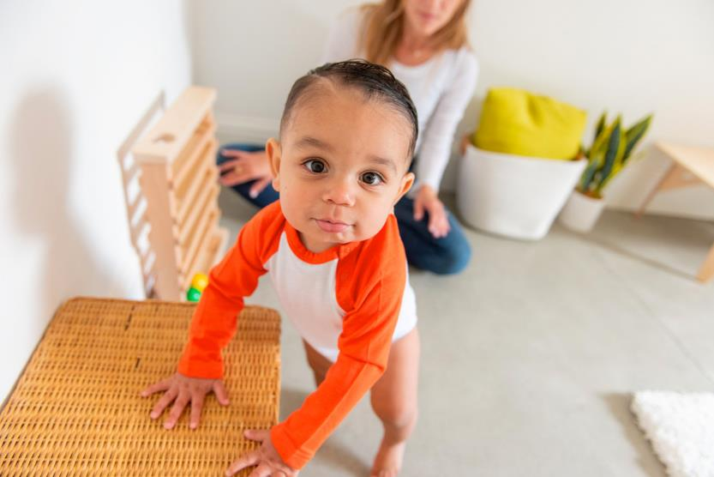
Attention to positive behavior
Good behavior only continues as long as it is noticed
If you want to teach a new behavior, acknowledge it right away, every time
New behaviors need to be shaped
Notes:
Introduction: “We are going to start using the principle of positive reinforcement to increase positive
behaviors and help your child learn new skills.”
B. Discuss 3 important points about rewarding/praising behavior:
1. “Good behavior only continues as long as it is noticed. Think about how you feel if you go out of your
way to make a really nice dinner for your friends and no one says anything about it. How likely will you
be to do that again?”
2. Consistent: “If you want to teach a new behavior, reinforcement need to happen EVERY TIME. It can be
less frequent after your child has really learned these new skills.”
3. Immediate: “It needs to occur in the moment at the same time as the behavior is happening, otherwise,
the connection between the behavior and the positive attention is lost.”
4. New behaviors need to be shaped:
a. “Reward small behaviors that come closer and closer to the exact behavior you want your
child to learn.”
b. “Recall your child learning to walk. You laughed, applauded with pulling up, cruising, and first
steps rather than waiting until he walked across the room.”
c. Example: “If goal is getting dressed independently, praise each step of this (putting on shirt,
socks, etc), rather than waiting until they are completely dressed to praise.”

Slide 18

“Differential Attention”
Water the flowers, NOT the weeds
Notes:
This means giving lots of attention to things we like and want to see more of, and giving less attention, or sometimes no attention at all, to behaviors we want to go away.

Slide 19
Catch ‘Em Being Good
Acknowledge the good things your teen does
Talk to your teen like an employee you manage at work
Labeled praise - be specific, tell them exactly what they did that you liked
Immediate or as close in time to the behavior as possible
Include physical affection if it feels natural (high 5’s, hugs)
Avoid getting too gushy or cheesy
Notes:
We call paying attention to good behaviors “Catch ‘Em Being Good” (CEBG)
A. How-To’s of Catch your Child Being Good (Refer to Handout 5: Catch ‘Em Being Good)
1. “CEBG is using specific praise to tell kids that you like and appreciate what they are doing.”
2. “Do CEBG by using praise, compliments and physical affection. It is like using the 1-on-1 Time skill
of being the sportscaster and focusing attention on the child when they are doing well.”
3. Labeled Praise examples (see Handout 5)
“Being specific helps keep kids on track by providing clear feedback about how they are doing.”
B. NOT CEBG:
1. Unlabeled Praise: General statement of approval, not specific to a behavior.
Examples: “That’s great.”, “Good job”, “Thank you”.
2. “Compliments with a Kick”: Ending a compliment with a “zinger”
a. Share examples from handout
b. “What do children take away from a comment like that?” The positive intent is often lost.

Slide 20
Examples of catch ‘em being good
Good examples
“I really appreciate how kind you’re being to your brother.”
Not good examples
Compliments with a kick: “You put your shirt in the laundry, why didn’t you do your pants too?”
“Thank you for rinsing your dishes after dinner.”
“Nice work sticking with that math even though you felt it was hard.”
Unlabeled/generic praise: “Nice work!” “Thanks for being good”

Slide 21

Catch ‘Em Being Good
Why do it?
Everybody likes to be acknowledged
Changes patterns of negative attention into positive ones
Teens and parents feel better
Builds self-esteem and confidence
Notes:
Imagine you made a wonderful dinner for your family. Chose a recipe, shopped for it, and spent several hours making it. And then no one said anything about it. Would you be likely to continue to put this effort in?

Slide 22
“Speak respectfully”
Looking at parent when they are talking
Using calm tone of voice
Talk about your own perspective, not blaming
Notes:
Display orange writing – ask group to come up with a way to define a “baby step” behavior (clear and observable) toward this goal

Slide 23
“Cooperating”
Acknowledging when instructions given
Getting started with one reminder

Slide 24
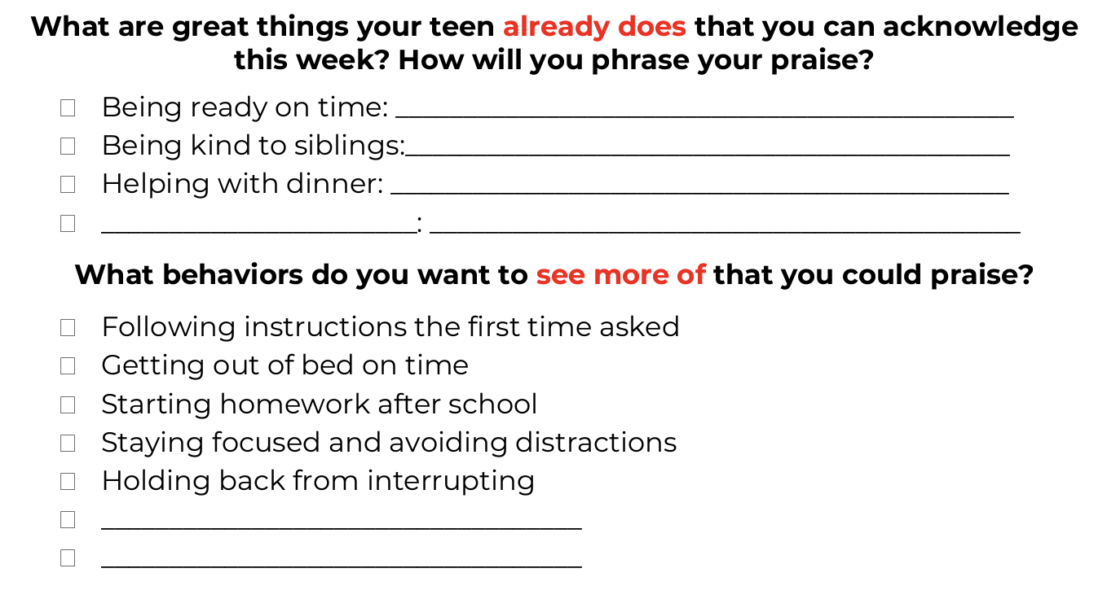
Home Practice: Catch ‘Em Being Good
Notes:
Everyone type in the chat one “catch them being good” phrase you will say to your child this week
Which behaviors will you especially focus on catching
Freebies are things your child is already awesome at doing
This is the tracking sheet from the handouts

Slide 25
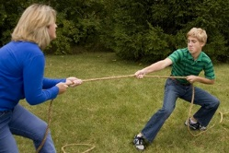
When should we give LESS attention?
Pick your battles
Ignoring is an ACTIVE technique
Kids learn better ways to communicate and
get attention
Decreases “power struggle”
between parents and teen
Notes:
Ask: “Why can it be helpful to ignore some behaviors?”
Introduce rationale
1. “Now that we’ve discussed positive attention, we will talk about how to think wisely about how you’re
using negative attention and whether it is accomplishing what you want it to — is it decreasing
negative behavior? We are going to talk about how to remove your attention in order to decrease
minor, negative behaviors.”
2. “Sometimes parent attention can accidentally reward negative behaviors. We may think that yelling
and lecturing are punishments — but if child’s behavior doesn’t decrease, then it is not really serving as
a punishment and may be rewarding the behavior. If you are giving the same lecture over and over
again, you can be sure it is not serving as a punishment. “

Slide 26
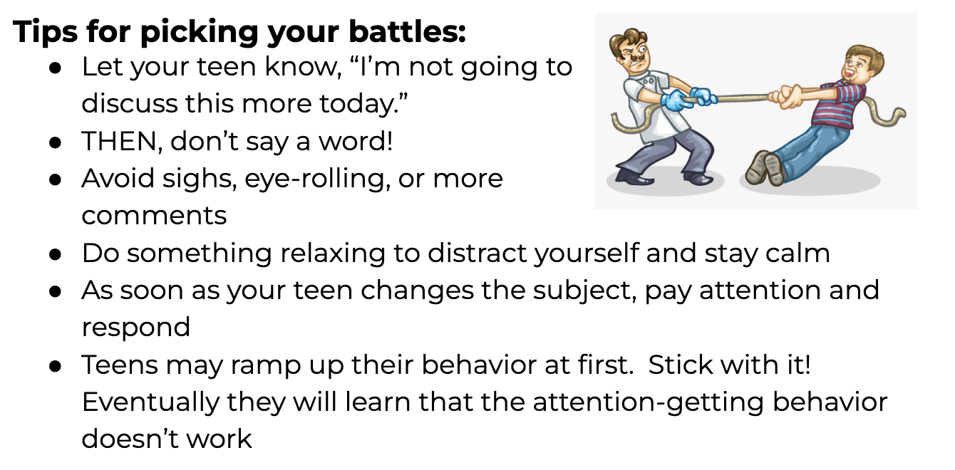
Notes:
This is a screenshot from the handout.
Defining planned ignoring strategy
1. Active technique: Planned Ignoring is an active technique — it is not doing nothing. It’s
intentionally removing attention from a negative behavior.
2. You can tell your child in advance you will no longer respond to this certain behavior. But, you
need to know your child. Some children will see this as a challenge to “win,” and in that case you
should ignore without explaining the strategy.
3. Tell your child about the positive opposite behavior that you will respond to. (Example: You will
ignore interrupting of adult conversations, but you will respond if they tap you on the arm and wait).
4. Refer to Handout 7. Give no verbal/nonverbal attention; including not telling the child you are
ignoring them repeatedly in the moment: No rolling eyes, no sighing loudly, no making faces,
no muttering.
5. Try to stay in the room so you can monitor child’s response — you want to be able to praise/
respond positively when they stop doing the negative behavior. Do leave the room if you are
about to lose your cool and respond.
6. Parents should do something calming to distract themselves while ignoring. Brainstorm ideas
with parents. Ideas: pet the cat/dog, flip through a catalog, tidy up, practice deep breaths, remind
themselves of the reason for doing this (e.g., “Not responding will help my child learn a better
way”)

Slide 27
What Should I Ignore?
IGNORABLE
  Arguing
  Complaining/whining
  Back talk
  Yelling
  Annoying noises
  “Attitude”
  Anything meant to get a big negative reaction from you!
NOT IGNORABLE
  Not doing what you’ve asked
  Safety risks
  Aggression/threats
Notes:
Ask people to type or call out things they think are ignorable
Ask parents what sorts of behaviors their children do that earn frequent negative attention from them,
or that they find themselves getting into silly arguments about behaviors, things that seem designed
to get negative attention from others.
2. List behaviors to ignore. Refer to Handout 7: Planned Ignoring and add to the list on the handout.
a. Whining, complaining, pouting,
b. Arguing, negotiating
c. Tantrums
d. Sassy tone, making faces, stomping feet, rolling eyes
3. What behaviors are not ignorable? Add behaviors to a second column that are NOT ignorable
behaviors — behaviors that feel good or are rewarding on their own, whether or not they get
parent attention.
a. Aggression (and other safety issues)
b. Noncompliance (the reward is not having to do the thing parent just asked, so ignoring won’t help)
c. Bullying/teasing siblings (rewarded by the sibling’s response)
d. Swearing, breaking things (could feel fun for the child — ignoring may or may not work)
4. “Different families have different standards about what to ignore — this is ok! Do not ignore if kids are
violating rules or otherwise crossing your line for what is respectful or acceptable in your home. “
5. “On the other hand, if you respond to too many behaviors, you will have constant battles. You will need
to pick your battles! Try putting some of the more minor behaviors on the ignorable list for now.”

Slide 28
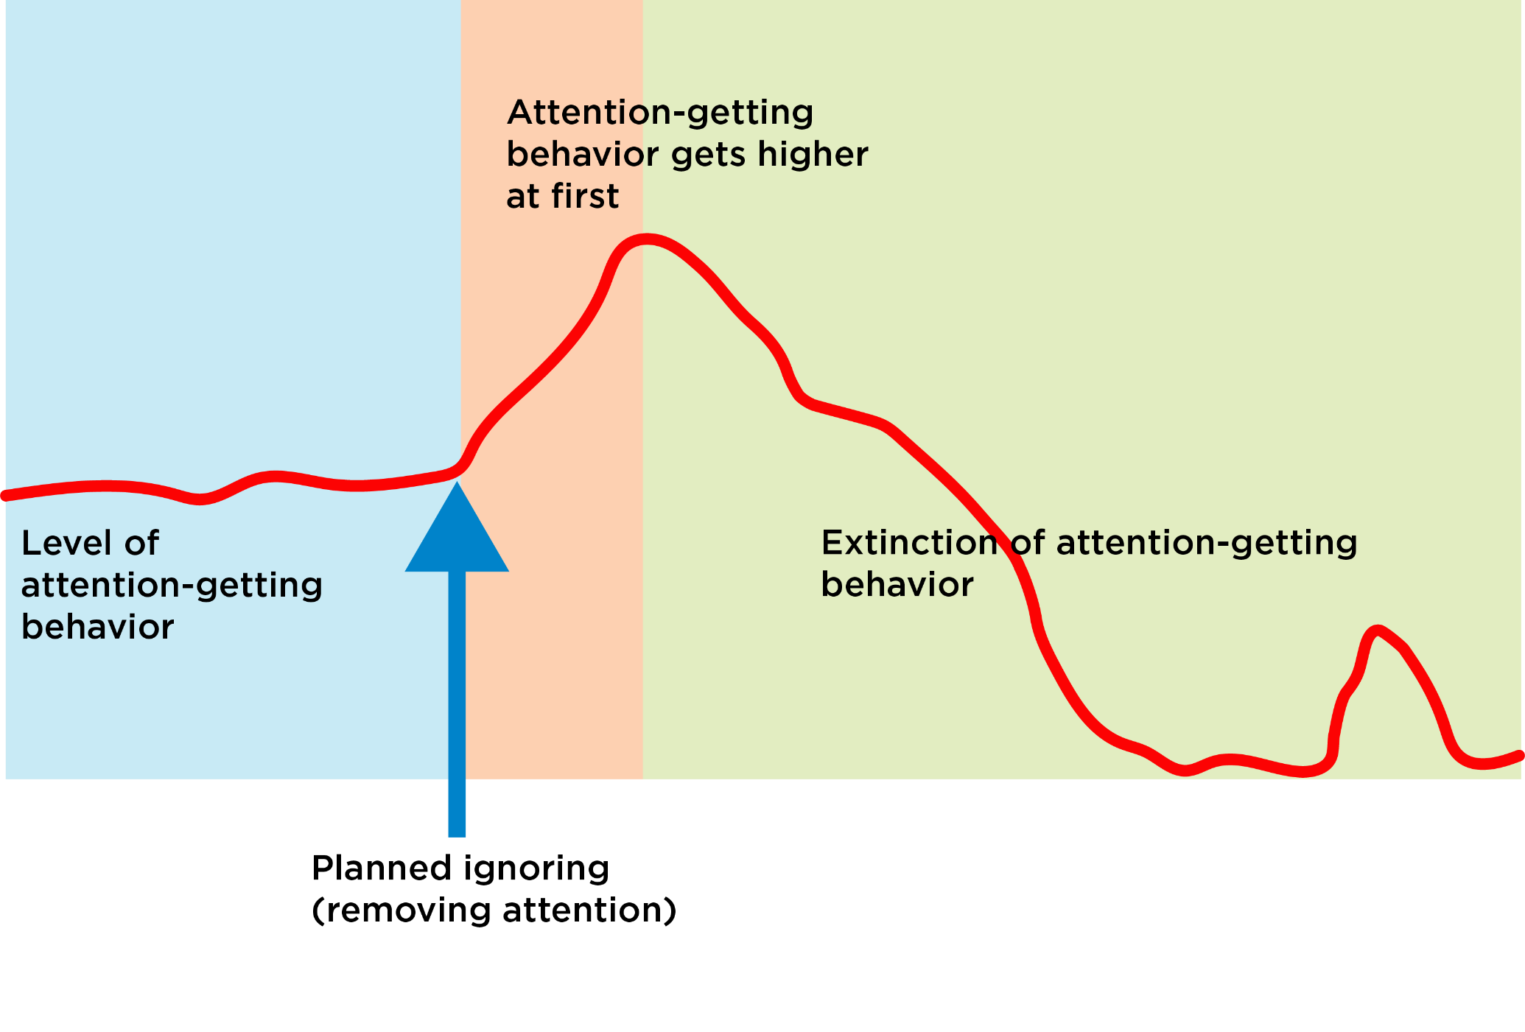
Extinction burst
Notes:
Extinction burst: “It will get worse before it gets better!”
1. Ask parents what is likely to happen if they ignore something that they have previously been
responding to (refer to graph on handout).
2. Many kids will “try harder”to get your attention and behavior will get initially worse. If you see
this, you know that ignoring is working! You must stick to it for behavior to go down eventually.
If you give in, you could end up making behavior worse (child learns they must up the ante to
succeed in getting parent’s attention).

Slide 29
Ignoring Tips
Tell your teen what you will ignore
  “The complaining is only making things harder in the morning. I’m not going to discuss complaints in the morning.”
  “You’ve asked, I’ve answered.”
  “I will not respond to yelling. I’ll be glad to respond to a calm voice.”
Hold boundary if behavior becomes “not ignorable”
  Hold limit/consequence as “Robot Parent”
  Use few words, no lecturing, no eye contact
  Avoid criticizing, showing emotion, or “fueling the fire”

Slide 30
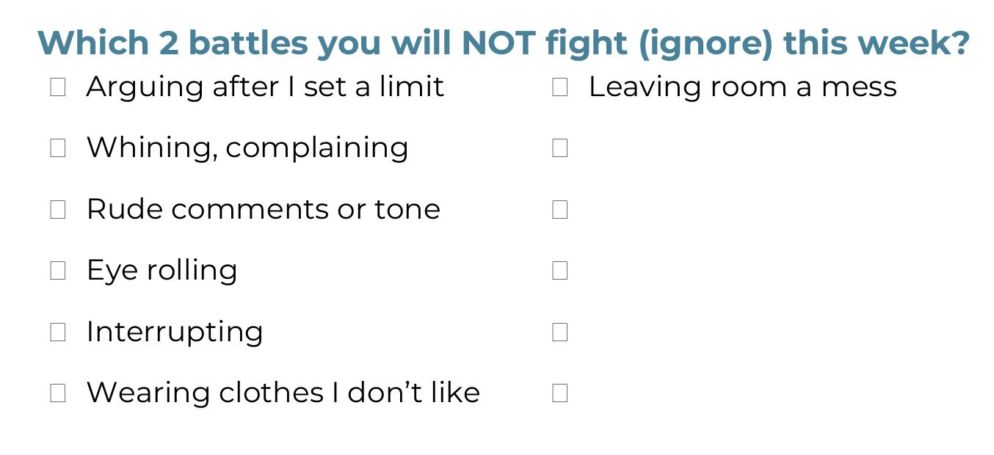
Home Practice: Picking Your Battles
What challenges might happen?
How will you keep calm while ignoring?
Notes:
Break out if more than 6 parents in group
Ask each family to type the behavior they’ll ignore into the chat, read them aloud
Ask families to type in what they will do to keep calm

Slide 31
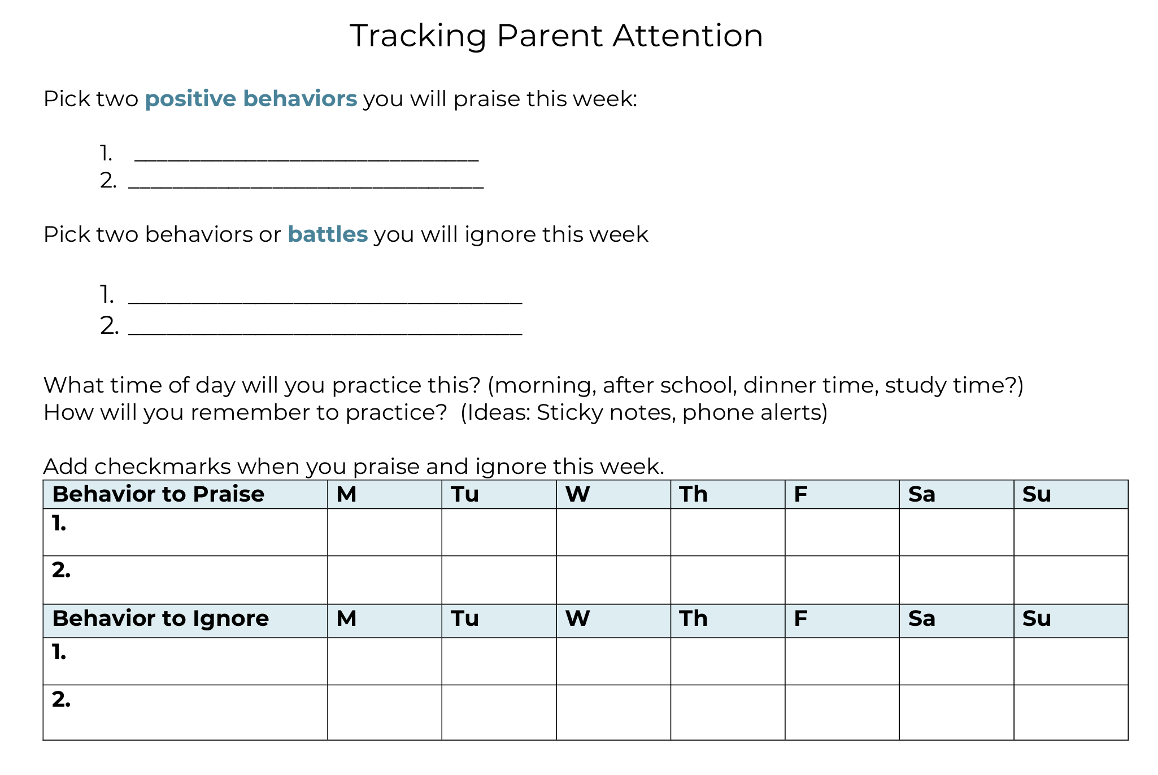
Notes:
Everyone type in the chat one “catch them being good” phrase you will say to your child this week
Which behaviors will you especially focus on catching
Freebies are things your child is already awesome at doing
This is the tracking sheet from the handouts

Slide 32
Week 3
Communication

Slide 33
Welcome back!
Home Practice review:
Catch ‘Em Being Good
Picking Your Battles
One-on-One Time
Observations?
Insight?
Questions?
Notes:
Intro question for chat: What is one awesome thing you caught your child doing this week?
Review Homework: Catch 'Em Being Good: How did it go? What was child's response when they praised?
Planned Ignoring: Any successes? Are they still in the extinction burst phase? Encourage families to keep with it. Change the behaviors to ignore if needed.

Slide 34
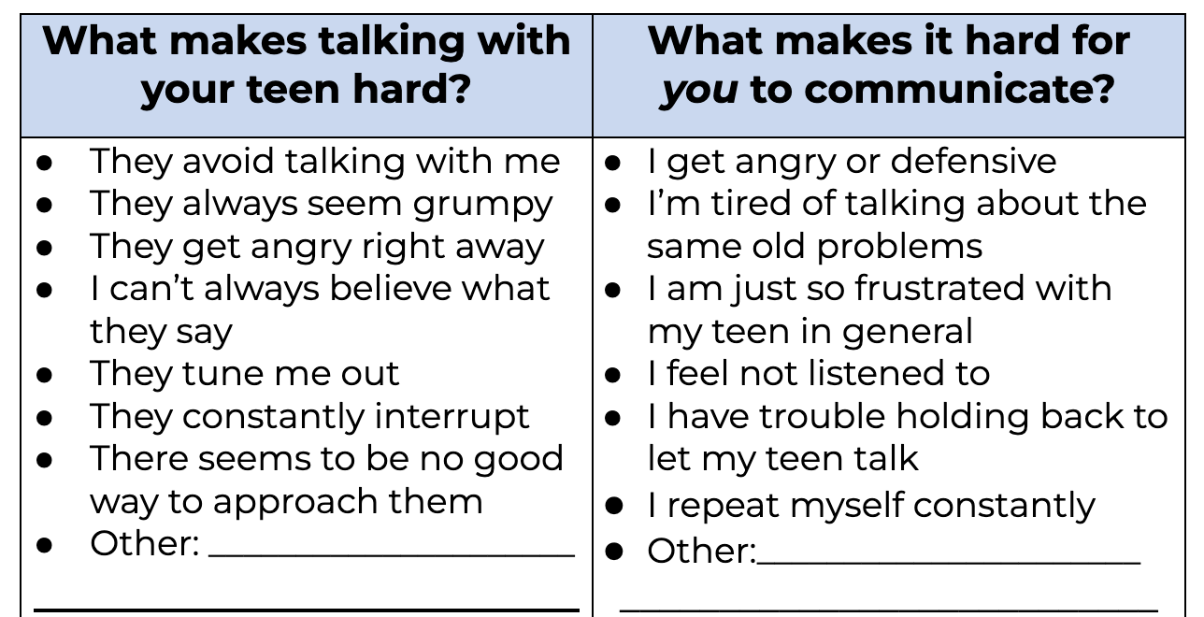
Communication with Teens
Notes:
Let’s identify and discuss barriers you see in your communication. Any of these? Any others? Can write on your handouts in the workbook.

Slide 35
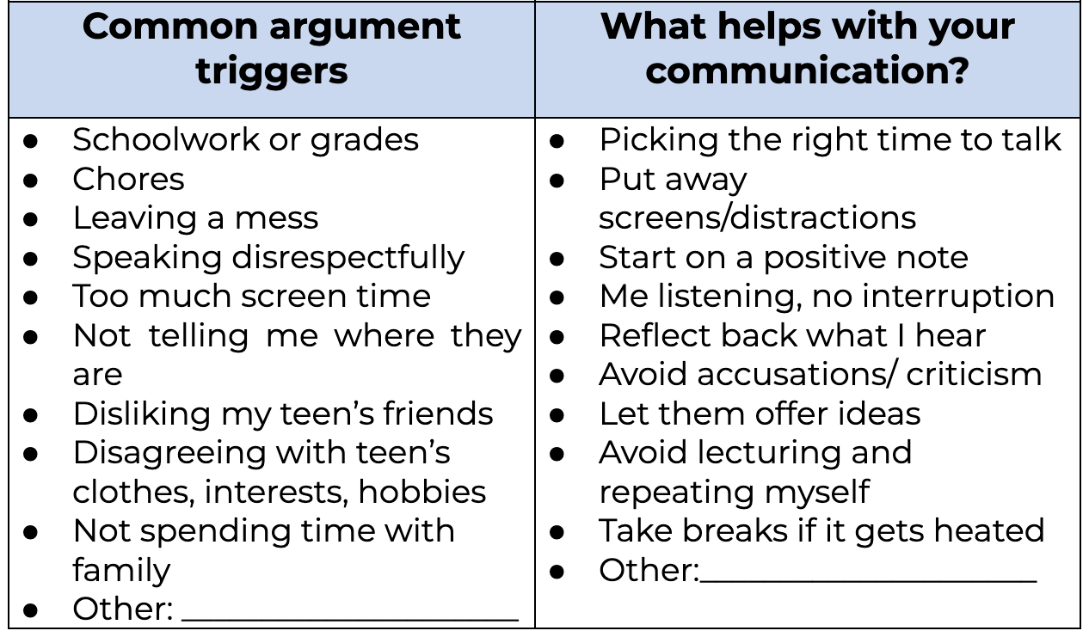
Communication with Teens

Slide 36
Validation
  Finding the ‘kernel of truth’ in another’s perspective
  Reflecting and labeling your teen’s emotions
Why do it?
  Makes others feel understood and respected.
  Models good communication for teen
  Helps teens understand their own and others’ emotions
  Makes problem solving possible
Notes:
Who is that person in your life who listens to and validates you?
When teens don’t feel respected, they will escalate or shut down

Slide 37
Validation Steps
  Tune In
  Hold back fast reactions to your teen’s feelings. Step away and breathe until you are calm enough to talk
  Read your teen’s facial expression, body language, behaviors (pacing, shutting down, fidgeting)
  Limit questions about how they feel or what happened
Notes:
This content is on the Validation handout

Slide 38
Validation Steps
  2. Guess Your Teen’s Emotion
  Say which feeling you think your teen is having
  Guessing wrong is ok – they’ll correct you!
  Examples:
    “You look frustrated.”
    “I can imagine you feel hurt and left out.”
    “It seems like you’re feeling nervous.”
    “I wonder if you’re overwhelmed right now.”
Notes:
Who is that person in your life who listens to and validates you?
When teens don’t feel respected, they will escalate or shut down

Slide 39
Validation Steps
  3. Name the reason for their feeling
  Ask yourself: Why do they feel this way?
  Say:
    “It makes sense that you feel [exhausted], that was a rough day.”
    “I get why you’re [disappointed]. You thought you were ready for that test.”
    “I’d feel [hurt] too, if it happened to me.”
  You don’t have to agree with their reasons, but it’s their reality!
Notes:
Why do they feel this way? Have I ever had a similar experience?
The point is to show you understand.

Slide 40
Validation Steps
  4. Give Space and Listen
    Resist the urge to solve it NOW
    No BUTS!!! Do not lecture or explain the other point of view until your teen is calm and ready to talk.
    ASK if they want your help coming up with ideas or a plan, or schedule a time to talk about solutions
Notes:
Why do they feel this way? Have I ever had a similar experience?
The point is to show you understand.

Slide 41
Validation Steps
  Plan for Rejection
    Your teen may not want to talk more when upset
    Model a “graceful exit” by calmly giving space
    Tell them you want to listen/support/help later
Notes:
Ask group: How will you respond to rejection?

Slide 42
Validation Steps
  Remember: All emotions are okay, but not all behaviors are okay.
  You don’t need to validate in every situation
  DO set a limit or give a consequence for a behavior that breaks household rules, like swearing, name-calling, threats or aggression.
  Say: “It makes sense you’re angry with your sister for taking your shirt. AND swearing at others is not allowed in our family.”
Notes:
When would it be best to NOT validate? When is not possible to validate?

Slide 43
“You have no right to take away my phone! I need it to text classmates about schoolwork!”
I’d feel _______ too if ____________.
I’d feel frustrated, too, if my communication lines were cut off.
Notes:
Brainstorm as a group how to validate this statement. Remember, you don’t have to AGREE with what they’re saying!

Slide 44
““I don’t want to go to track practice anymore. Track sucks.”
I’m wondering if you feel ____ because ____.
I’m wondering if you feel nervous because the big meet is this week.
Notes:
Which trap? Vague
Rephrase this instruction

Slide 45

Validation Traps
  Criticism
  Fueling the Fire
  Assuming Intention over Impact
  Teasing
  Quick Fix
  Lecturing
  Punishing Feelings
Notes:
Refer them to the handout with examples and explanations of each.
Which traps do you most often fall into?

Slide 46
Practicing Validation
  Get into pairs
  Share a conflict topic between you and your teen
  Ask other parent to play your teen while you use the 5 steps of validation (Handout)
  Switch roles and scenarios
Notes:
Refer them to the handout with the 5 steps of validation to follow along

Slide 47
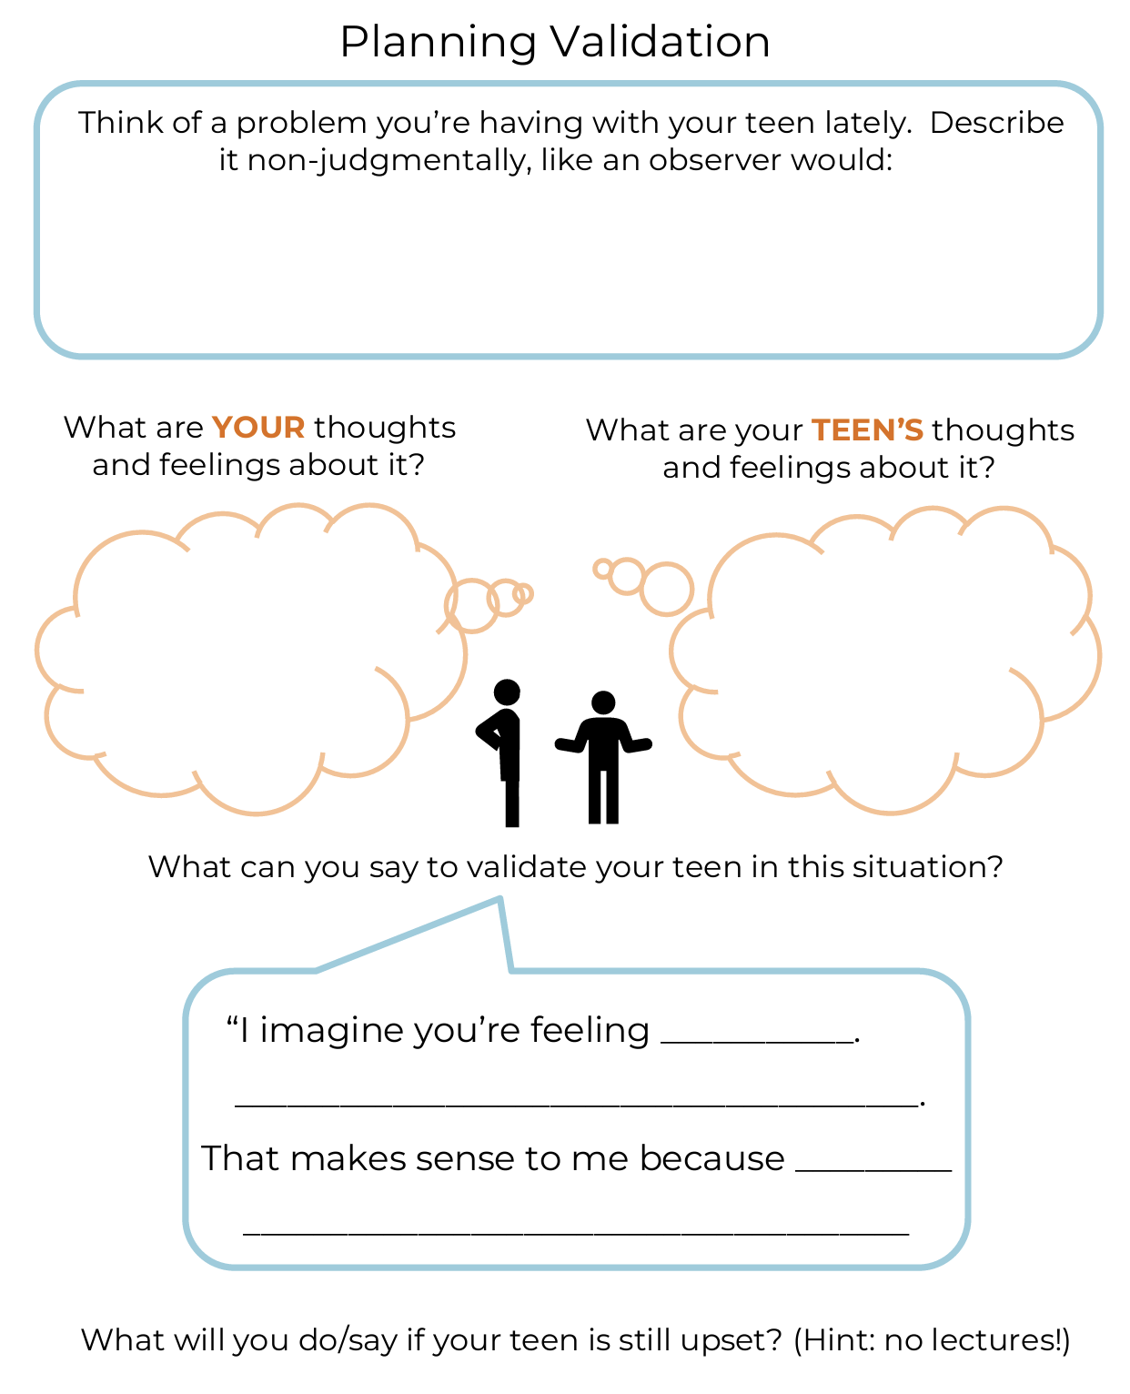
Home Practice
Plan a conversation with your teen this week
Notes:
In the workbook, there is an example of this worksheet completed.

Slide 48
Week 4
The ABCs of Behavior

Slide 49
Welcome back!
Home Practice review:
Validation Practice
Watching communication patterns
Planned Ignoring
One-on-One Time
Observations?
Insight?
Questions?

Slide 50
Teen told to turn off Xbox and go to bed
Teen yells and throws controller
Parent soothes, explains, and gives 5-minute warning
Teen and parent both got rewarded
(Teen escaped demand, parent escapes tantrum)
Notes:
What your child is doing in the window can be called a “B,” behavior. But behavior usually isn’t totally random. Behaviors are triggered by things going on in the environment, or their designed to get a reaction or outcome of some kind.
Antecedents- What happens before the behavior – triggers, what is in the child’s environment, child’s mood/feelings, interactions with adults.
For example, if you know that every time the TV is on, your child can’t concentrate and get homework done so you decide to turn off the TV before they sit down to start, that’s behavior modification. You may know your child has difficulty going shopping so you develop a plan of expectations and review explicitly with your child before you go.
Consequence- A consequence is anything that immediately follows as a result of a behavior. Could include how YOU react, others react, and whether your child gets an outcome they wanted or not. Consequences can increase the likelihood of a behavior happening again, decrease the likelihood of a behavior happening again, or have no effect on the occurrence of a behavior of the future.
Young children are especially influenced by their parent’s reaction to their behavior; parents have more influence than they may realize. What this means is that you change how often your child does something by how you respond to it
Consequences can be both positive and negative. Parents may not be aware that they sometimes unintentionally reward a negative behavior (i.e. argument about not cleaning room while parent does it for him/her) or punish a positive behavior (i.e. your child stayed with you in the store and didn’t beg for things, you were relieved but didn’t say/do anything whereas if he/she had whined, he/she might have gotten a treat) and actually make it less likely to happen again.
Here’s an example. Child throws a tantrum and throws Xbox controller. This may seem random, but when we look at the context…
It turns out parent asked child to do LITERALLY THE MOST BORING THING ON EARTH in the middle of child doing LITERALLY THE MOST EXCITING THING ON EARTH. You’ve got a dopamine crash going on, so it’s no wonder they’re resisting the transition and are upset.
On the consequence side, parent talks the child down from the tantrum, but WHAT DID THE CHILD LEARN FROM THE SITUATION? (elicit answers)
Yes, the child got rewarded with extra play time, plus delaying bedtime, plus lots of attention from parent
BUT WHAT DID THE PARENT LEARN FROM THIS?
Parent may think “I’m the child whisperer” but because they escaped the tantrum, they are more likely to keep backing down when their child throws a fit, and giving lots of soothing and positive attention while their child is breaking rules like throwing things.

Slide 51
Antecedents: Setting Up Good Behavior
What can I do ahead of time to help my teen do what’s expected?
Common antecedents:
  Talking about the expectations
  Using timers, lists or digital reminders
  Choose better timing
  Parent/teen check-ins
  Let teen offer ideas
Notes:
Many families see negative behaviors decrease as a result of the positive parenting strategies, but often Positive strategies along are not enough
Parents need a way to address “not ok” behaviors that cross a line
For these behaviors, parents need to use effective punishment.
Example: Lecturing your child. If you find yourself giving the same lecture over and over, it is not actually serving as a punishment

Slide 52
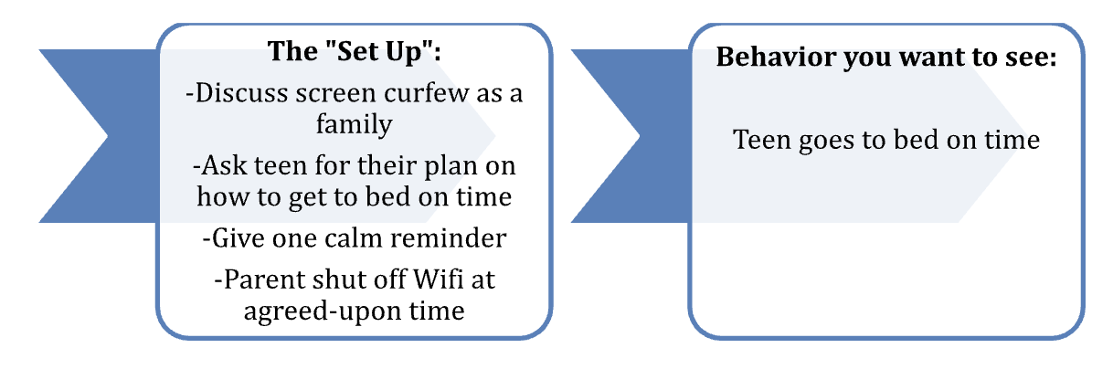
Antecedents: Practice
Example: Going to bed on time
Notes:
Get a “behavior you want to see” from the group. Work backwards, brainstorming ways to “set up” this behavior

Slide 53
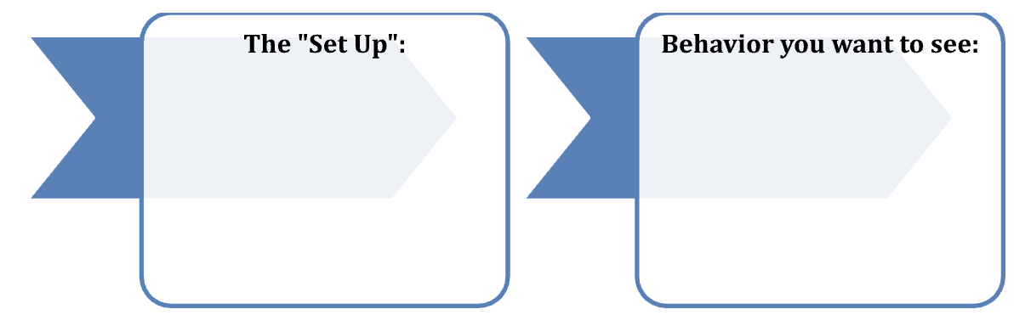
Antecedents: Practice
Example from the group:
Notes:
Get a “behavior you want to see” from the group. Work backwards, brainstorming ways to “set up” this behavior

Slide 54
Consequences: When-Then
Pair something they want to do with something they need to do
Need to Do | Want to Do
Complete morning routine | Pick favorite cereal
Clean up bedroom | Be the “DJ” during dinner
Complete math homework | Start screen time
Notes:
When-Then Instructions
Goal: “We will ask you to choose a couple of behaviors that your child “Needs to Do” that are difficult, frustrating, or not exciting for them. We will then pair those boring tasks with something your child “Wants to Do” to motivate them to get started and stick with it.
Key Concepts. Refer to Handout 10: When-Then Commands
Review instructions and examples together
In the first column, list behaviors your child needs to do that they don’t enjoy
In other column, list some of the privileges or positive things your child wants to do each day.
Draw a line between a Need to Do and a Want to Do behavior that would make a good pair. A when-then command lets the child know they can do the “fun” activity right after the less fun activity
Pair things that could happen close together in time
Make sure you define the “Need to Do” behavior very carefully and specifically, so there are no loop holes or gray areas. Refer to suggestions on effective commands above for this.
Think about how you will monitor that it was actually done.
Set reasonable goals well within the child’s ability (pick up clothes off floor before bed, rather than “keep room clean”). Criteria can be increased as the child is more successful. If the child fails to get the reward, they will give up more quickly the next time
Examples of When/Then commands:
When you finish your homework, then you can have your screen time.
When you get dressed, then you can pick out your favorite breakfast cereal
When you put on your shoes, then you can pick the music you want to hear in the car
If there isn’t a natural reward to link to the “Need to Do” behavior, you may choose a special extra reward that you will give to reward a behavior. See Handout 11: Examples of rewards and privileges. You could let your child help you brainstorm reward or privilege ideas.
Only give the reward after the target behavior, not on promise.
Give bonus rewards for especially great behaviors!
Ask parents to write down at least two When/Then commands they will try this week on Handout 10.

Slide 55

Reward Ideas
When: “You take the dog for a walk”
Then:
You can have uninterrupted Xbox time
I’ll make your favorite snack to take with you
Notes:
More ideas here on the handout.
Write in the chat: What is a privilege or reward your child would be motivated to earn?

Slide 56
Reward Ideas
When “You’ve made your to-do list for studying today”
Then:
You can have your phone back to listen to music
Your sister and will I leave to give you space
Notes:
More ideas here on the handout.
Write in the chat: What is a privilege or reward your child would be motivated to earn?

Slide 57
Consequences: When-Then
How will you use when-then with your teen?
Need to Do | Want to Do
Notes:
When-Then Instructions
Goal: “We will ask you to choose a couple of behaviors that your child “Needs to Do” that are difficult, frustrating, or not exciting for them. We will then pair those boring tasks with something your child “Wants to Do” to motivate them to get started and stick with it.
Key Concepts. Refer to Handout 10: When-Then Commands
Review instructions and examples together
In the first column, list behaviors your child needs to do that they don’t enjoy
In other column, list some of the privileges or positive things your child wants to do each day.
Draw a line between a Need to Do and a Want to Do behavior that would make a good pair. A when-then command lets the child know they can do the “fun” activity right after the less fun activity
Pair things that could happen close together in time
Make sure you define the “Need to Do” behavior very carefully and specifically, so there are no loop holes or gray areas. Refer to suggestions on effective commands above for this.
Think about how you will monitor that it was actually done.
Set reasonable goals well within the child’s ability (pick up clothes off floor before bed, rather than “keep room clean”). Criteria can be increased as the child is more successful. If the child fails to get the reward, they will give up more quickly the next time
Examples of When/Then commands:
When you finish your homework, then you can have your screen time.
When you get dressed, then you can pick out your favorite breakfast cereal
When you put on your shoes, then you can pick the music you want to hear in the car
If there isn’t a natural reward to link to the “Need to Do” behavior, you may choose a special extra reward that you will give to reward a behavior. See Handout 11: Examples of rewards and privileges. You could let your child help you brainstorm reward or privilege ideas.
Only give the reward after the target behavior, not on promise.
Give bonus rewards for especially great behaviors!
Ask parents to write down at least two When/Then commands they will try this week on Handout 10.

Slide 58
Home Practice
Watch the A-B-Cs for a behavior your teen struggles with
Discuss changing an Antecedent (setting up for success)
Plan a When-Then to motivate

Slide 59
Week 5
Problem Solving

Slide 60
Welcome back!
Home Practice review:
Noticing the A-B-Cs
”Setting up” antecedents
When-Then Rewards
Observations?
Insight?
Questions?
Notes:
Icebreaker question in the Chat: What is one when-then reward you used this week?
Which instructions traps did you struggle with?

Slide 61
Problem Solving
Conditions for problem solving:
  Teen feels heard and understood
  Teen and parent see that there is a problem (even if the problem is different for each of them)
  Teen believes parent will listen to their ideas
  Problem Solving Steps:
  Describe the problem (both sides)
  Join together to agree to try solving it
  Brainstorm ideas
  Evaluate ideas, pick the best one
Notes:
Does anyone have a problem solving process they already use with their teen?

Slide 62
Problem Solving Demo (Group)
Example Problem: Teen wants to go to a new friend’s birthday party on Saturday, but it’s grandma’s birthday dinner that night.
  Problem Solving Steps:
  Describe the problem (both sides, using “AND”)
  Join together to agree to try solving it
  Brainstorm ideas
  Evaluate ideas, pick the best one
Notes:
As a group, have a parent volunteer a scenario they’ve had with their teen recently, and call on parents to demonstrate each of the steps

Slide 63
Problem Solving Practice Examples
  1. Describe the problem (both sides):
  “You’re really wanting to go to this party, AND grandma has been expecting you to come to her dinner tonight.”
  2. Join together to agree to try solving it
  Validate: “I realize the party sounds more fun than grandma’s dinner.”
  ”Would you be up for talking through different solutions with me?"
  3. Brainstorm ideas:
  Stop by grandma’s beforehand? Make plans with friend a different night? Plan lunch with grandma tomorrow?
  4. Evaluate ideas, pick the best one
  “I imagine it sounds ideal to skip grandma’s dinner. What ideas do you have that will also make grandma happy?”
Notes:
As a group, have a parent volunteer a scenario they’ve had with their teen recently, and call on parents to demonstrate each of the steps

Slide 64
Problem Solving Demo (Group)
Example Problem: You want teen to spend Saturday with the family, but they only feel like playing Xbox.
  Problem Solving Steps:
  Describe the problem (both sides, using “AND”)
  Join together to agree to try solving it
  Brainstorm ideas
  Evaluate ideas, pick the best one
Notes:
As a group, have a parent volunteer a scenario they’ve had with their teen recently, and call on parents to demonstrate each of the steps

Slide 65
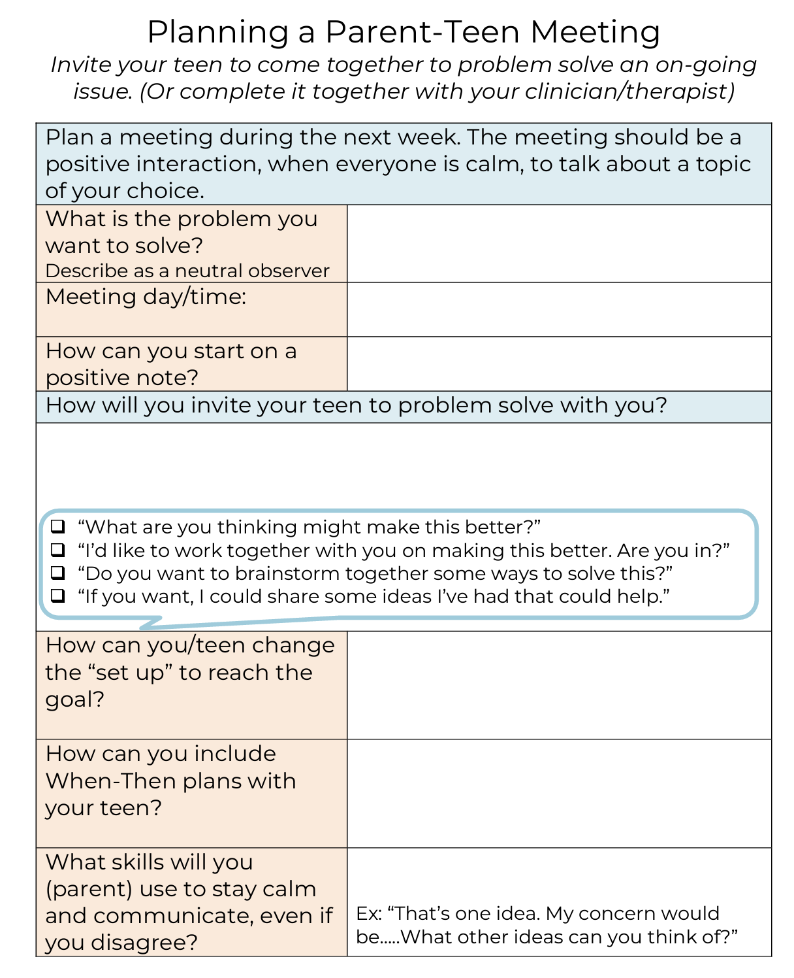
Parent Teen Meeting
Notes:
Think of a problem you’d like to solve with your teen. On the handout, plan how you can set up a meeting to discuss the issue with them.
NOTE: There may be some deadlocked issues that will be REALLY hard to solve. Start with something you think CAN be solved. Having success with that will give you both confidence for taking on a bigger problem later.

Slide 66
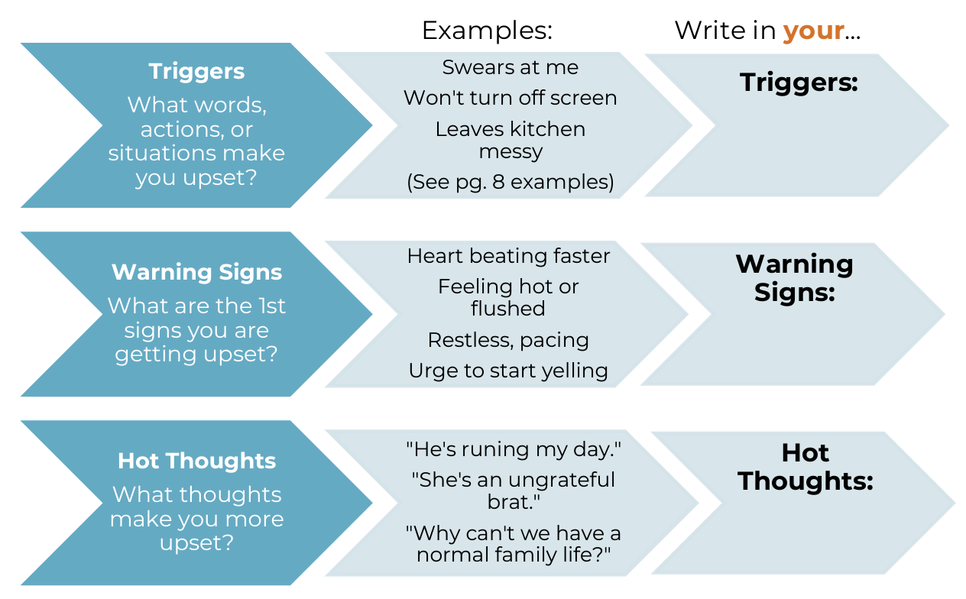
Parent Emotions
Notes:
Let’s be real, talking about problems or anything negative with a teen can get heated very fast. And it’s common for caregivers to feel ALL the emotions. Your own upbringing, culture, termperment, and mental health can make you react more than you wanted to.
Let’s work on a plan so you can walk into tough conversations as prepared as possible.

Slide 67
Crisis Cycle
3
Crisis/Red or Blue Zone
This is the emotional peak of the problem situation. This phase can include unsafe behavior toward self, others, and community, so be ready to manage safety. People don’t think well when they’re this upset. Your child’s yelling may be a trigger that casues you or other caretakers to escalate. Be aware of your own emotional state and be ready to use coping skills during this period.
To Do:
Use your Safety Plan.
Give space as appropriate to keep you and your child safe.
Use small words, short sentences; only one person should talk at a time.
Have different expectations.
Psychiatry and Behavioral Medicine
2
Escalation/Yellow Zone
When we are triggered, we show warning signs. Warning signs are an early indication that a problem or “crisis” is coming. Use an intervention when you first see warning signs that your child is triggered. This may help your child avoid a crisis. Interventions work best early on and are less likely to be successful as your child becomes more escalated.
To Do:
Listen.
Try to understand why your child is triggered.
Use your Safety Plan.
Help focus your child on a coping skill.
De-Escalation/Yellow Zone
₄ The “crisis” begins to calm. Because adrenaline
levels are so high, it can take over 30 minutes for
everyone’s body to return to baseline functioning.
To Do:
Do not problem solve yet. It will likely re-escalate your child.
Adrenaline is high - focus on safe high-energy activities to “burn off” the adrenaline.
Focus on using a coping skill.
Line of
“No Thinking”
What Are Triggers? Triggers are experiences that make us feel mad, sad, or upset.
Sometimes you can see triggers, and sometimes you can’t.
6
Return To Baseline/Green Zone
Your child is calm and stable. To Do:
Discuss the problem: What happened?
What started it? What could we have done differently? (Adult and child take turns sharing their thoughts.)
Teach new skills.
Discuss any consequences.
Update the Safety Plan and Coping Card
1
Baseline/Green Zone
Baseline behavior is behavior that is “normal” or typical. It looks different for everyone. This is the best time to talk about difficult topics, such as new rules and new schedules.
To Do:
Be proactive: There will always be problems, but there are strategies you can use to reduce them.
Problem solve.
Practice and model coping skills.
Safe proof your home.
Use and update the Coping Card.
Create a Safety Plan.
5
Post-Crisis Recovery/Gray Zone
Your child is feeling the aftermath of the adrenaline, so may be very sad, tired, remorseful, and/or hungry. They may sleep, cry, and be hard on themselves.
To Do:
Allow time and space to calm down.
Promote coping skills.
Do not discuss consequences yet.
3/20
PE1551
Notes:
The orange line is the “Line of No Thinking.” Once a child or adult passes that line, there is no reasoning, rationalizing, pleading or convincing that will get through to you. Your brain and body are flooded and the only thing that will help is some space and time for your bloodpressure to come down. You can use emotion coaching above the line, but your child will be more receptive if you do it before or after that peak.
What will YOU do if you pass that line? How will you get space? How will you know you’re ready to engage again?

Slide 68
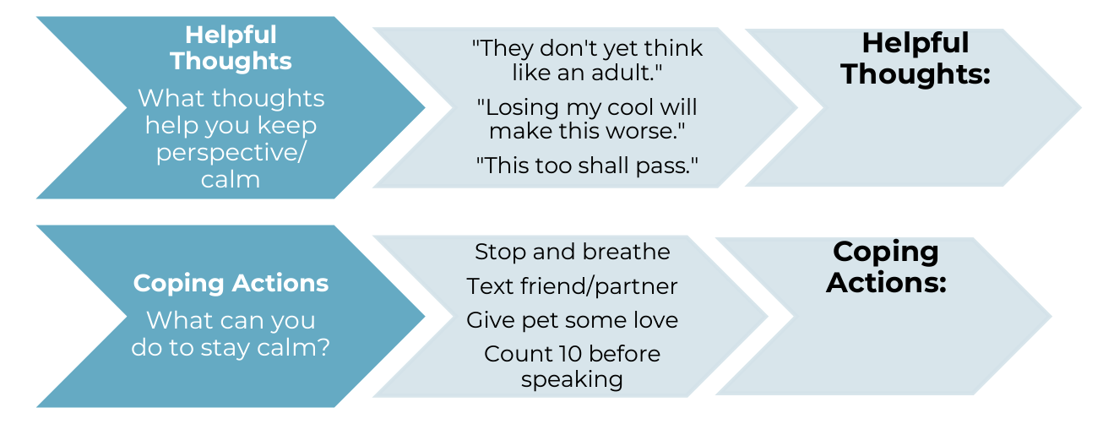
Parent Coping
Notes:
Write in one helpful thought, and one thing you can do to keep your cool in the moment.

Slide 69
Ways to practice
Plan a parent-teen meeting
Create your coping plan
Continue:
  When-then rewards
  giving positive attention
  planned ignoring
  effective commands

Slide 70
Week 6
Planning for the Future

Slide 71
Welcome back!
Home practice review:
Problem Solving Meeting
Parent Coping Plan
Other skills
Observations?
Insight?
Questions?
Notes:
Intro question for chat: What is one activity your child chose this week for special time? Also, any burning questions for us?

Slide 72
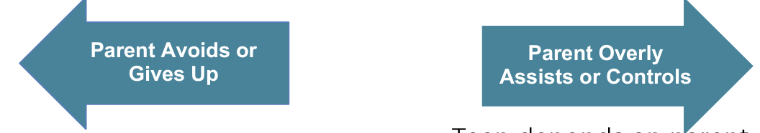
Finding a balance?
What does a middle ground look like for you?
How can you give a little more freedom, while keeping teen accountable for what they agreed to?

Slide 73
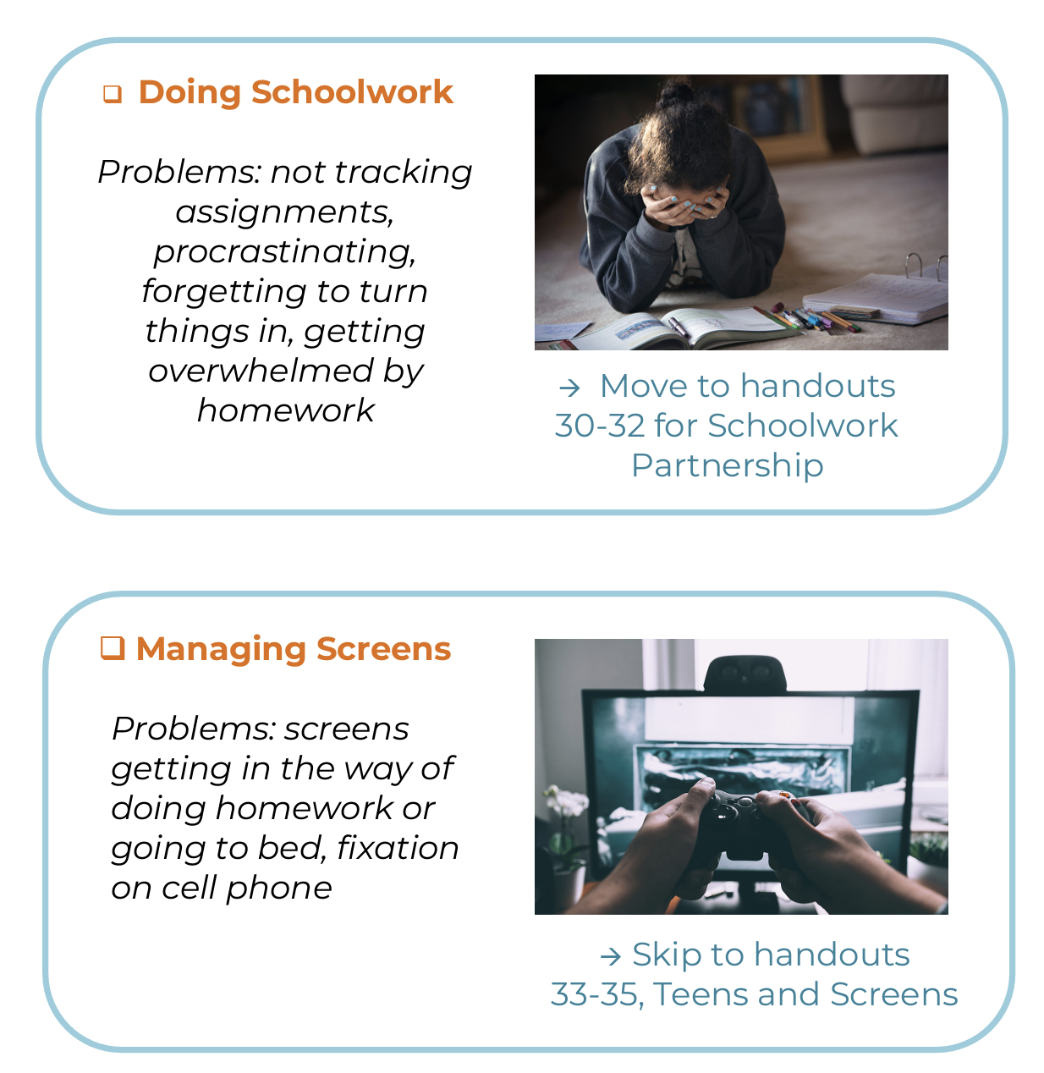
Let’s Problem Solve
Which is a bigger problem in your home?
Create a Homework Contract or a Family Media Plan for your family
Notes:
Today we will dig into a primary issue in your household. Which of these is the bigger problem right now?

Slide 74
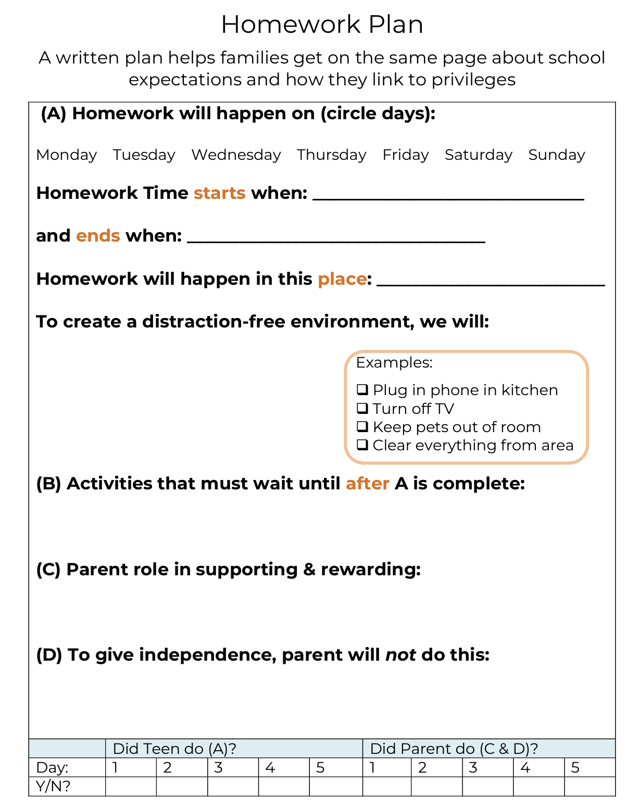
Homework Problems
See handouts:
Find balanced parent role
Which organizational skills is your teen missing?
Notes:
If you chose HW, See handouts about creating a HW plan together

Slide 75

What are the biggest screen challenges in your home?
Notes:
In the chat: What problems are you having with screens at home?

Slide 76

Creating Screen Limits
Guidelines for the whole family
Discussed at a family meeting
Linked to privileges and consequences
What do teens learn
from rules?
  Values
  Healthy limits
  Adults are in charge
  Self-control
Notes:
Roller coaster harness metaphor: When you put on a roller coater harness, what’s the first thing you do? Shake it! And you DON’T want to give – you are hoping it will hold firm. Same applies for children and rules. They feel safer and more in control knowing there are limits. They WILL test the rules, but they really want them to hold.
Parents establish rules to let children know what is expected of them (to do the right thing). Rules are appropriate for behavior that children should learn to do every time, without needing to be told, and so parents do not have to wait for misbehavior and then reprimand. Rules also help teach self-control and teach how to inhibit behavior (most children with ADHD need help with this!).
When behavior rules are being broken, no reminders, warnings, or stop commands are given! Instead, an immediate consequence is applied. “Since you broke the rule about XX, you now have a time out – or you now lose your TV time.” This helps motivate children to learn to stop their impulses themselves. Parents cannot anticipate misbehavior every time it might occur, and parents cannot be responsible for telling the child to stop every time they do something wrong (especially at school or with friends).

Slide 77

Family Media Plan
Without screen limits, other parenting limits won’t work!
Introduce screen time monitoring
Consider turning off internet router at curfew
Use FAST-P template or digital version on www.healthychildren.org
Notes:
If there are no limits on screens – your child will not want to do special time, will not be motivated by other privileges, and won’t hear your instructions. Must address screen boundaries to make the other skills work.
Check out www.healthchildren.org for an interactive digital version (free)

Slide 78
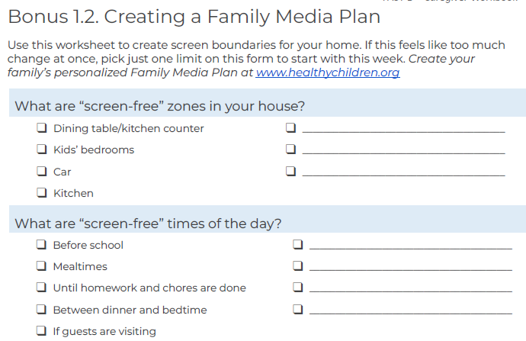

Slide 79
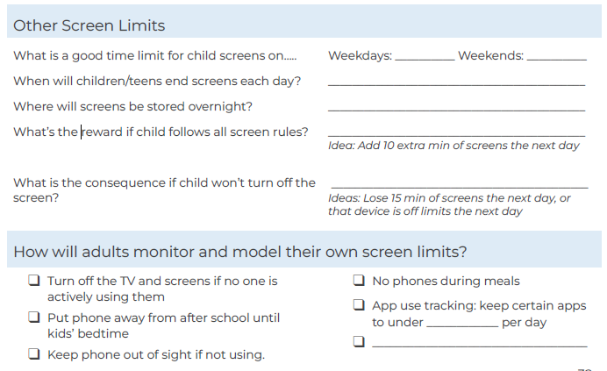

Slide 80
Screen Limit Examples
  No screens in bedroom
  No screens if guests over
  No screens at the table
  Limit of X time on screens per day
  Screen time starts after schoolwork/chores
  All screens remain charging in kitchen overnight
  Screen curfew is 8pm
  Limits on certain games
  Parents will put away their phones from 6-8 pm
Notes:
Will anyone share successes with any older skills we didn’t yet discuss?
Any barriers or questions?

Slide 81
Partner Up
Which is a bigger problem in your home?
Create a Homework Contract or a Family Media Plan for your family

Slide 82
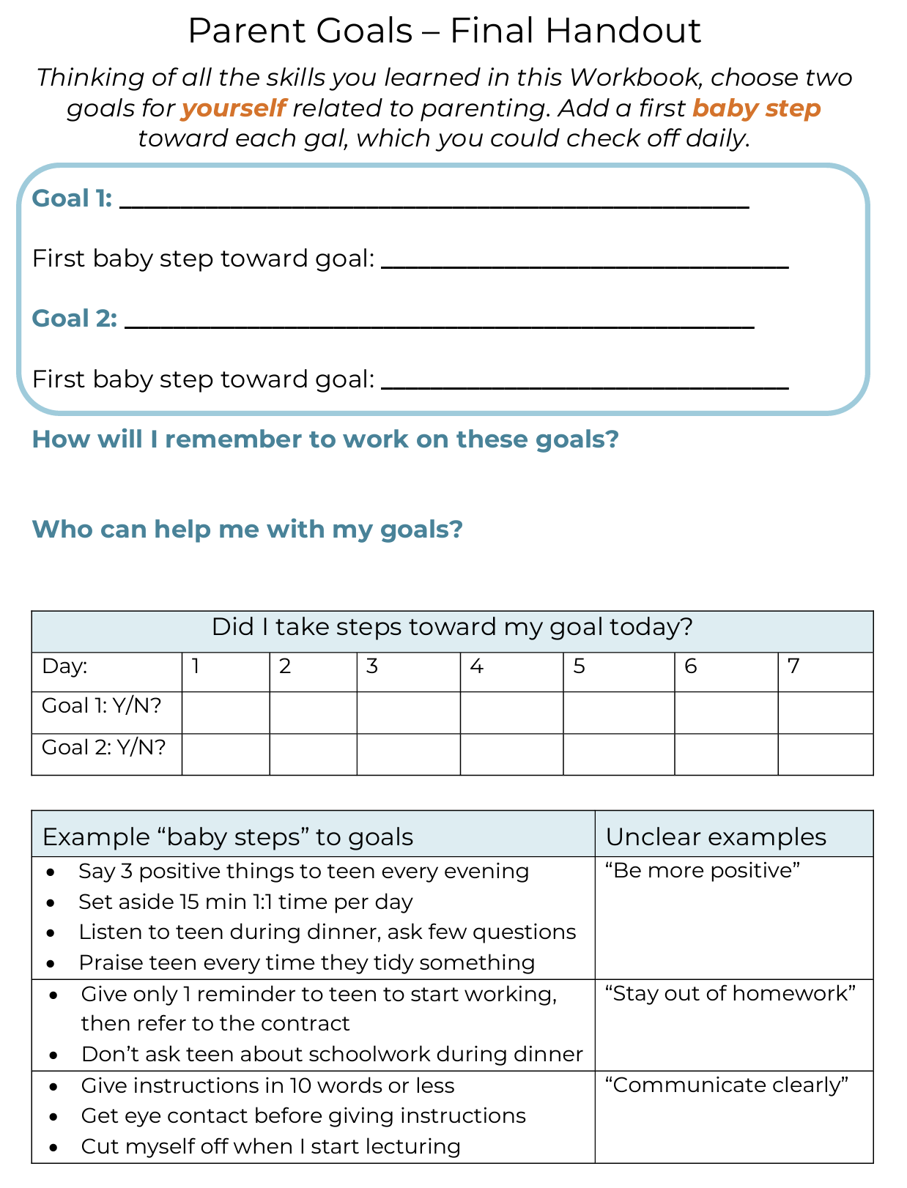
Your Goals
When-Then Rewards
Privilege removal
Time out
Screen Limits
Notes:
Will anyone share successes with any older skills we didn’t yet discuss?
Any barriers or questions?

Slide 83
Review of skills
Family Patterns
One-on-one time
Catch ‘Em being good
Planned Ignoring
Changing Antecedents
When-Then Rewards
Parent Coping
Problem Solving Meeting
Homework Plan
Screen Limits
Notes:
Will anyone share successes with any older skills we didn’t yet discuss?
Any barriers or questions?

Slide 84
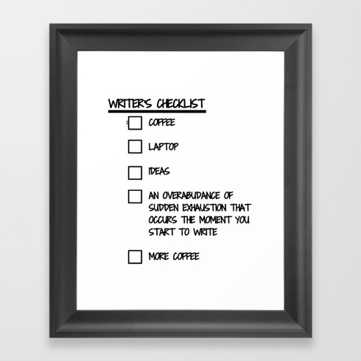
How will you keep using skills?
Digital reminders
Visual reminders
Partner check-ins
Teach another parent
New family traditions
Frame a checklist of skills, check them off!
Notes:
How have you remembered so far?

Slide 85
Planning for the Future
What other needs does your teen have?
  Educational
  Mental Health / Emotional
  Medical
  Social
What needs do you have?
Talk to your child’s doctor about more resources
Notes:
Encourage action items – talking to teacher/school, learning about IEP/504, consult with PCP about meds, look for therapies to treat a MH condition, signing child up for activities to have more social opportunities

Slide 86
Thanks for joining us!

