Slide 1
First Approach Skills Training Early Childhood (Fast-E)

Slide 2
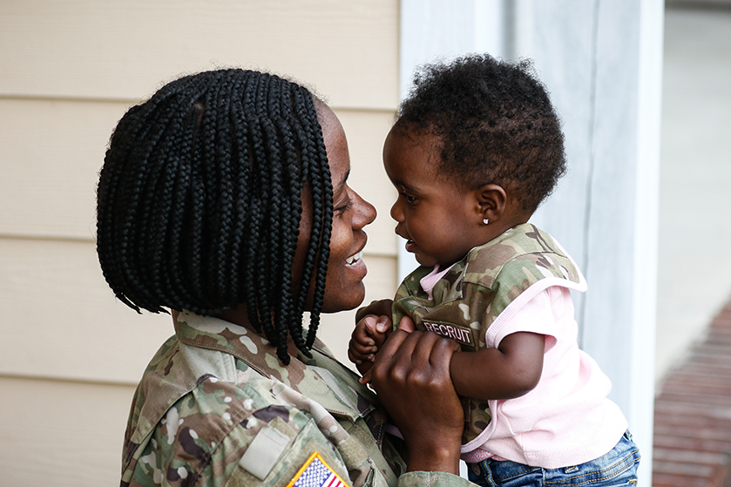
Week 1
Boost your Child’s Development

Slide 3
Welcome to group!
Please log into Zoom early, we will start right on time
Label yourself on Zoom:
Your name (child’s name – age)
Example: Tim & Ellen (Lina- 4)

Slide 4
TeleGroup guidelines
Please do:
Turn on your video!
Mute when not talking
Prop up device
Use the chat, hand raising, and “reaction” emojis anytime
Use big nonverbal communication to support each other
Try to remain in one place

Slide 5
TeleGroup guidelines
During group, please avoid:
Driving
Calling from a public place
Cooking meals
Multi-tasking
Privacy: Please keep other families’ information private

Slide 6
What is FAST-E?
Parenting in Early Childhood: joy, excitement, and challenges!
FAST-E:
Tools for common early childhood challenges
Builds a strong parent-child connection while boosting development
Created with psychologists from Seattle Children’s Hospital Partnership Access Line.
Grounded in evidence-based parenting programs
Notes:
Note, the program will not change your child’s temperament altogether, or get rid of ADHD.
We may decide together that you want or need more support than this program, and I will help you determine what that additional help might be.
1. Evidence-based skills
a. “The skills we will practice are part of “well-established” treatments for kids with disruptive
behaviors and come from programs that are found by research to be effective.”
b. This type of treatment is called Parent Behavior Management Training
2. What to expect
a. Skills focus: “Each time we meet, I will introduce something new to try out with your child at
home, and we will troubleshoot how it went the next time we meet. This program will only work
if you try out the things we talk about. Each skill builds on the previous one, so they work best
together as a package. The more you put into working on these things outside of our meetings
here, the more change you will see in managing your child at home.”
b. “You may have already tried similar things and found they haven’t worked. However, for an
especially challenging child, the usual strategies need to be tweaked, and that’s something we
will do together. This program will give you the structure and support to practice using and
fine-tuning these strategies successfully.”
c. “Finally, I will warn you that some kids may resist new changes at home, so there will be ups and downs. Things may get worse before they start to get better. We’ll be here to talk about it every step of the way.

Slide 7
Who is FAST-E for?
Ages 1-4 (+ or -)
Top Concerns
Tantrums/Behavior
Difficulty regulating emotions
Difficulty with parent-child connection
Sleep problems
Transitions/Routines
Caregiver burnout
Early life stressors

Slide 8
Introductions
Leaders
You/your child
Child’s name and age
Something you love about your child
Something you hope to learn from group
Notes:
Ask families to keep their intro to about 1 min

Slide 9
What are the social-emotional needs of young children?
…of their parents?
Consistency
Safe base
Affection
Mirroring
Modeling
Back-and-forth
Validation
Comfort
Venting/outlet
Brainstorming/guidance
Connection (with adults)
Notes:
ice breaker, ask group the question before showing the answer

Slide 10
Why Does My Child Act Like That?
Most behavior has a purpose. If we understand what our child is trying to tell us with their challenging behavior, we can help find better ways of meeting their needs.
Possible Messages | Needs to be met
“I don’t feel good.” “I need your help.” “I don’t know how to calm down” “This feels good!” “I can make adults react.” “I have energy to get out!” “I need entertainment!” “I need you right now.” “I can’t handle this on my own” “I need predictability and safety” “I want a say in what I do” “New things are scary” “I don’t know what’s happening” | Food Rest Calm and quiet Soothing Space Sensory stimulation Entertainment Access to fun Security/safety Connection Attention Control Predictability, routine
Notes:
Self care is key to caring for your children

Slide 11
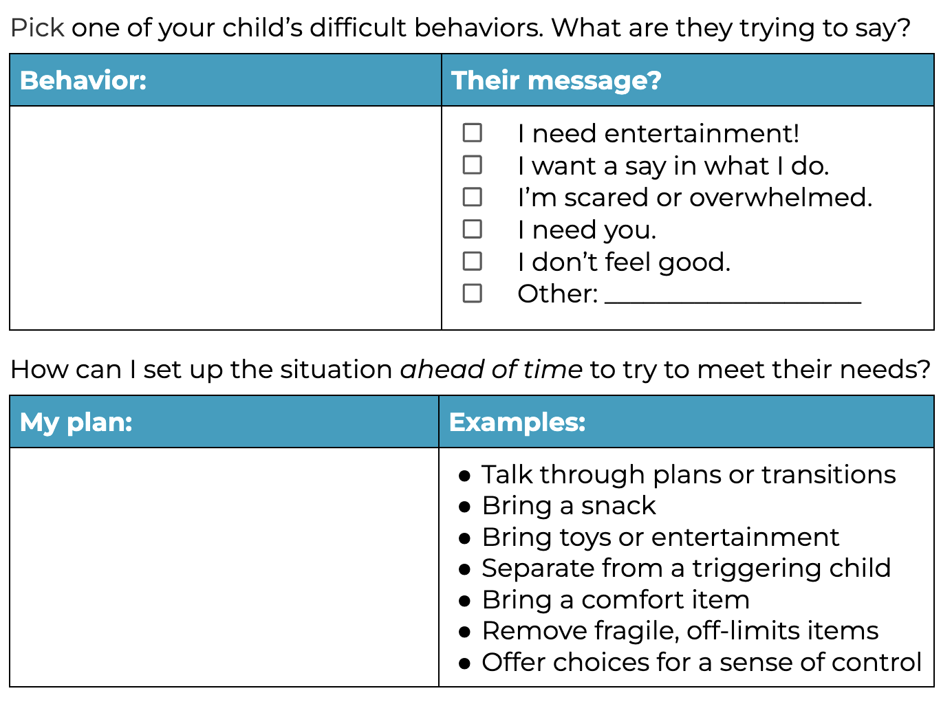
Tuning Into Behavior Messages
Notes:
Self care is key to caring for your children

Slide 12
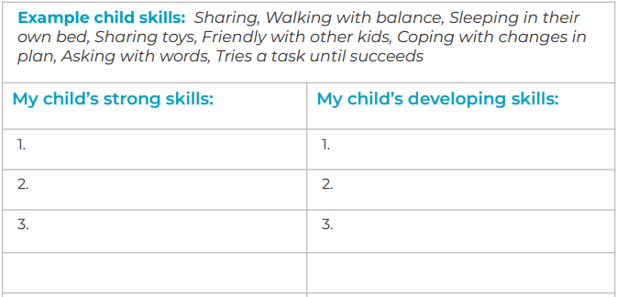
Strengths & Challenges: Your Child’s Skills
Notes:
Have each family spend a few minutes brainstorming child’s strong skills and what may be developing.

Slide 13
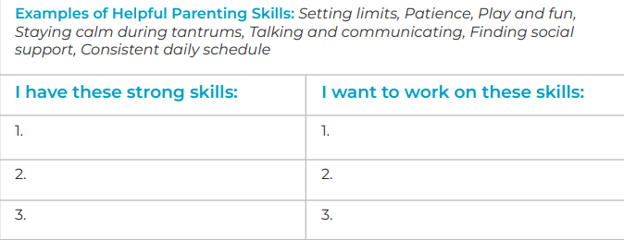
What Skills Do You Bring to Parenting?
Every parent has natural skills to boost development.
List parenting skills or attributes you have and those you are still developing.
Notes:
Have Parents add their own and co-parent skills and if time, share with group.

Slide 14
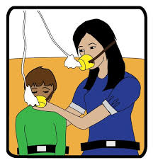
It’s True: Parenting Self-Care is Key
You Are the Center of Your Child’s World
Children tune into your mood, energy, and feelings.
Your well-being is a priority:
Your emotional well-being directly impacts your child’s ability to thrive
Regular self-care is essential for both you and your child
Notes:
Self care is key to caring for your children

Slide 15
Finding Time for Self-Care
The challenges?
Even simple activities like going out with friends or taking a peaceful shower can be difficult for busy parents.
Try This:
Daily 5-minute “Calm Moments” using one of your 5 senses:
Vision
Smell
Taste
Touch
Hearing
Notes:
Everyone knows we’re supposed to be doing self care. So why is this so hard? Why don’t we do it?
Have the group discuss what are some of their “go tos” for self care. How do they find time or others to support in this process?
THIS IS IMPORTANT. Maybe the most important.
Practice: On a scale of 1-10, how much stress/overwhelm do you feel right now? Drop it in the chat
Let’s practice this for 2 min
-What are 3 things catching your visual attention
-What are 2 smells?
-What is the taste in your mouth right now
-What is the feeling of your clothes on your skin? The chair on your legs or back? Your feet on the floor? Pressure, warmth, texture.
-What 3 sounds can you hear?
Now drop your 1-10 rating in the chat. Did it change?

Slide 16
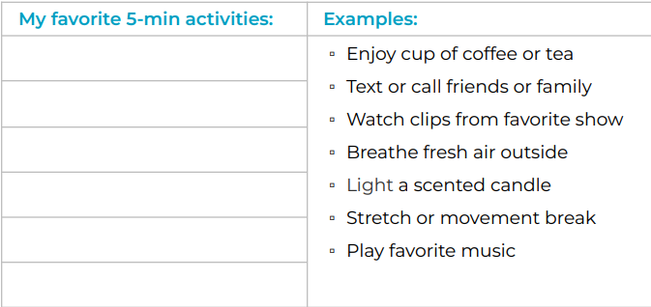
Reflect: What Brief Activities/Experiences give you joy, peace or calm?
When could you squeeze in these calm moments during the day?
Notes:
Everyone please write in a couple of activities you can commit to TRYING OUT this week on this handout in our workbook. Or star an example you will try.
Let’s try SCHEDULING THIS IN, rather than just doing it as distraction.
WHEN can you do this?

Slide 17
Home Practice
Tune into a challenging behavior
What is your child trying to say?
Can I predict what triggers the behavior
Parent self-care
5-minute coping
Notes:
Everyone knows we’re supposed to be doing self care. So why is this so hard? Why don’t we do it?
Have the group discuss what are some of their “go tos” for self care. How do they find time or others to support in this process?
THIS IS IMPORTANT. Maybe the most important.
Practice: On a scale of 1-10, how much stress/overwhelm do you feel right now? Drop it in the chat
Let’s practice this for 2 min
-What are 3 things catching your visual attention
-What are 2 smells?
-What is the taste in your mouth right now
-What is the feeling of your clothes on your skin? The chair on your legs or back? Your feet on the floor? Pressure, warmth, texture.
-What 3 sounds can you hear?
Now drop your 1-10 rating in the chat. Did it change?

Slide 18
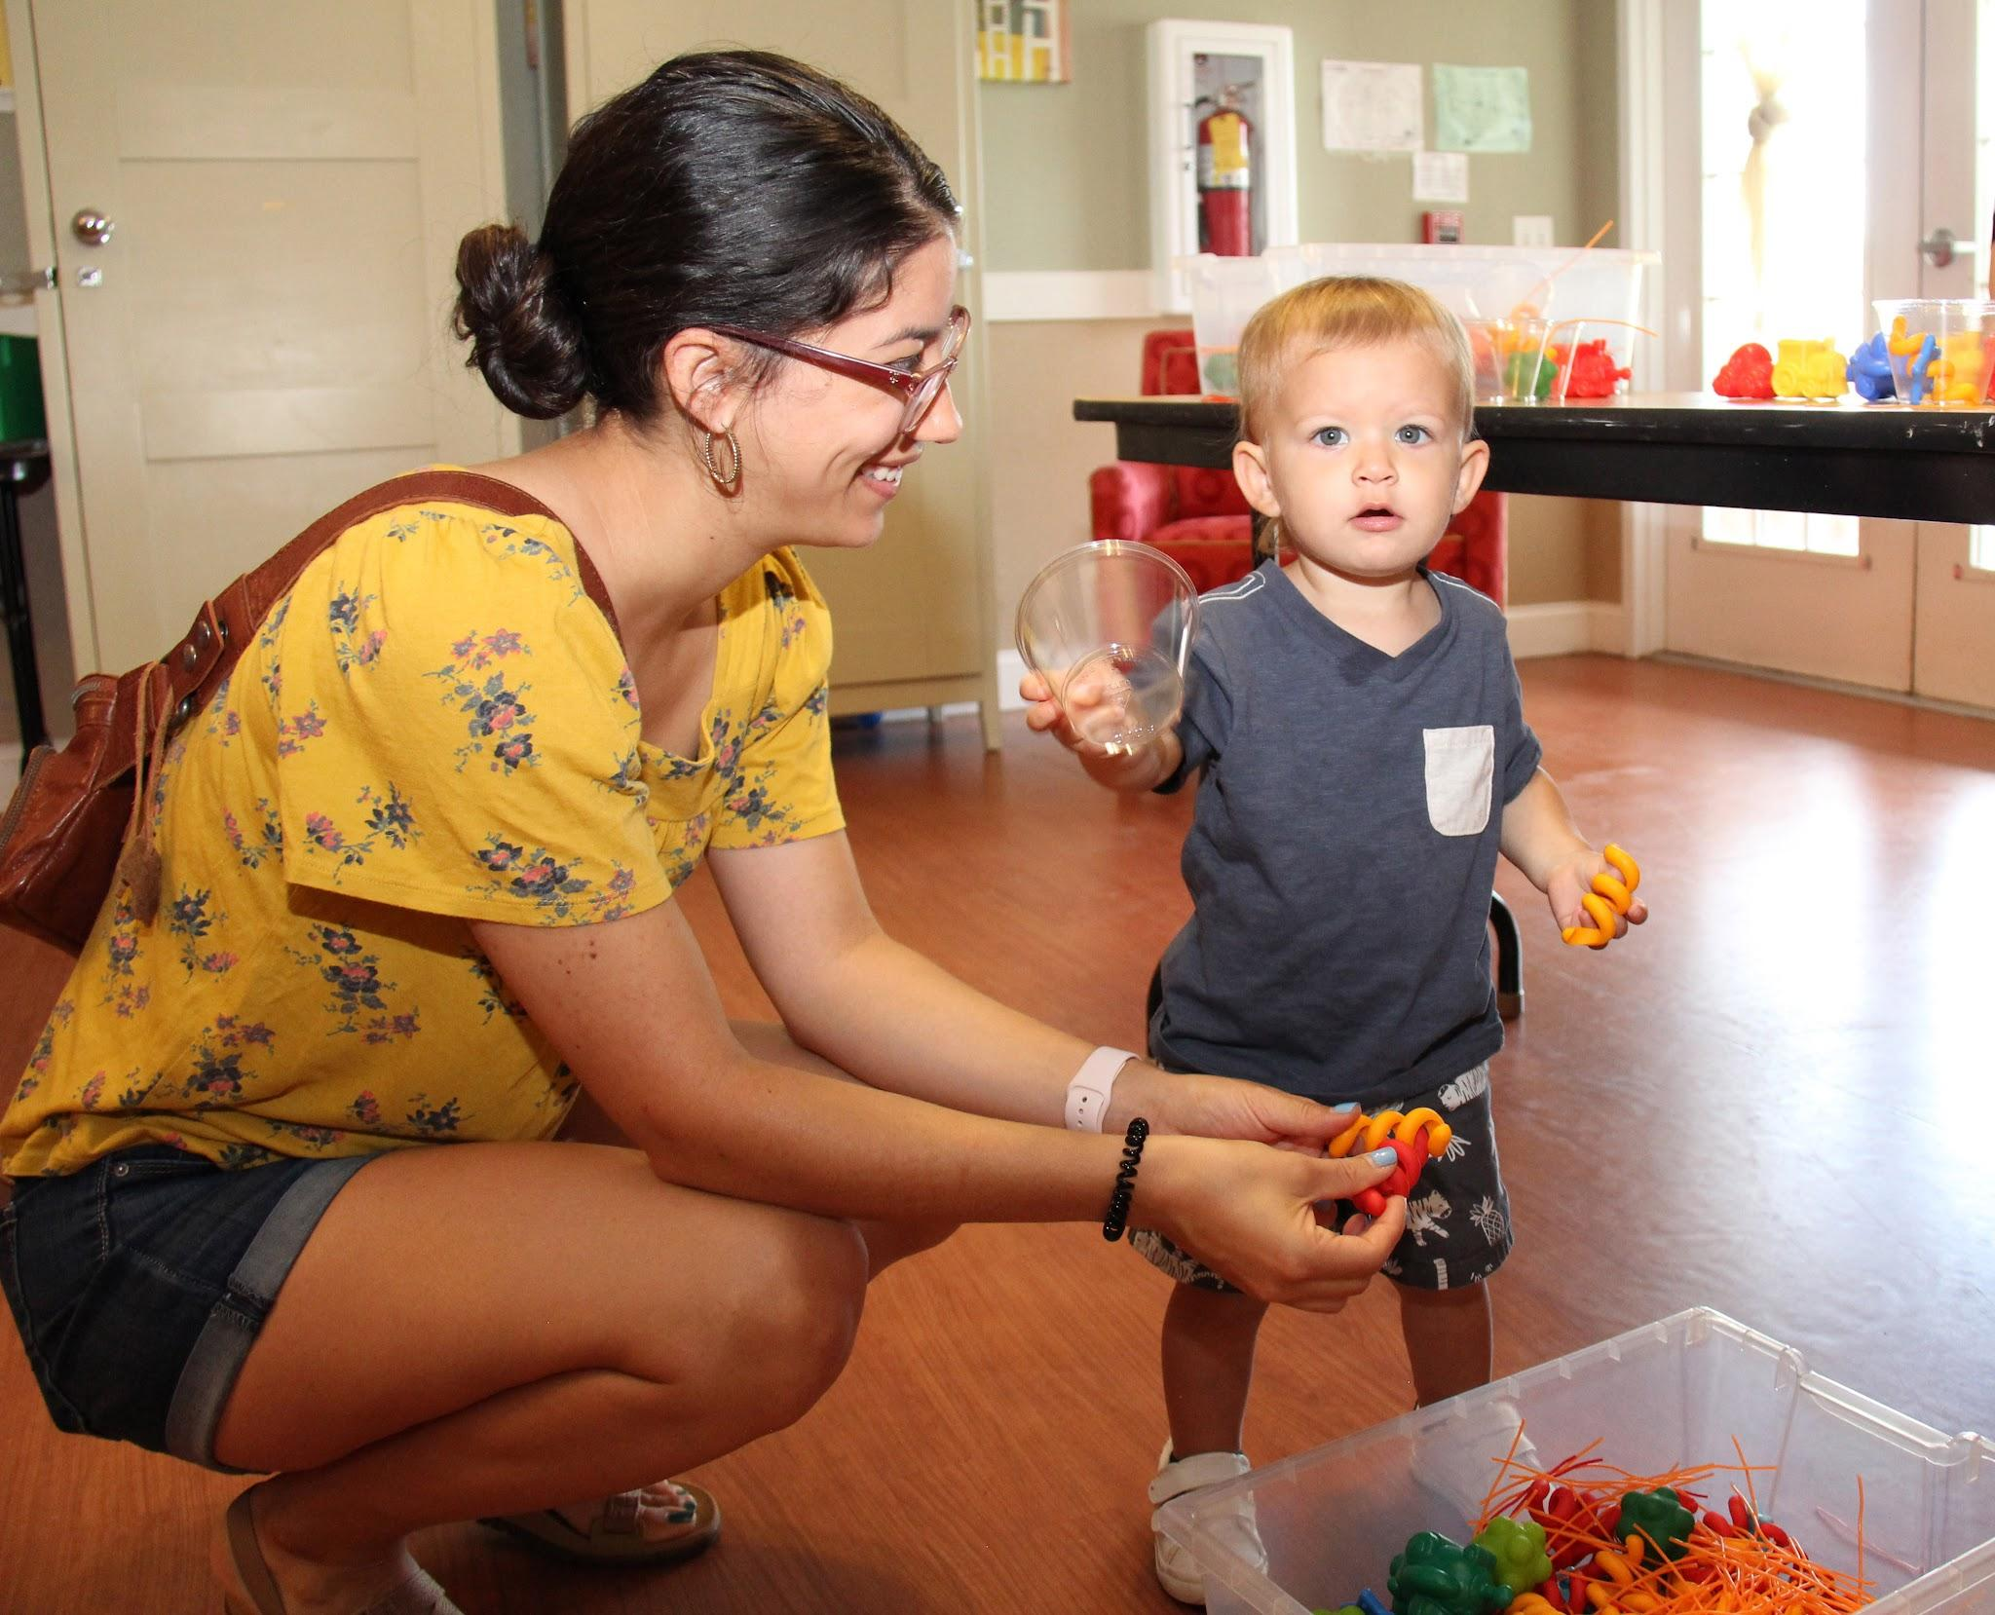
Week 2
Serve & Return and Special Time

Slide 19
Welcome back!
Home Practice review:
Parent Coping
What did you do?
How did it feel to prioritize yourself
Tuning into Challenging Behavior
What did you notice?
Were you able to prevent any challenging behaviors?
Observations?
Insight? Questions?
Notes:
What success did you have with Serve and Return? What did you notice? How did it feel?
Who can share a success story to start us off?
Later: Who ran into challenges?

Slide 20
What is Serve & Return?
Goal: Respond positively to your child’s cues to build strong brain connections.
How to:
Child “Serves”
They say, look at, or do something.
You “Return” the Serve
Name or copy what they are doing, looking at, or experiencing.
Provide support and encouragement.
Key Reminder:
Only “return” neutral, calm, or positive behaviors.
Do not return aggression or destructive behavior.
Special Time Tips
Notes:
ASK: What is 1 serve your child did today that you COULD return? What would you say?
Get a couple people to share exactly what they would say. Ask everyone else to drop an example in the chat?
Ask parents share some serve and return experiences they have already engaged in.
Ask parents to complete Handout 1 if they haven’t already

Slide 21
What is Serve & Return?
Example:
Notice what your child is doing or saying. Your child is picking up an apple.
Copy sounds, words, expressions, actions “Apple! You have a RED apple!”
Notice what your child does next? Copy that! “Now you are biting the apple.”
Notes:
ASK: What is 1 serve your child did today that you COULD return? What would you say?
Get a couple people to share exactly what they would say. Ask everyone else to drop an example in the chat?
Ask parents share some serve and return experiences they have already engaged in.
Ask parents to complete Handout 1 if they haven’t already

Slide 22
Serve and Return Benefits
Benefits
Promotes connection and mimics turn-taking.
Fosters focused attention.
Builds language and communication skills.
Impact
Helps children communicate when angry or overwhelmed.
Provides a foundation for setting limits and managing challenging behaviors.
Notes:
Elicit this from the group.
What are the benefits of returning your child’s “serve?” What are the benefits for YOU as a parent?

Slide 23
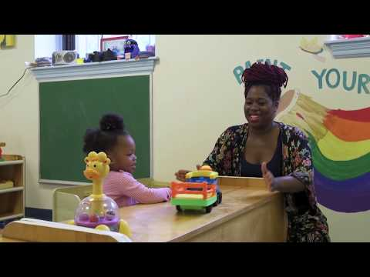
Serve & Return Video
https://www.youtube.com/watch?v=KNrnZag17Ek
Notes:
https://www.youtube.com/watch?v=KNrnZag17Ek
This skill is the foundation of all early childhood EBTs. We are teaching not only a positive engagement strategy, but we are teaching caregivers to read their child, understand and empathize, and respond more effectively. This strategy is key not only in the relationship, but also in speech development and learning other developmental skills.
Does anyone do this already with families?
Let’s watch the video.
AFTER: What stood out to you here? Which aspects would be compelling to your patients? Which aspects would be a challenge, or aversive? Any angles you think would help caregivers be open to trying this?

Slide 24
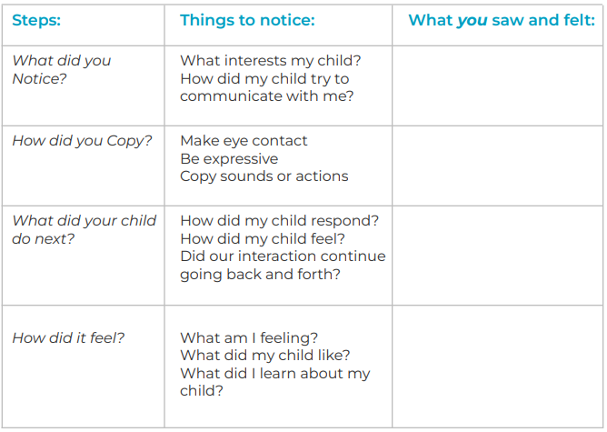
Activity - Practicing Serve and Return
During calm moments when you see your child wanting to interact, use ‘Serve and Return’ and track how it goes:
Notes:
Ask parents to complete this

Slide 25
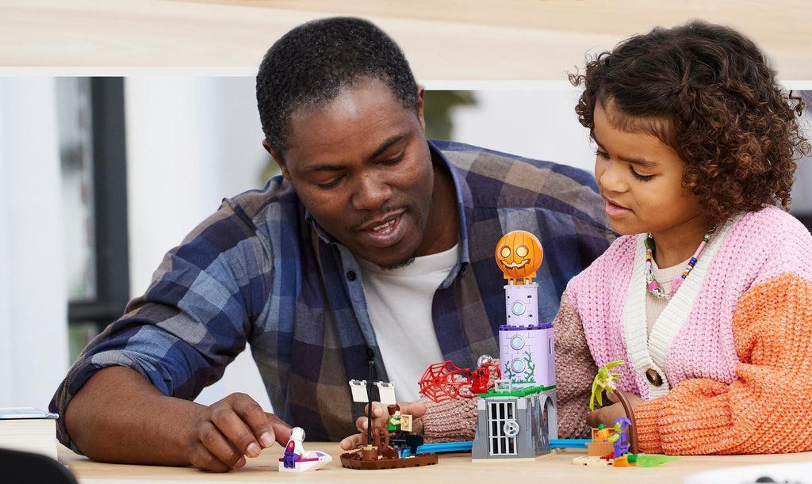
Special Time
Goal
Use play to strengthen your relationship with your child and teach skills like sharing and cooperation.
The Value of Play
Children learn about emotions and positive behavior through play.
Playful “serve and return” builds communication and brain development.
How Special Time Helps
Improves child behavior.
Boosts motivation to cooperate.
Strengthens connection and self-esteem.

Slide 26
How to Practice Special Time
Schedule 10-15 minutes daily
One-on-one if possible.
Let your child lead
Offer activity choices and let them pick.
Use “serve and return”
Respond to what they are looking at, doing, or saying.
Be a “Sports Commentator”
Describe out loud any positive behavior, just like narrating a game on the radio.
“You’re focusing so carefully, sorting the pieces by color.”

Slide 27
Special Time Do’s and Don’ts
Special Time DON’Ts
Giving instructions or suggestions.
Asking questions (interrupts their flow).
Teaching the “right way” to do something.
Criticizing or correcting minor misbehaviors (e.g., making noises).
Why Avoid These?
They work against the goal of boosting a positive connection.
Special Time DOs
Set a timer.
Let your child choose and lead the activity (offer options if needed).
Keep “Sports Commentator” comments flowing!
Follow along if your child changes activities.
Ignore minor misbehaviors (e.g., messiness).
Praise positive behaviors like:
Sharing, cooperation, persistence, problem-solving, coping, and focus.

Slide 28
Special Time Activity Ideas
Dolls, action figures, animal figures.
Play pretend or dress-up (e.g., house, superheroes).
Child “reading” or looking at a book.
Go outside or take a walk.
Build a fort.
LEGOs or blocks.
Crafts, coloring, or drawing.
Play with a pet together.
What would your child choose?
Notes:
What would you choose?

Slide 29
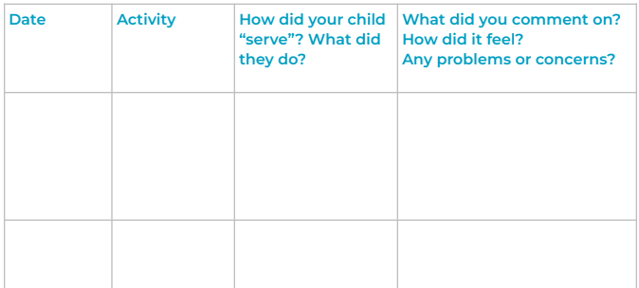
3.3 Special Playtime Tracking Sheet:
Notes:
Introduction: “We are going to start using the principle of positive reinforcement to increase positive
behaviors and help your child learn new skills.”
B. Discuss 3 important points about rewarding/praising behavior:
1. “Good behavior only continues as long as it is noticed. Think about how you feel if you go out of your
way to make a really nice dinner for your friends and no one says anything about it. How likely will you
be to do that again?”
2. Consistent: “If you want to teach a new behavior, reinforcement need to happen EVERY TIME. It can be
less frequent after your child has really learned these new skills.”
3. Immediate: “It needs to occur in the moment at the same time as the behavior is happening, otherwise,
the connection between the behavior and the positive attention is lost.”
4. New behaviors need to be shaped:
a. “Reward small behaviors that come closer and closer to the exact behavior you want your
child to learn.”
b. “Recall your child learning to walk. You laughed, applauded with pulling up, cruising, and first
steps rather than waiting until he walked across the room.”
c. Example: “If goal is getting dressed independently, praise each step of this (putting on shirt,
socks, etc), rather than waiting until they are completely dressed to praise.”

Slide 30
Home Practice
Watch video “serve and return” again (optional)
Practice serve and return anytime!
Schedule and practice Special Time
Notes:
Review the FAST-E Snapshot Handout: fast-e-caregiver-snapshot.pdf
Serve and Return

Slide 31
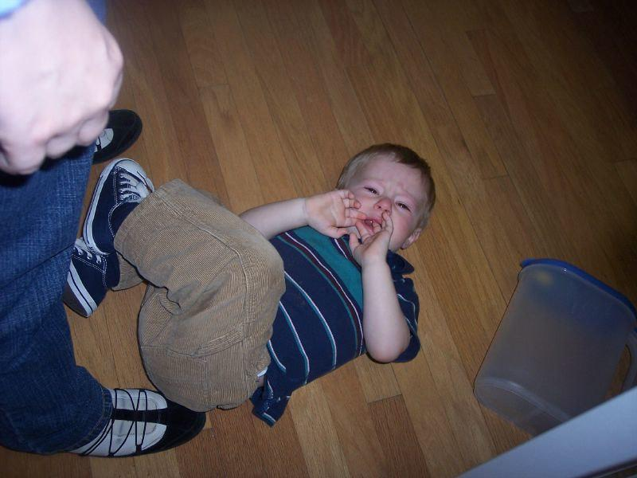
Week 3
Responding to Emotions

Slide 32
Welcome back!
Home Practice review: Serve and Return
What did you do?
Wins and challenges?
How did that time affect your child’s
behavior?
Special Time
Observations?
Insight? Questions?
Notes:
What success did you have with Serve and Return? What did you notice? How did it feel?
Who can share a success story to start us off?
Later: Who ran into challenges?

Slide 33
Child Emotional Development
Young children cry, shout, cling, or throw things to communicate needs
Caregivers can help children:
Notice and name their feelings
Tune into others’ feelings
Learn self-soothing techniques
Replace problematic behaviors with better communication
Early emotion skills contribute to success in school and life
Notes:
Adults need to learn to not take emotions personal and look at expression in a way that child is trying to communicate some need or want

Slide 34
3 Ways to Support Your Child’s Emotional Development
Teach About Emotions
Notice and name feelings
Soothe emotions with comfort while minimizing attention to misbehaviors
Model Coping Skills
Talk them through your process
Show your child how you handle your own emotions
Soothe and Support
Encourage self-regulation and problem-solving
Provide comfort and reassurance.
Reflect: What do you want your child to learn about feelings? How do children learn about feelings?
Notes:
group leader provide some examples: “it looks like you are feeling angry!”; allow your child to agree or disagree and open communication

Slide 35
Teach About Emotions
Tool 1: Label Parent Feelings
Use simple emotion words for yourself.
Example: “I’m feeling angry because the dog chewed up my shoe.”
Tool 2: Label Your Child’s Feelings
Guess and name what your child might be feeling.
Tool 3: Discuss & label feelings in others
Picture books, siblings, other children

Slide 36
Emotion Coaching
Coping starts with noticing and naming emotions.
Which emotion words do you want your child to learn?

Slide 37
Comfort with Words
The goal: Help your child self-soothe while giving less attention to “not ok” behavior.
Soothing language:
Physical Touch: Stay close and get on their level:
Hugs, back rubs, holding hands.
Take deep breaths together.
It’s okay if they don’t want touch!
Teach Self-Soothing and Distraction
Choose a “calm down” spot (e.g., bean bag, corner).
Model coping skills (e.g., deep breaths) and emotion words (“I’m angry, Mommy!”).

Slide 38
Model Coping Skills
Kids learn by watching, especially parents!
Model how to handle emotions when you’re happy, sad, or angry.
Use child-friendly words to talk about your emotions.
Show Self-Soothing Techniques:
What are your best coping skills?
How can you narrate/talk through these skills when you use them?

Slide 39
Soothing Emotions
Is your child ready to be soothed?
Physical soothing
Verbal soothing
Using distraction
Give LESS attention to unsafe behavior while gently setting physical limits
See handout 4.3
Notes:
When kids are most escalated they usually do not want to be touched at all. Soothing may be accepted better as they start to cool down.

Slide 40
Home Practice
Continue Practicing Serve and Return
Schedule Special Time
Label your and your child’s feelings
Which coping skills do you want to model?

Slide 41
Week 4
Detour: Tantrums!

Slide 42
Welcome back!
Home Practice Review:
Special Time
Naming emotions
Self-soothing skills
Observations?
Insight? Questions?
Notes:
Share a success from Serve and return or special time

Slide 43
Detour: Tantrums!
Tantrums Are…
Frustrating, disruptive, embarrassing, annoying... and 100% expected!
A normal type of early childhood communication
Goal:
Predict and avoid tantrums when possible
Respond to tantrums calmly and consistently
Don’t make it worse!
Model that feelings are ok and you and your child can handle them

Slide 44
Action Steps for Handling Tantrums
Plan for tantrums | Notice your child’s triggers and warning signs that a tantrum is coming, prevent or plan ahead
Provide calm and safety during the storm | Stay near while giving them space and quiet
Help your child recover | Show them you can accept and handle their feelings
Notes:
Have you noticed what triggers your child? Any patterns? Can you predict a “meltdown”? How can you distract or make a plan?

Slide 45
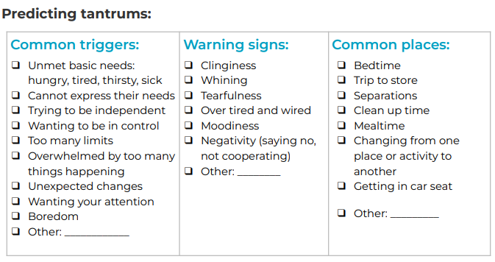
The Rising Tantrum

Slide 46
Ways to try to avoid a full-blown tantrum:
Change the Situation:
Get outside (leave the house/car)
Changing surroundings can help distract your child
Use Humor:
Say or do something goofy and unexpected
Give cheek or belly kisses
Distract & Redirect:
Point to a different game, toy, or snack
Whisper to capture attention
Offer a sensory activity (e.g., water play, squeezing a soft toy)
Give Your Child Words:
Reflect their feelings: “You are mad.”
Reflect their wants: “You want to stay longer.”
Suggest solutions: “Let’s ask for help: ‘help me, mama/dada.’”
See handout 5.1
Notes:
recommending having two strategies prepared…

Slide 47
Staying Calm and Providing Safety During Tantrums
When you can’t stop the storm, focus on:
Physical Safety: Move your child to a safer area
Emotional Safety: Offer consistency and support. Say LESS.
“I love you and I’m here to help you calm down when you’re ready.”
Don’t Fuel the fire
Talk less to avoid rewarding the tantrum.
Briefly turn attention away if needed
Stay close to show you’re there and ready to reconnect when your child calms down
Reassure Your Child
Use calming language: “We can practice calming down together.”
Let the tantrum run its course while maintaining their safety and your calm demeanor.
Notes:
How do you keep yourself calm and from feeling pressured from others or the environment?

Slide 48
Reflect
How will I provide physical safety for my child?
How will I provide emotional safety for my child?
Notes:
Share in group or jot some ideas down. Practice and being prepared will make a big difference in confidence and ability.

Slide 49
Hold Limits During and After Tantrums
Why Limits Matter:
Tantrums often happen when adults say “no” or set limits (e.g., “No sweets before dinner”)
Giving what the child what they want when tantruming teaches that the tantrum gets them what they want
If a tantrum works “sometimes,” kids will keep trying it
When “Not Ok” Behavior Continues:
Give space (talk less and do less) until child is calmer
Try redirecting or distracting child
If behavior cannot be ignored, remove child to quieter place and monitor safety
Notes:
Sometimes parents reward or “give in” to avoid confrontation or dealing with it and to reassure their own emotions of guilt or feeling badly about children being dysregulated

Slide 50
Recovering from a Tantrum
Keys:
How you respond after the tantrum is crucial
Re-establish safety, security, and love while holding firm limits.
Do’s
Stay close and model how to calm down (breathe together).
Reconnect with cozy time (hugs) or an “I love you” ritual.
Help your child find a safe activity.
Distract by moving on to a positive topic or activity.
Don’ts
Show more anger
Give additional punishments.
Lecture, shame, or criticize.

Slide 51
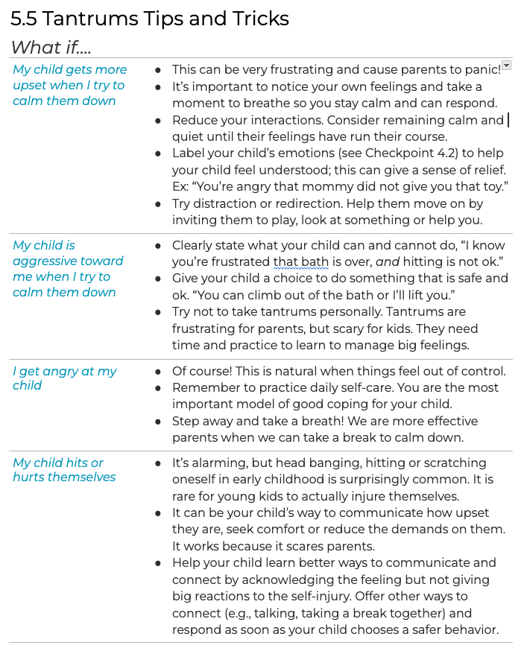
Notes:
Alert parents that there is a Tips & Tricks sheet that looks like this. They can refer to this for more ideas to solve specific tantrum problems.

Slide 52
Remember
Tantrums are scary and exhausting for children.
Big emotions are painful, and they need help to process them.
Reconnection helps your child feel safe and loved.
Comforting is NOT giving in!

Slide 53
Coping Strategies for Caregivers
THINK:
“He’s still little, his brain is still growing.”
“She is only 3 years old. This is hard for her.”
“I won’t take the bait. I can be the adult here.”
“I can model ways for them to cope.”
“My child’s behavior is not my fault.”
Other: ___________________________
DO:
Take 4 deep breaths.
Focus on 3 things you see.
Focus on what went well today.
Pet the dog or cat.
Drink sips of cold water.
Other: ___________________________
What are your best coping strategies?

Slide 54
Home Practice
Complete your Tantrum Plan and try it out!
Keep record of triggers or patterns
Continue with:
Special Time
Parent Self Care
Emotion Coaching & Modeling

Slide 55
Week 5
Independence: Routines & Instructions

Slide 56
Welcome back!
Home Practice review:
Handling Tantrums
Self Care
Responding to Feelings
Special Time
Observations?
Insight? Questions?
Notes:
What was a “win” this week? What was a challenge and how did you manage this?

Slide 57
Offering Planned Choices
Goal
Help your child follow directions by offering them choices
Give them a sense of control and independence
Key Benefits
Builds communication and positive behaviors
Supports self-confidence
Improves transitions and consistent routines
Routines Help Kids:
Know what to expect and feel safe
Build confidence and independence
Reduce behavior problems by minimizing overwhelm and disappointment during changes
Notes:
Again, offer choices that still meet parents goal

Slide 58
Planned Choices Examples
Notes:
If you find yourself saying “BUT,” stop. You’re able to un

Slide 59
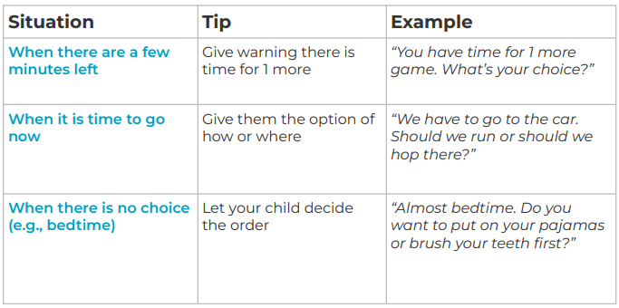
Handling Hard Transitions
When Compliance is Non-Negotiable,
Give choices about how to comply.

Slide 60
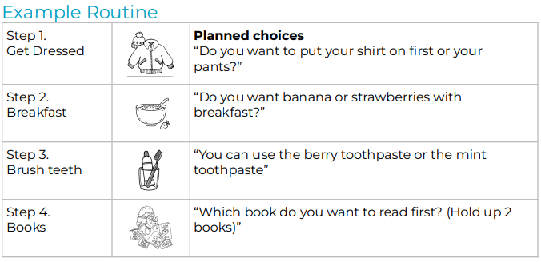
Visual Routine with Planned Choices
Create a routine with pictures and planned choices to help with tough times of day!

Slide 61
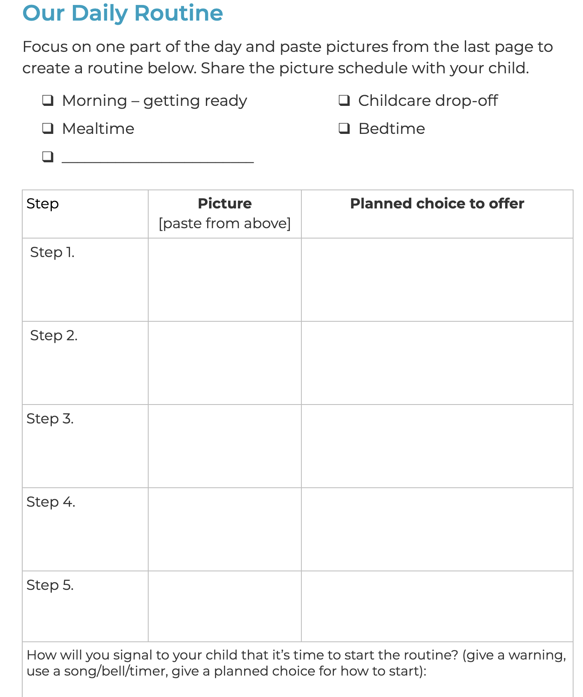
Create Your Routine
Home Practice:
Create a routine with pictures and planned choices to help with tough times of day!

Slide 62
Home Practice
Add “Planned Choices” to your instructions
Focus on giving clear instructions
Create a daily routines picture schedule
Continue with:
Special Time
Parent Self Care
Emotion Coaching & Modeling

Slide 63
Week 6
Instructions & Limits

Slide 64
Welcome back!
Home Practice review:
Handling Tantrums
Planned Choices
Consistent Routines
Observations?
Insight? Questions?
Notes:
What was a “win” this week? What was a challenge and how did you manage this?

Slide 65
Boosting Following Directions
Goal: Help your child learn expectations and follow directions
Benefits:
Clear limits help children learn and grow safely and confidently
Best Practices
Model desired behaviors
Encourage, coach, and practice until they master it
Give the message: “I know you can do it. I am on your side. I notice what you do.”
Notes:
use supportive, patient language. Give yourself and your child TIME. Setting limits is comforting to children

Slide 66
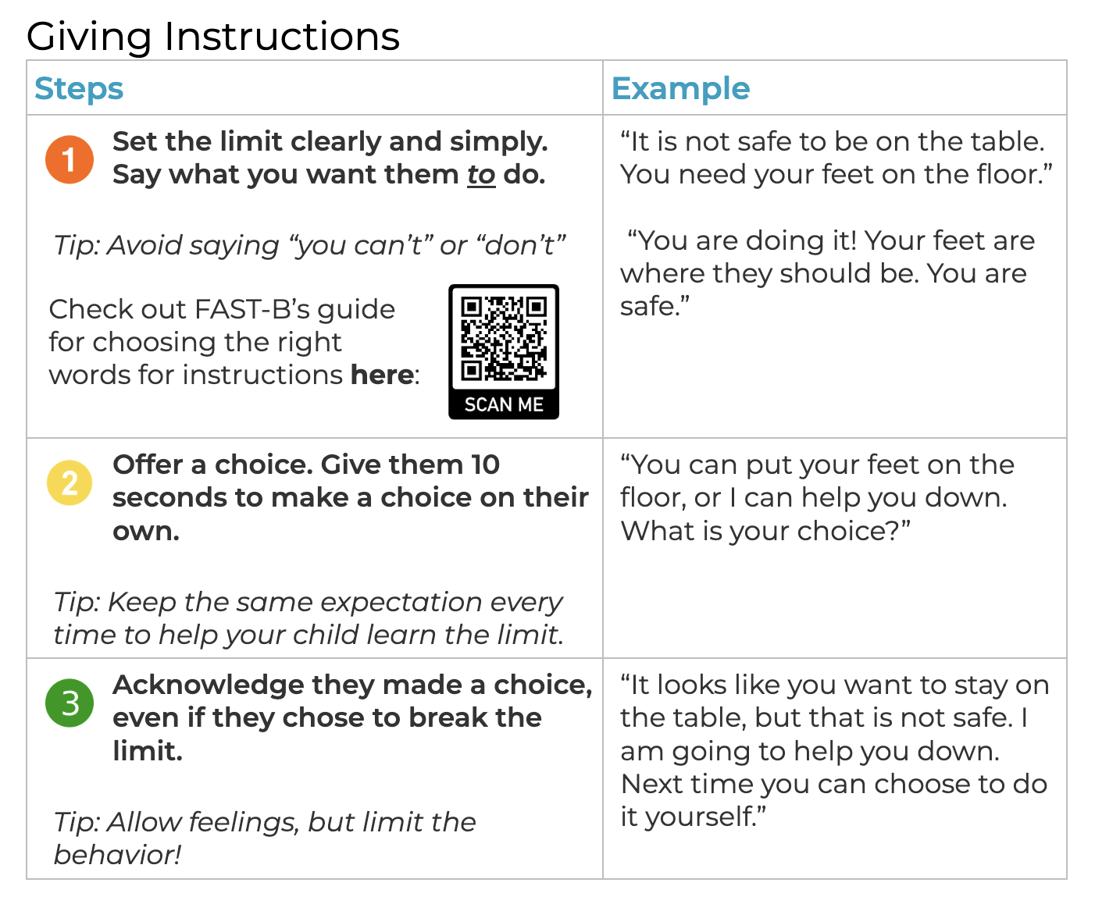
Steps for Giving Instructions

Slide 67
Clear Instructions (FAST-Behavior)
Notes:
Consider including your preschooler in making their own “big kid” chart or coloring or engaging them in the plan

Slide 68
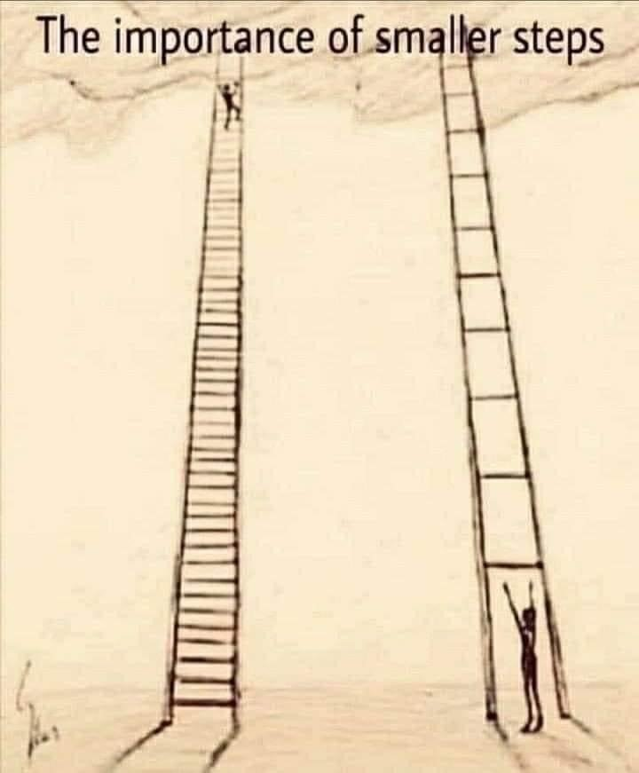
Effective instructions
Get your child’s attention
Direct and specific
Only one at a time
Followed by 10 seconds of silence
Praise any steps toward compliance
Notes:
Consider including your preschooler in making their own “big kid” chart or coloring or engaging them in the plan

Slide 69
Rephrase this instruction….
“Let’s get ready to go!”
Notes:
Consider including your preschooler in making their own “big kid” chart or coloring or engaging them in the plan

Slide 70
Rephrase this instruction….
“You need to clean up this mess”
Notes:
Consider including your preschooler in making their own “big kid” chart or coloring or engaging them in the plan

Slide 71
Setting Limits Practice
Step 1: Identify Problem Behaviors (Choose 2-3): ❑ Hitting ❑ Running ❑ Throwing ❑ Biting ❑ Climbing on furniture ❑ Grabbing things from others ❑ Other: _________________________

Slide 72
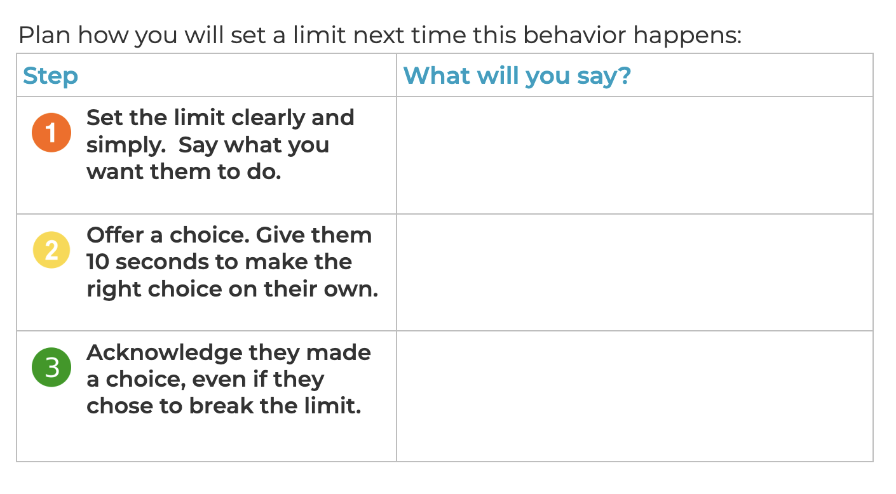
Plan Your Response

Slide 73
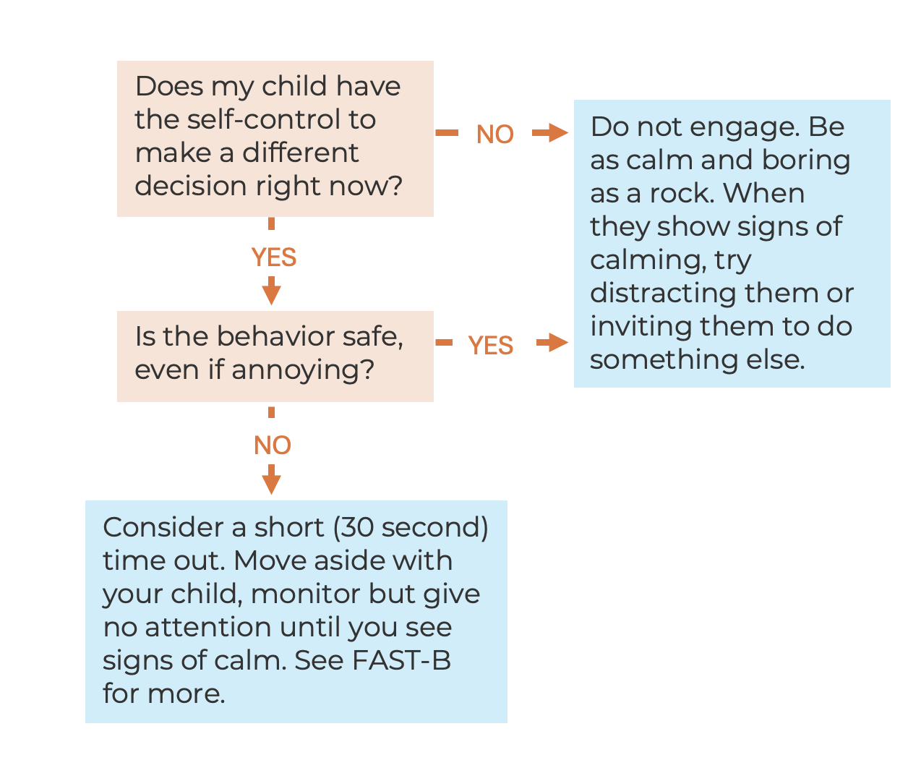
When “not ok” behavior continues
Options:

Slide 74
Other topics in FAST-E:
Notes:
Check out these bonus checkpoints if any of these topics are relevant to you.

Slide 75
What’s Next?
Which FAST-E skill was most helpful?
Which FAST-E skill do you want to prioritize practicing?
What’s your parenting goal for this week?
How will you remember to practice?
Let us know: What other resources do you need?
Notes:
Check out

Slide 76
Thanks for joining us!

