Slide 1
Mood and Anxiety in Autism
Stephanie Pickering, PhD
Rachel Earl, PhD
Soo-Jeong Kim, MD
March 19, 2020

Slide 2
Each person with ASD can look different!
Sleep Deficits
Mood
Hyperactivity/Attention Difficulties
70% of children with ASD have at least one additional diagnosis by adolescence…
Anxiety/OCD
Restricted and Repetitive Interests/Behaviors
Social Communication Deficits
Intellectual Disability
Seizures
Language Disability
Irritability
Self Injury
Tantrums
Aggression

Slide 3
Anxiety and ASD
Rates of anxiety higher in ASD than in other groups (Bellini, 2004; Gillot & Standen, 2007; Green et al., 2000; Russell & Sofronoff, 2005; White et al, 2009, Van Steensel et al, 2011)
44-55% of children with ASD meet criteria for an anxiety disorder (White et al, 2009);
Children with ASD often do not display age-typical symptoms of anxiety (White et al., 2009)
  Changes in schedule, specific phobias, reactivity to sensory input, externalizing behaviors

Slide 4
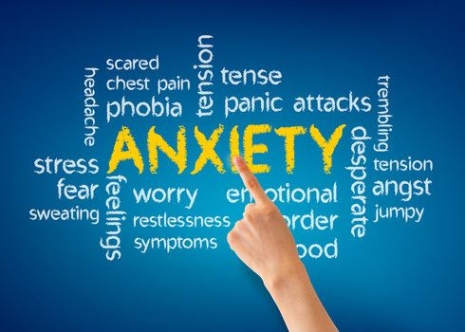

What is anxiety?
Excessive fear and worry where there is a perceived imminent or future threat
Triggers the need to flee/escape
Experienced as bodily sensations (e.g. heart racing, tummy ache), especially in preparation for future anxiety-provoking situations
Response to perceived danger gets in the way of completing activities at home and/or school

Slide 5
What is OCD?
Obsessive-compulsive disorder (OCD) includes two parts:
Intrusive thoughts that are disturbing and worrisome (i.e. obsessions)
Habitual actions that reduce distress over intrusive thought (i.e. compulsions)
Together, these form a reaction to anxiety that gets in the way of daily life at home or at school
Example: Obsessive thought: “If I touch a doorknob, I will get sick from germs” → Compulsion: excessive hand-washing and cleaning
Example: Obsessive thought: “What if I leave the back door unlocked and someone breaks in and hurts me?” → Compulsion: repeated checking that door is locked

Slide 6
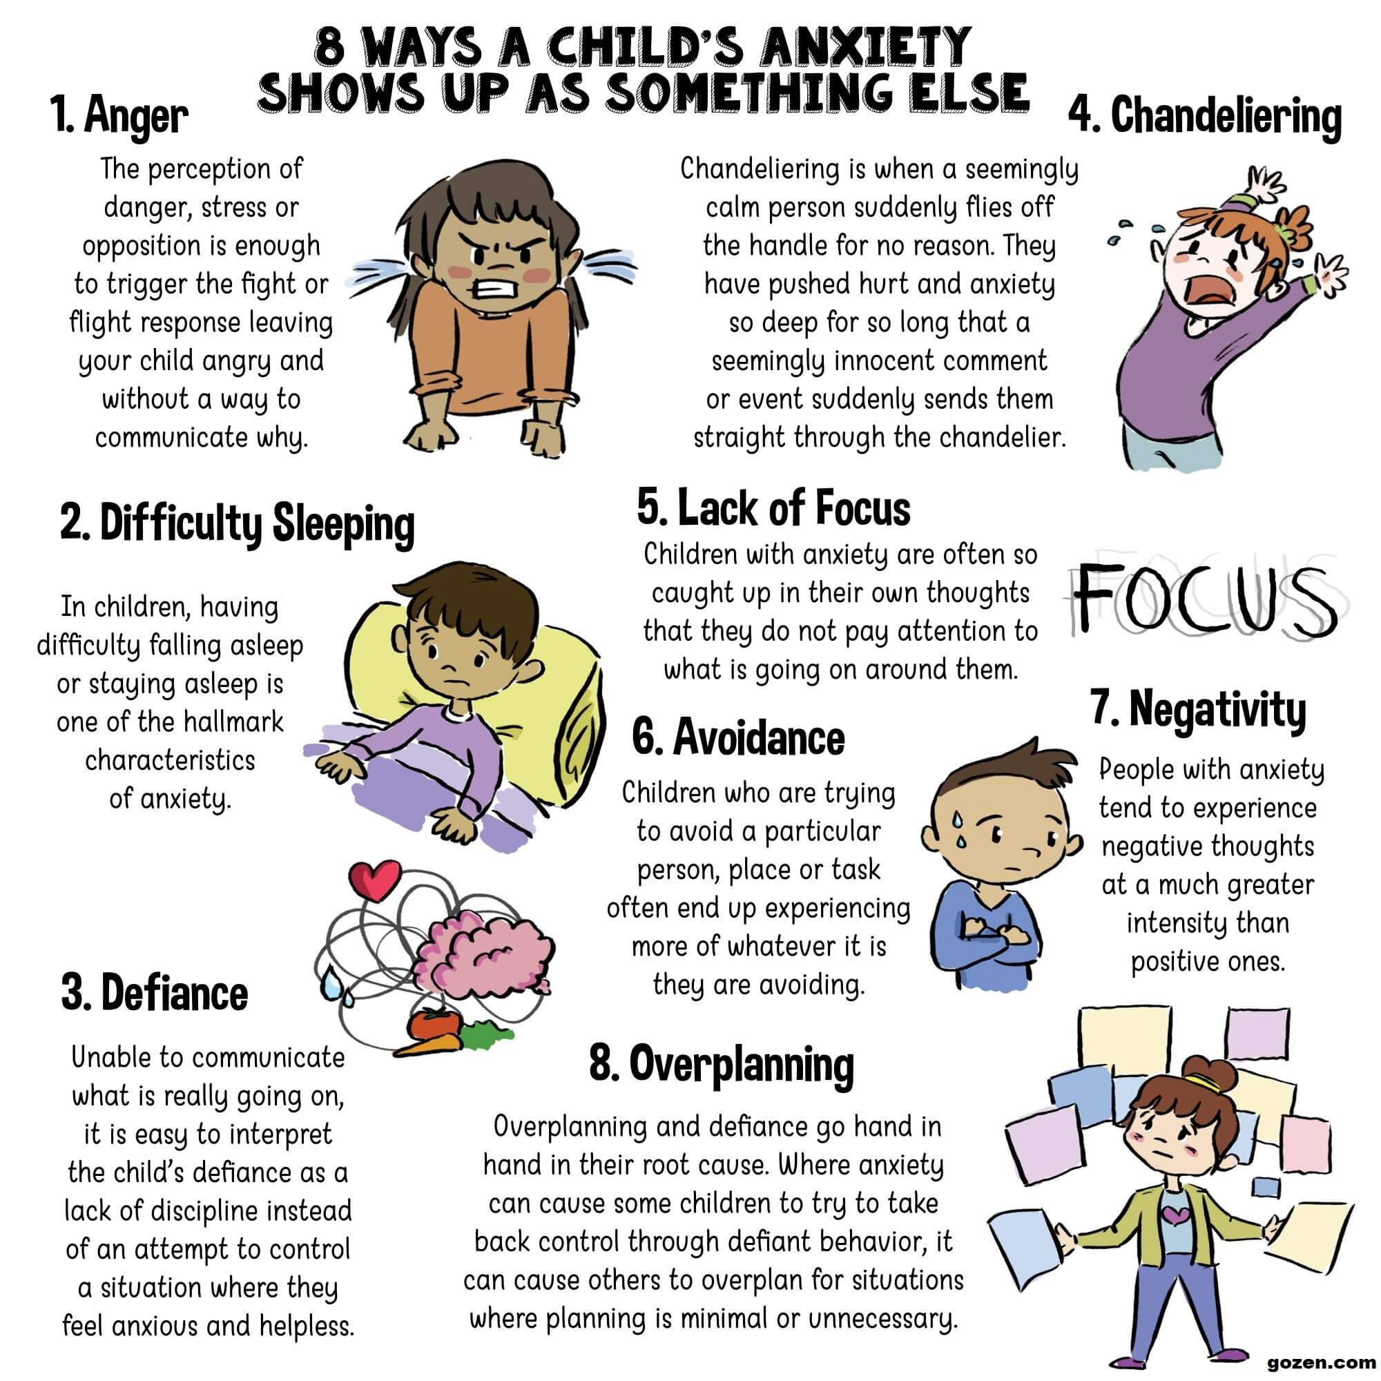
Anxiety can look different in children and teens

Slide 7
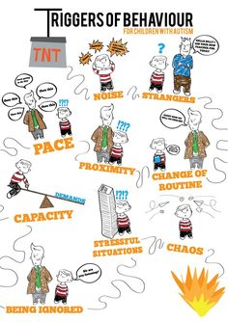
Is this anxiety or is this ASD? It may be both!
Does my child actively avoid situations at home or at school?
Does my child regularly seek reassurance from me that something will or will not happen?
Has my child come up with rituals that they have to do or have me do in stressful situations?

Slide 8
Common sources of anxiety
Separation from caregiver
Germs
Insects
Dogs
Medical procedures (i.e., needles)
Performance (e.g., taking a test, presenting in front of class)
Perfectionism
Natural disasters
Bad things happening to loved ones
Social interactions/Talking to new people
Rule breaking
Additional ASD-related anxiety triggers:
Transitions
Disruptions in routine (e.g. substitute teacher)
Disruptions in environment (e.g., new haircut for mom)
Unpleasant sensory experiences (e.g., fire drills, toilets flushing)

Slide 9
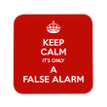
How to explain anxiety to children
Anxiety is normal: Everyone experiences anxiety (taking tests, public speaking, riding a rollercoaster).
Anxiety is not dangerous: Even though it may feel uncomfortable it’s temporary. Most people don’t even know your anxious.
Anxiety is adaptive: It helps us know when to fight, flight or flee for real danger! Or else we would all walk into oncoming traffic!
Anxiety can become a problem: When your body reacts to danger in the absence of real danger. Smoke alarm analogy
“An alarm can help protect us when there is an actual fire, but sometimes a smoke alarm is too sensitive and goes off when there isn’t really a fire (e.g. burning toast in toaster). Like a smoke alarm, anxiety is helpful when it works right. But when it goes off when there is no real danger, then we may want to fix it.”

Slide 10
Cognitive Behavioral Therapy for treating anxiety
Cognitive Behavioral Therapy (CBT) for treating anxiety in high functioning autism successful (Chalfant, Rapee, & Carroll, 2007 Sofronoff, Attwood, & Hinton, 2005; White el al, 2009; White et al, 2010)
CBT addresses the following:
  Physical responses: how our body responds (fear/arousal)
  Thoughts: what we say to ourselves
  Emotions: how we feel (worried, scared)
  Behaviors: what we do/our actions (escape)

Slide 11
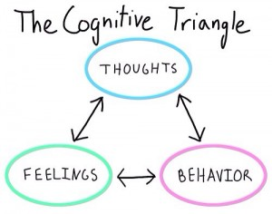
The CBT Triangle
TRIGGER: Mom is late coming home from work
Thoughts: “What if something bad happened to mom?”
Physical feelings: tummy ache, headache, heart racing
Behaviors: Repeatedly calling/texting mom, difficulty separating from mom next time

Slide 12
Key modifications in treatment for youth with ASD
Larger parental component
Positive behavior supports within session
Make skills more concrete & visual
Expect treatment to last longer
More focus on external reinforcers and REWARDS
More focus on behavioral strategies and less on cognitive strategies

Slide 13
Key modifications in treatment for youth with ASD
Generalization of skills
Help improve insight
Treatment goals include adaptive skills & executive functioning
Can integrate social stories
May be helpful to have ABA therapy on board in addition to CBT (for some children)

Slide 14
Medication management of mood and anxiety
There is strong evidence to support the use of medication AND therapy together to reduce mood and anxiety symptoms in patients with ASD
SCAC provides medication consultation
For more information on medication management in the context of ASD, there’s a whole Autism 200 talk devoted to it! It can be found on our Autism Center website:
Perspectives on Psychiatric Treatment of Autism Spectrum Disorder
Notes:
Video link: https://youtu.be/z2DcaPF0hzY

Slide 15
Services provided at SCAC
Time-limited individual therapy for ages ~4-21:
  CBT for anxiety disorders (OCD, GAD, phobias, panic, social anxiety, trauma, selective mutism), with emphasis on exposure techniques
  Comprehensive Behavioral Intervention for Tics/Tourettes, Trichotillomania, and excoriation/skin-picking (CBIT)
  Behavioral Activation (BA) for Depression
  Mindfulness-Based Stress Reduction for Teens (MBSR-T)
“Facing Your Fears” Group: Fall, Spring, Summer (ages 8-14)
DBT Skills Parent Group for parents of teens with ASD (ages 11-18)
Mental Health Evaluations (Assessment, Diagnosis, and Recommendations)
Short-term medication management as needed

Slide 16
Facing Your Fears Group
Designed for ages 8-14 with anxiety/OCD, ASD, and average to above average cognitive ability
14 weeks, child group AND parent group
Psychoeducation on anxiety, introducing worry vs. helpful thoughts, relaxation strategies, and EXPOSURE
Children make a movie of the steps to facing their fear (i.e. exposure hierarchy)
Reaven et al., 2012

Slide 17
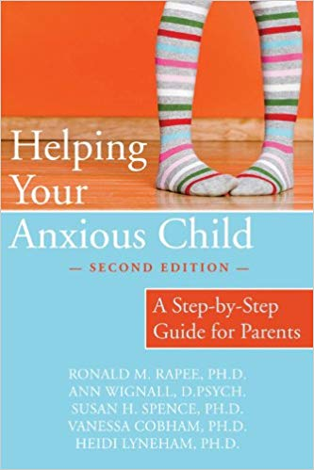
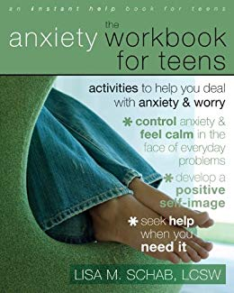

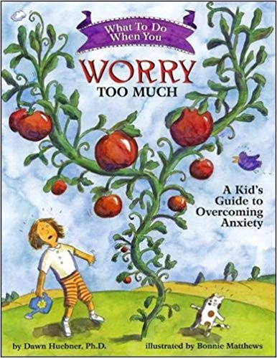
Parent Resources for anxiety
https://www.anxietycanada.com/learn-about-anxiety/anxiety-in-children/

Slide 18
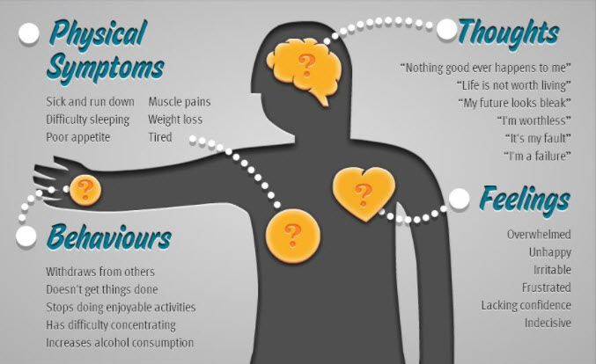
What is Depression? Look for changes in:
ASD Considerations:
Affect
Adaptive/Self-Care
Withdrawal
Physical symptoms
Its about change!

Slide 19

Depression and Autism Spectrum Disorder (ASD)
Individuals with ASD are four times more likely to experience depression in their lifetime (Hudson, et al, 2019).
At risk for: Social isolation, bullying, relationship issues, employment difficulties, and problems adapting to the demands of a social world.
Depression in ASD may be associated with severe consequences:
  A regression in level of functioning (Magnuson and Constantino 2011)
  Attempted suicide (Cassidy and Rodgers 2017; Richa et al., 2014)

Slide 20

What to do if you think your child is depressed
Be aware of their symptoms
Talk to them about it
Empathize
Ask about suicide
See your pediatrician
Seek mental health treatment
National Suicide Prevention Hotline: https://suicidepreventionlifeline.org/ 800-273-TALK (8255)
Teenlink: 1-866-TEENLINK (833-6546); http://866teenlink.org
Crisis Text Line: www.crisistextline.org ; Text “Start” to 741-741 (24 hours/day)
Suicide Prevention- What Parents Need to Know: https://www.youtube.com/watch?v=YVi56-Qaa8s&feature=youtu.be
Call 911 for a life-threatening emergency

Slide 21
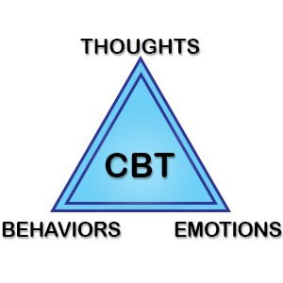
Treatment for Depression in ASD
Cognitive Behavioral Therapy:
  Identify self-defeating thoughts:
    All or nothing thinking
    Automatic negative thinking
    Personalization
  Learn to control and change thoughts, emotions, and behaviors
  Practice accurate self talk
Psychiatric Medications

Slide 22
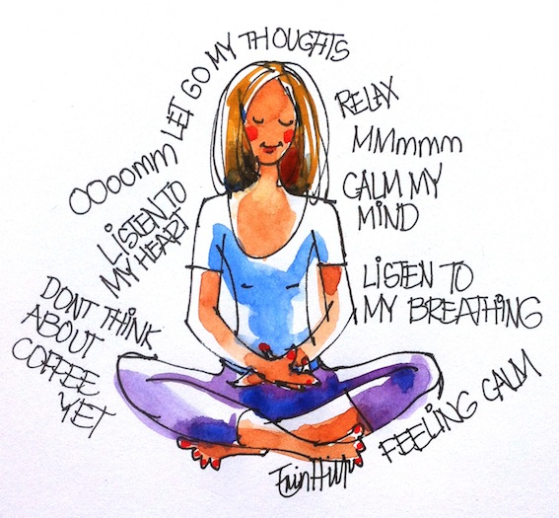
Third Wave Therapies
Emphasize non judgmental awareness of thoughts and emotions
  Decrease avoidance of emotion-triggering situations
  Increase effective coping
Concepts such as acceptance, mindfulness, metacognition, personal values, and spirituality integrated into more traditional behavioral interventions.

Slide 23

Third Wave Therapies
Second Wave (1960s): Cognitive Therapy/CBT to identify and challenge problematic thinking.
Third Wave (1980/90s): Change our relationship to thoughts and emotions, rather than modify content of cognitions (Hayes, 2004)
First Wave (1950s): Behaviorism, including classical conditioning and operant learning.

Slide 24



Examples of Third Wave Therapies
Mindfulness Based Stress Reduction (MBSR) & Mindfulness Based Cognitive Therapy (MBCT) (Kabat-Zinn, 1979)
Awareness of thoughts, feelings, sensations in current moment, without judgement, as often as possible
Dialectical Behavior Therapy (DBT) (Linehan, late 1980s)
Teaches people to live in the moment, cope healthily with stress, regulate emotions, and improve relationships with others.
Acceptance and Commitment Therapy (ACT) (Hayes, 1982)
Modifies how a person relates and responds to internal experiences (thoughts, sensations, emotions, urges) in order to more fully engage in values-based behaviors.

Slide 25

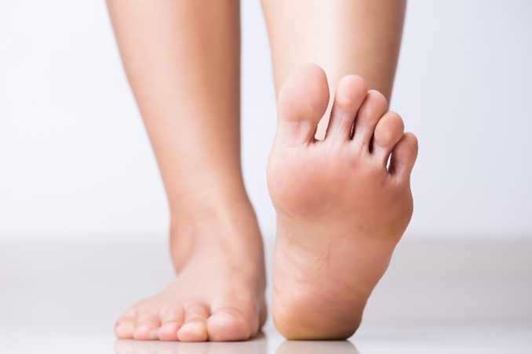
Early Research on Mindfulness in ASD
Meditation on the Soles of the Feet: Rapidly shift the focus of attention from the aggression-triggering event to a neutral place on the body (Singh et al., 2011).
Taught to 3 adolescent males with ASD to manage their physical aggression
Mothers were taught the procedure, then they taught their adolescent
Practiced at least twice per day – with parent and then via audiotape

Slide 26
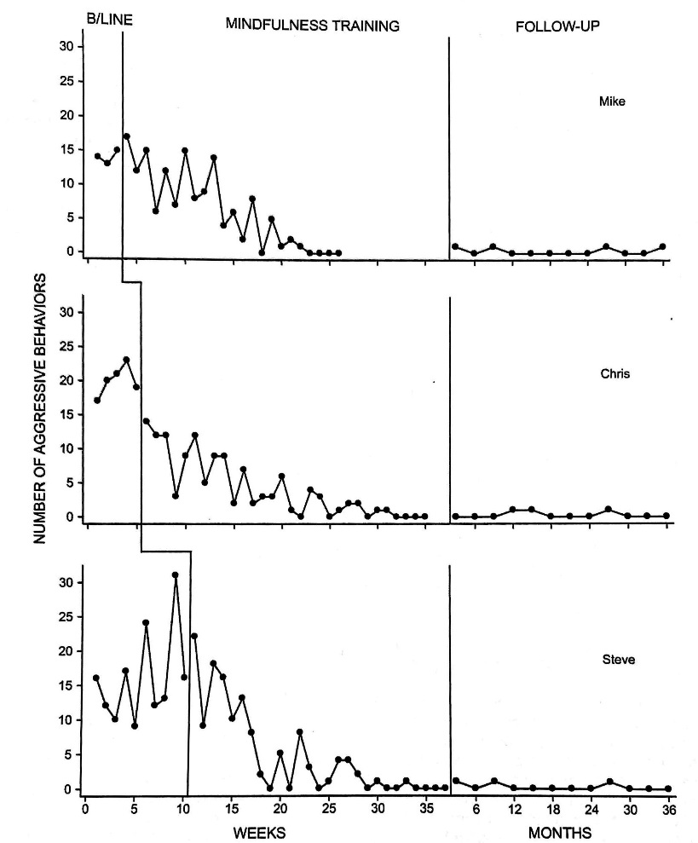
Early Research on Mindfulness in ASD
Incidents of aggression:
  14–20 per week during baseline (pre-treatment)
  4–6 per week during mindfulness training
  Zero rates during the last 4 weeks of intervention.
Aggression occurred a rate of about 1 incident per year during a 3-year follow-up.

Slide 27
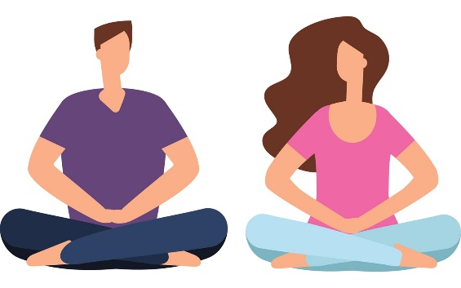
Third Wave Therapies & ASD
Reduced depression, anxiety and rumination and increased positive affect (Spek, van Ham, and Nyklcek, 2013, Sizoo & Kuiper, 2017).
Reduced ASD symptoms (Sizoo & Kuiper, 2017) and increased social approach (Pahnke et al. 2014).
Reduced stress, hyperactivity, and overall psychological distress (Pahnke et al. 2014).
Positive changes lasted in follow ups 2 months later (Kiep, Spek, and Hoeben, 2015; Pahnke et al. 2014).
Modifications:
shortened activities/meditations
Simplified language
Reduced abstractions (e.g. eliminating metaphors)
Reduced cognitive reappraisal
Use of visual aids

Slide 28
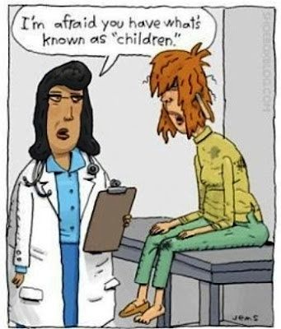
Parenting and Autism Spectrum Disorder
Parenting strategies:
  Accommodating
  Modifying the environment
  Providing structure, routine, and occupation
  Supervision and monitoring
  Managing non-compliance
  Responding to problem behavior
  Managing distress
  Maintaining safety
  Analyzing and planning
  “Quantitatively greater and qualitatively more complex parenting demands and accommodations…” (O’Nions, et al, 2017).

Slide 29
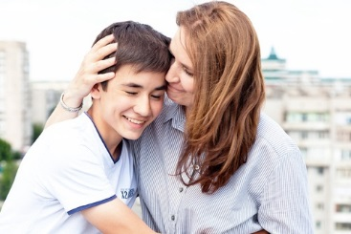
Mindfulness and Caregivers
Significant gains in subjective well being (Hartley et al, 2019)
Reduced parenting stress, depression, and anxiety, and improved general health (e.g Da Paz & Wallander, 2017).
Reduced depression, anxiety, stress, and marital conflicts (e.g. Bigdelee, 2012)
Improved emotion regulation (e.g. increased positive re-evaluation, less blaming of self and others) (Salmini et al, 2019)

Slide 30
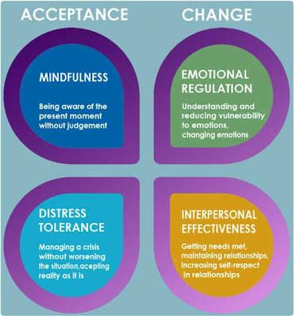
Dialectical Behavior Therapy
4 main modalities
  Individual Therapy
  Skills Building Class
  Phone Coaching
  Consultation Group for Therapists
May include:
  Medication management
  Other necessary treatments (e.g. treatment for anxiety or trauma)

Slide 31



DBT & ASD: What we know
Intensive therapy (more hours/week; longer)
Highly structured
Concrete coping skills
  Emotion regulation
  Distress Tolerance
  Interpersonal Effectiveness
Mindfulness
Support between sessions
Support for parents and therapists

Slide 32
Parenting Teens with Strong Emotions Group (Gurtovenko et al., 2020)
  Monitoring and crisis management
  Validation and relationship building
  Dialectics (e.g., finding the middle path when in conflict)
  Mindfulness
  Emotion regulation
  Distress tolerance
  Incentives and privileges
  Attention and ignoring
  House rules, clear instructions, and behavioral contracts
  Limit setting and effective consequences at home

Slide 33

PTSE Group Reactions
“Concrete skills to handle various areas of challenging behaviors; Hearing and sharing with other parents in similar situations; practicing mindfulness.”
“Dialectics, Mindfulness, Acceptance”
Useful Skills (M = 4.43)
More confident (M = 4.14)
Improved behavior in teen (M = 4.2)
Continuing to use skills (M = 4.83)
Overall Satisfaction (M = 4.5)
“The mindfulness skills were a revelation.”
“Meeting with others and sharing similarities and solutions.”
“Feeling of belonging”

Slide 34
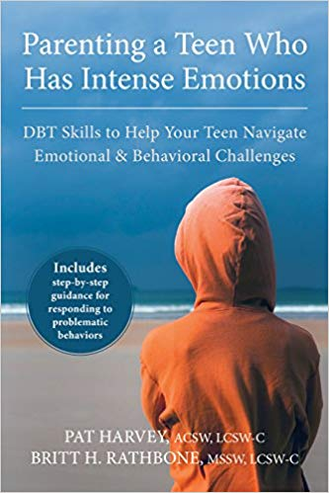
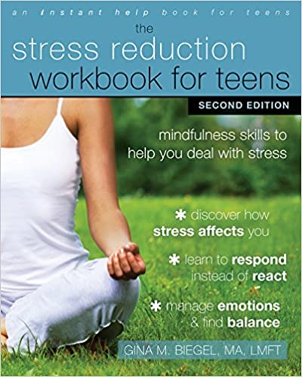
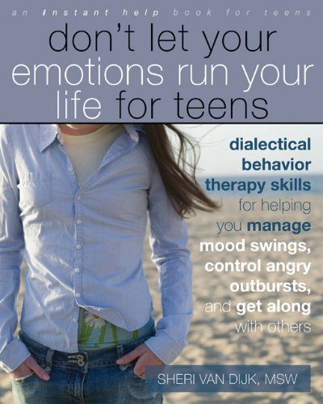


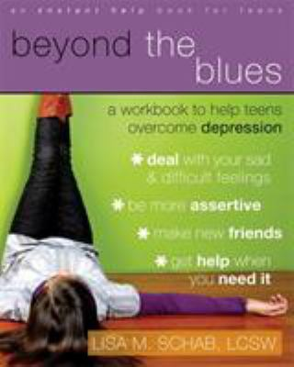


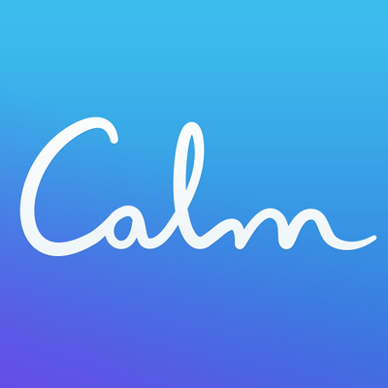



Parenting Resources for Mindfulness & Third Wave Therapies

Slide 35

Tips for Dealing with Coronavirus Anxiety
For your kids:
Listen to them and be present
Provide reassurance & helpful thoughts
Check the facts
Give them a sense of control
Have a schedule/routine
Plan fun and relaxing activities
Be a “positive coping model”
See Article: Helping Children and Teens Cope with Anxiety About COVID-19 https://pulse.seattlechildrens.org/helping-children-and-teens-cope-with-anxiety-covid-19/
Social Story by Carol Gray: Pandemics and the Coronavirus https://carolgraysocialstories.com/wp-content/uploads/2020/03/Pandemics-and-the-Coronavirus.pdf?fbclid=IwAR3hVGdl64r_iGYBmwY2Uljhx9a5Fk5fM3Qr_TwORTsxhuq9NP7Ic5nXick

Slide 36
Tips for Dealing with Coronavirus Anxiety
For you:
Practice good self care: Adequate sleep, nutrition, and exercise
Use mindfulness: Pause multiple times per day and observe your thoughts, emotions, and bodily sensations. Be mindful of how you spend your time (e.g. reading scary news vs. relaxing). Try out a mindfulness app!
Practice shifting your attention to happy things, gratitude, or the soles of your feet ☺
Take a “self compassion break”
“I am struggling. It is difficult to deal with a pandemic.”
“I am not alone, everyone is facing this.”
“I am doing the best I can.”
Talk to other adults: Connect with others! If not in person, then text, call, or use social media. Social distance does not mean isolation.

Slide 37

Loving Kindness Meditation (while washing hands)
Practice Loving Kindness
Sensing the water and soap, touch of hands and fingers:
May I be happy.
May I be safe.
May I be healthy, peaceful, and strong.
May everyone be happy,
May everyone be safe,
May everyone be healthy, peaceful, and strong

